Slide 1
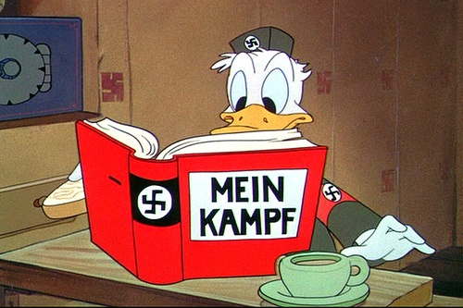
World war ii
Return of the German

Slide 2
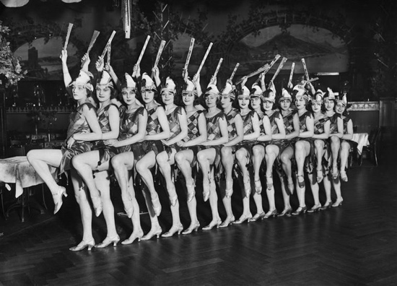
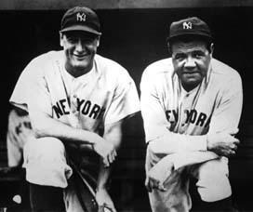
From Versailles to Pearl Harbor U.S. Isolationism: 1919 - 1941
America during the 1920’s
A. Many Americans were disillusioned by WWI and wanted to “return to normalcy”.
B. “The Business of America was business!”
C. The U.S. embraced isolationism in the face of prosperity.

Slide 3
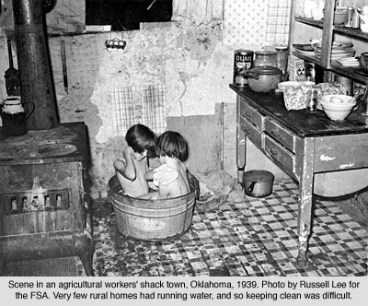
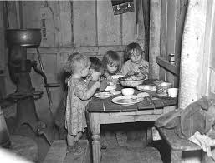
II. America During the 1930 ’ s
A. The Great Depression re -enforced a policy of isolationism.
B. FDR and Congress pass a series of four Neutrality Acts in the late 1930’s to re -enforce this

Slide 4
III. Global Conditions between WWI and WWII
A. After WWI, countries looked to America for economic help
B. The stock market crash started a global depression.
C. There was a 50% decrease in world trade during the 1930’s.
D. Totalitarianism, fascism, and dictatorships are on the rise in Europe and Asia as a result of these hard times.
E. Strong leaders thrive in these conditions.

Slide 5
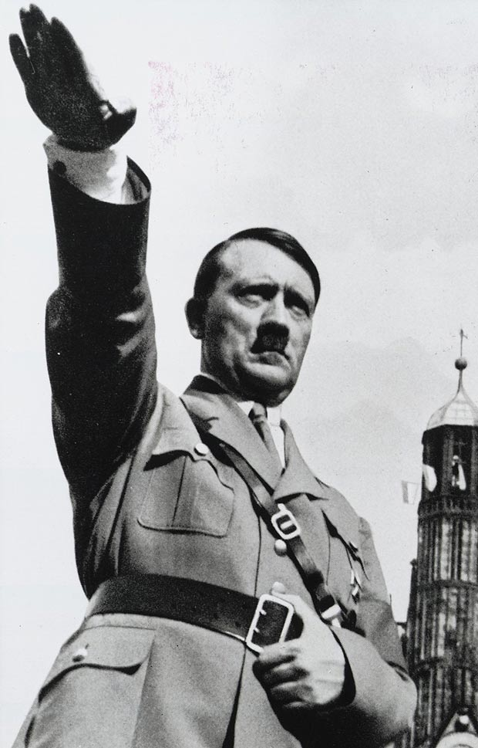
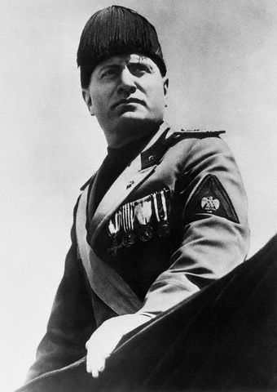
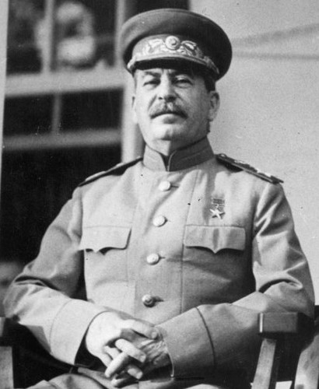
The Rise of the Dictators in Europe
Germany: Adolf Hitler
Italy: Benito Mussolini
Soviet Union: Joseph Stalin

Slide 6
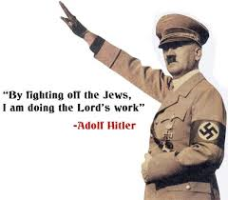
Hitler’s Rise to Power Included the Use of…
Scapegoating
Extreme Nationalism
Propaganda
Fear tactics

Slide 7
Timeline of German Aggression
1921 - takes control of the National Socialist Party (a.k.a. the Nazis)
1923 - attempts Putsch (seizure of government) and fails; lands in jail, where he writes Mein Kampf
1933 - becomes Germany’s Chancellor – Begins passing restrictive laws for Jews – Germany leaves League of Nations – Dachau opens
1934 - German president dies; Hitler takes over
1936 - Takes back the Rhineland (forbidden!)
1937 - Hitler renounces Treaty of Versailles
1938 - Munich Pact - gives Hitler Czechoslovakia
1939 - Non-aggression Pact with USSR

Slide 8
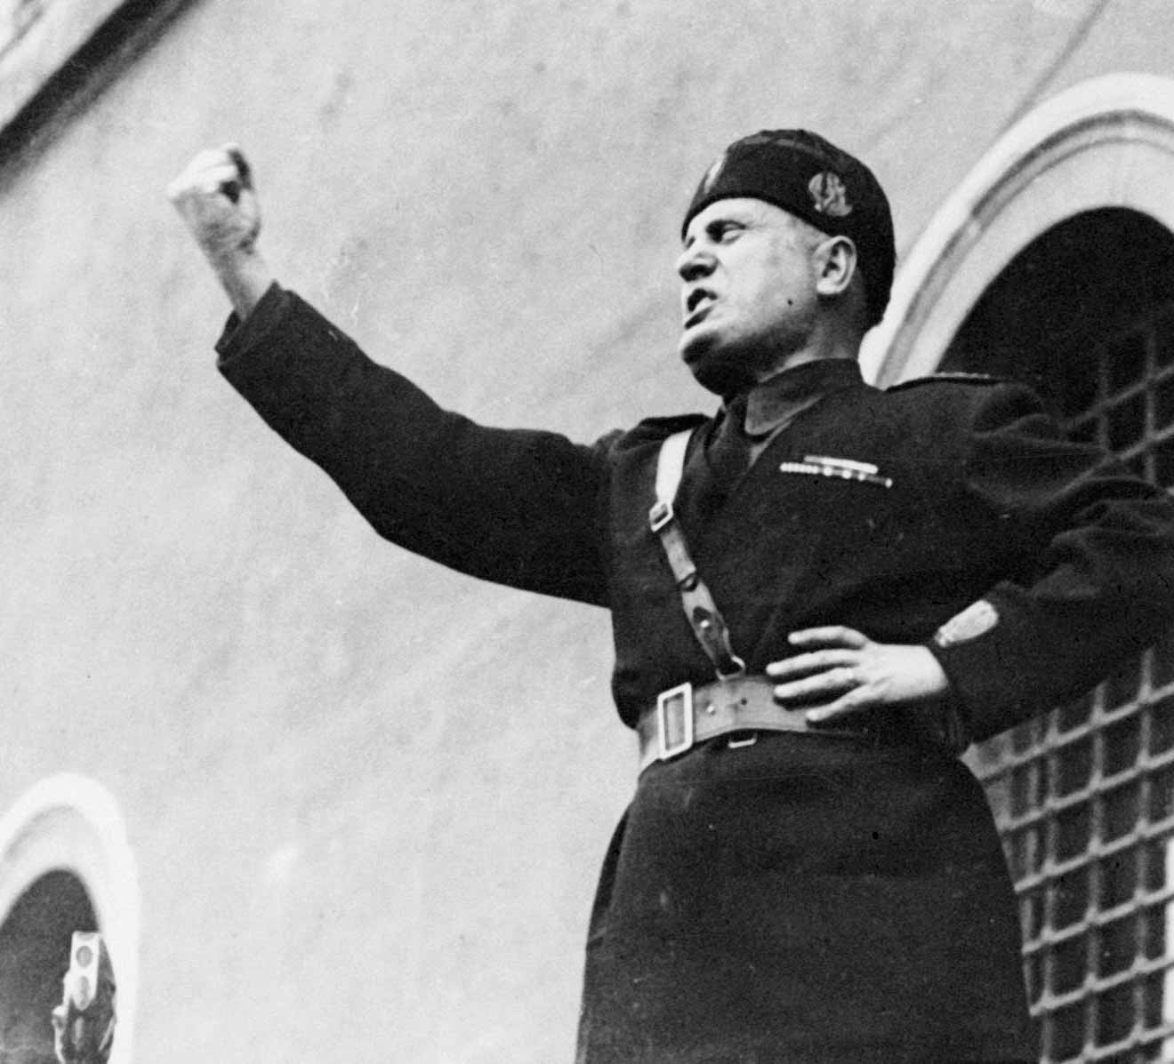
Mussolini’s Rise to Power and a “New Roman Empire”
Originally disliked Hitler (viewed Germany as competition in his conquest)
1935 - retakes Ethiopia easily (tanks vs. rifles) –Germany fully supports
1936 - Germany and Italy form “an axis around which all European states animated by the desire for peace may collaborate”

Slide 9
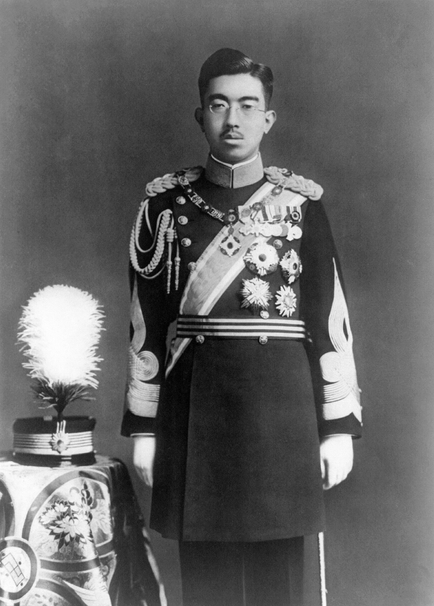
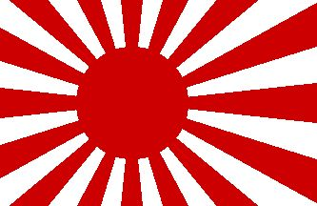
Japanese Imperialism during the 1930’s
Emperor Hirohito
A. Japan wanted to reduce their reliance on foreign imports so in 1931 they invaded China to have resources available closer to home.
B. By 1937, Japan had launched an all out war with China, Manchuria (which the League of Nations disapproved of)

Slide 10
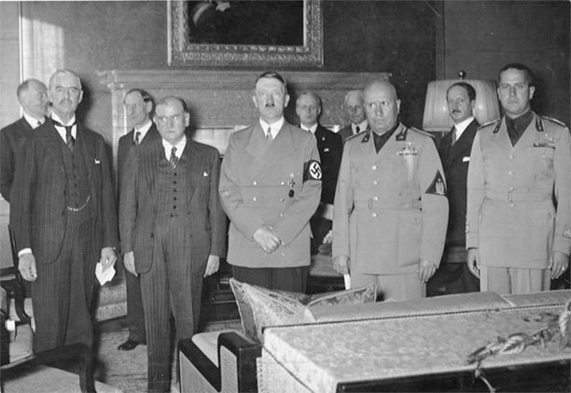
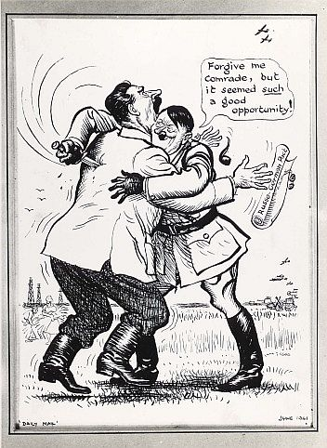
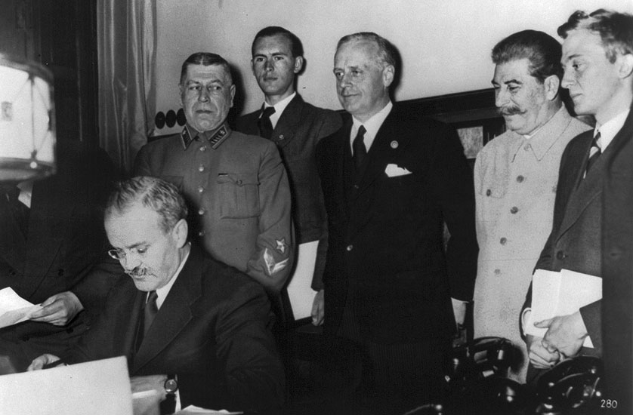
Signs of Conflict
A. Munich Conference (Sept. 1938) - Britain and France appease Hitler by giving him the Sudetenland.
B. Non-aggression Pact (Aug. 1939) - once the Stalin and Hitler agree not to invade each other, Hitler invades Poland in Sept. of 1939.

Slide 11
WWII Begins in Europe and the Pacific 1939-1945
I. The Axis Take Control
A. Germany invades Czech. and Poland and war is declared in 1939.
B. Germany is relentless in it’s BLITZKRIEG, or lightening warfare and focuses on the Western front.
C. France falls to Germany in June of 1940.
D. Hitler breaks the Non-Aggression Pact and invades the Soviet Union.
E. Japan extends much of it’s control into southeast Asia and begins planning an invasion of the U.S.
F. The United States still maintains it’s isolationist stance, but gives aid under the “Cash and Carry System” and later under the “Lend Lease Act”.

Slide 12
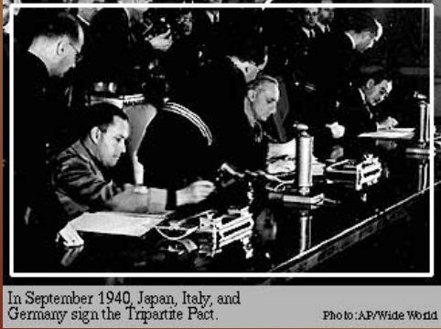
The Alliances of WWII
A. Axis Powers - Germany, Italy, Japan
B. Allied Powers - Great Britain, France, Soviet Union (After Hitler breaks the NonAggression Pact), and the United States (after 1941)
1940 TRIPARTITE PACT SIGNED

Slide 13
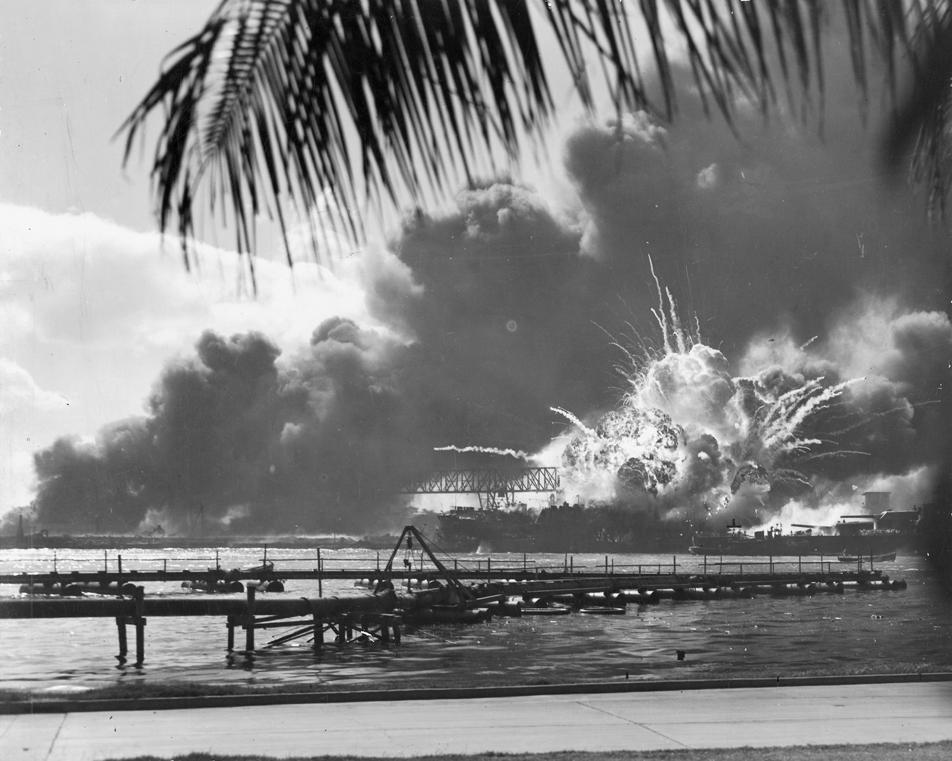
Sunday December 7th, 1941 “A day that will live in infamy” -FDR
Pearl Harbor is Attacked :
A. Isolationism No More!
B. U.S. declares war on Japan
C. Germany declares war on the U.S.

Slide 14
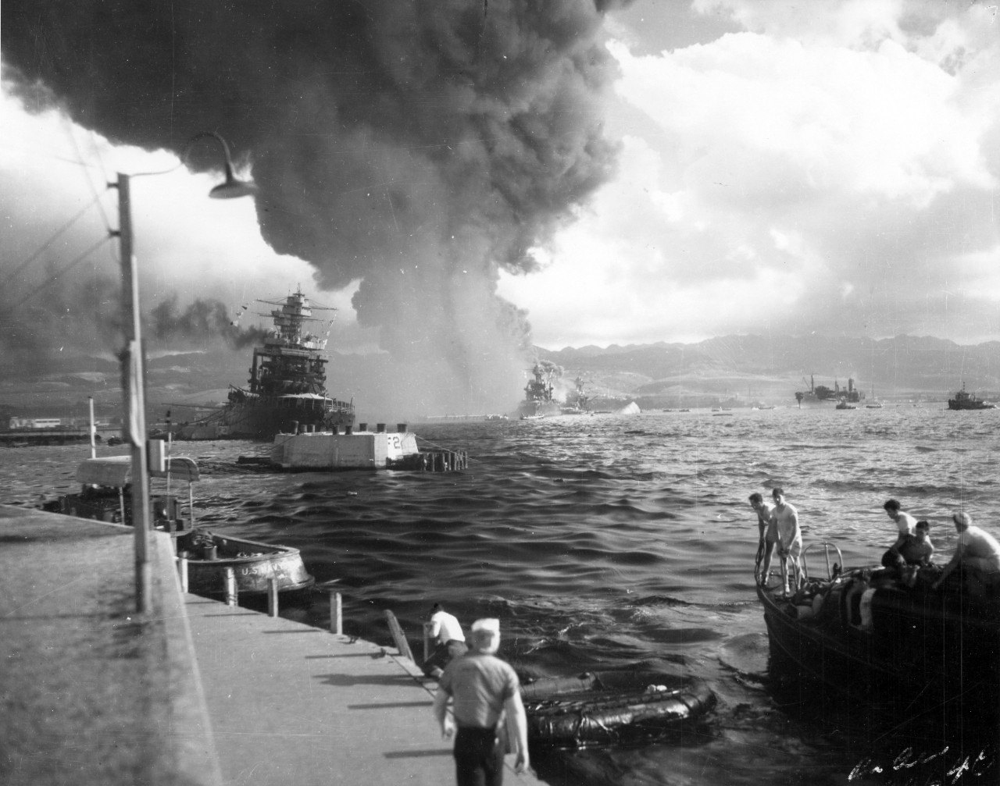
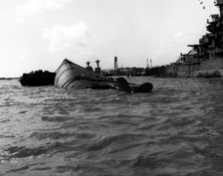
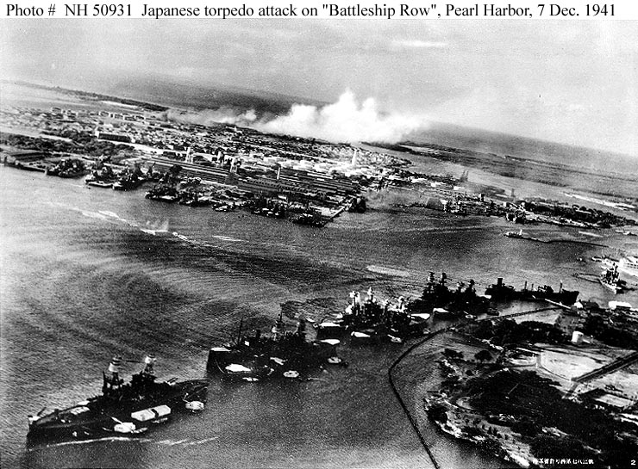
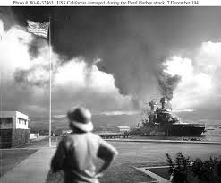

Slide 15
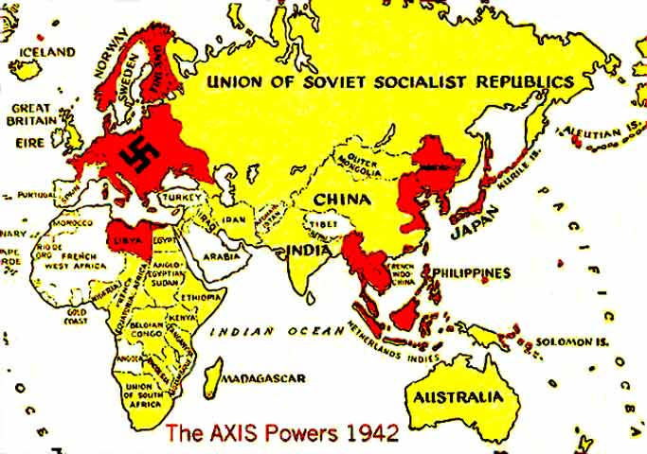
The U.S. is Fighting a Two Front War!!!

Slide 16
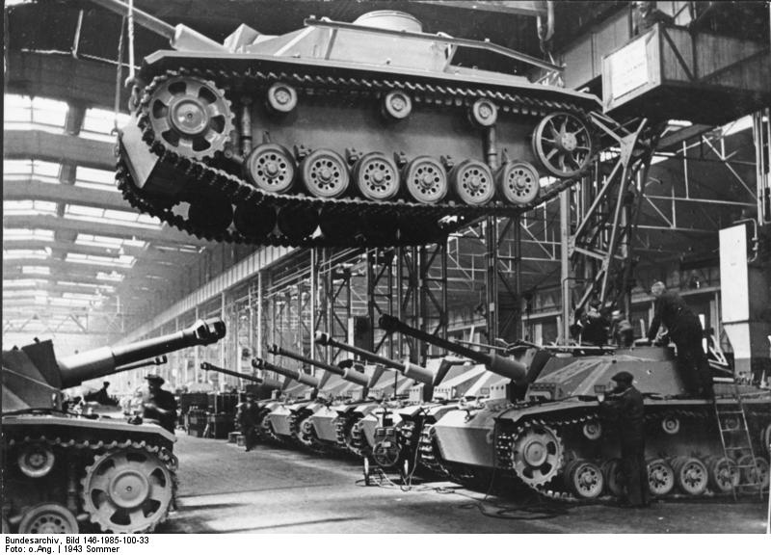
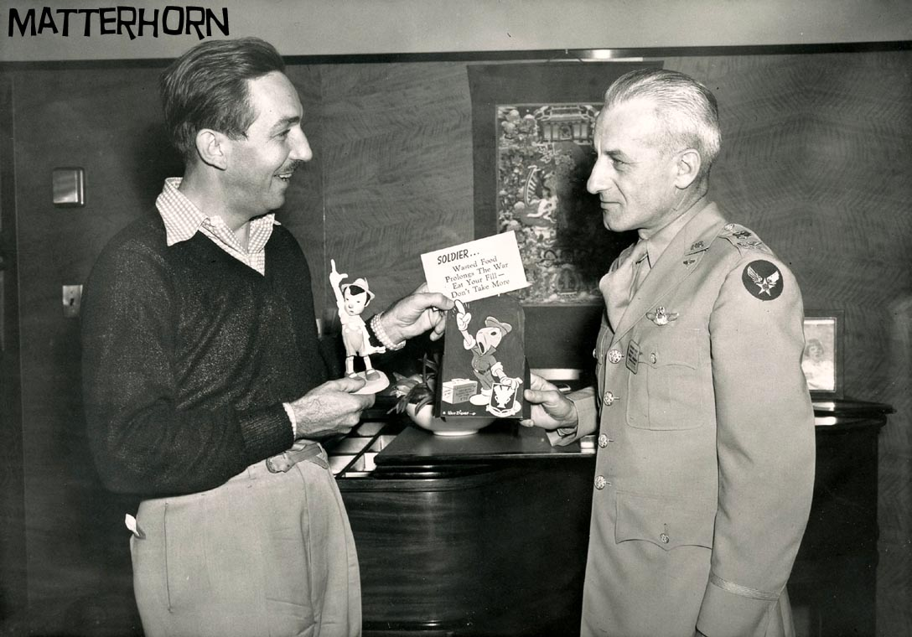
The United States Home Front 1941-1945
I. Mobilization of Industry
The War Production Board converted factories to meet the necessities of war.
Tanks, jeeps, guns, ammunition, uniforms, and food rations were produced in full force.
U.S. Government takes over Disney Studios to help create propaganda cartoons.

Slide 17
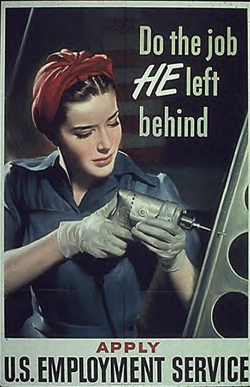
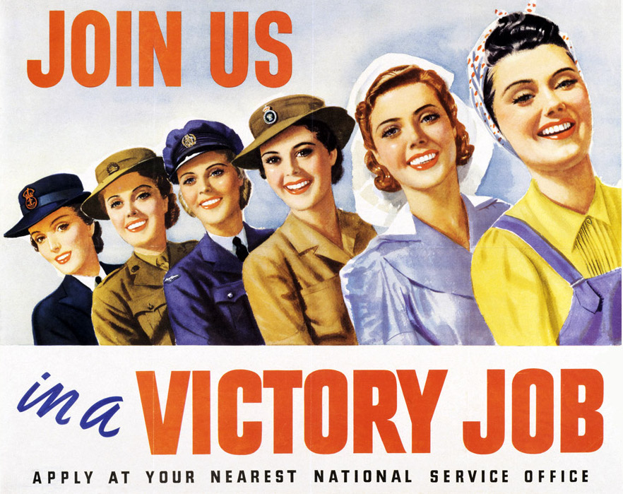
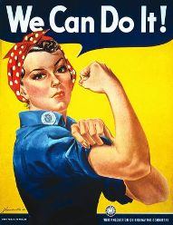
Women performed a variety of military jobs.

Slide 18
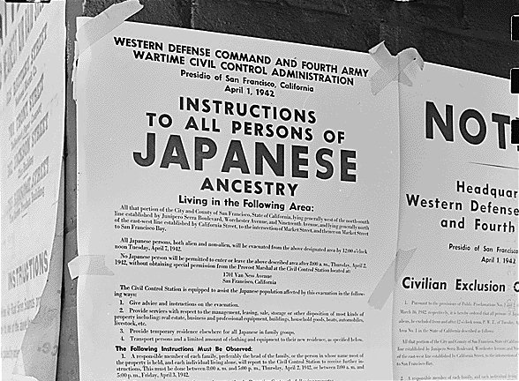
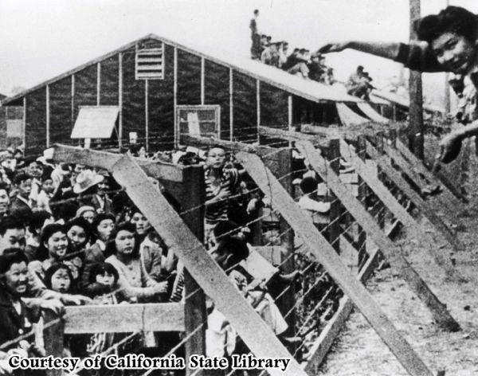
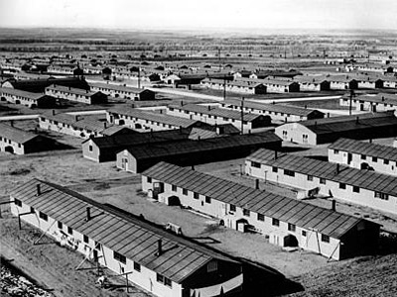
Violation of Civil Liberties
Japanese American Internment
American Hatred for the German / Italian Enemy was different than the hatred for the Japanese Enemy
While the Army was not yet desegregated, more and more minorities were proving their equality on the battlefields of WWII

Slide 19
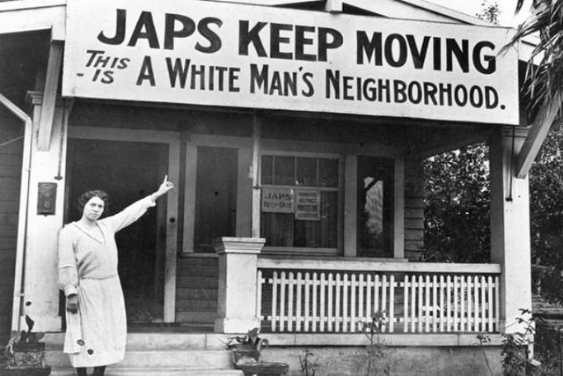
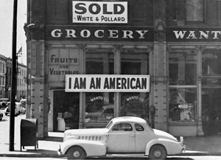
Discrimination of the Japanese Americans was widespread
“A Jap is a Jap.” - Lieutenant General John L. Dewitt

Slide 20
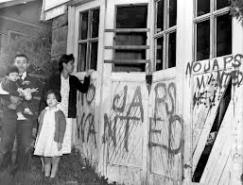
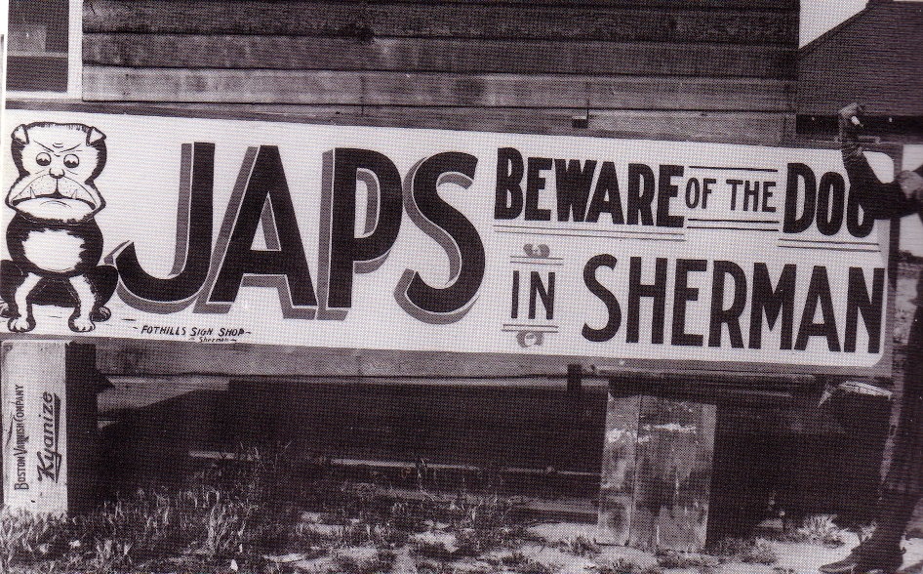
The Epitome of American Hypocrisy
1932 - FBI and military lists of “potentially dangerous” Japanese Americans
Dec. 1941 - West Coast Japanese must hand over radios and cameras
Spring 1942 - 11,700 of West Coast Japanese put into camps (most are U.S. citizens)

Slide 21
Sources
http://www.pkwy.k12.mo.us/homepage/athornhill/file/wwii_powerpoint.pdf
History.com
http://trackstar.4teachers.org/trackstar/ts/viewTrackMembersFramesMember.do;jsessionid=AC6E7C468863D3E58C3E3BF1D6E3C614?key=org.altec.trackstar.om.TrackMember%3Btrack_member_id%5B1393981%5D
http://www.nationalww2museum.org/learn/education/for-students/ww2-history/at-a-glance/women-in-ww2.html
http://matterhorn1959.blogspot.com/2012/02/walt-disney-world-war-2-food-saving.html
http://en.wikipedia.org/wiki/German_armored_fighting_vehicle_production_during_World_War_II

