Slide 1
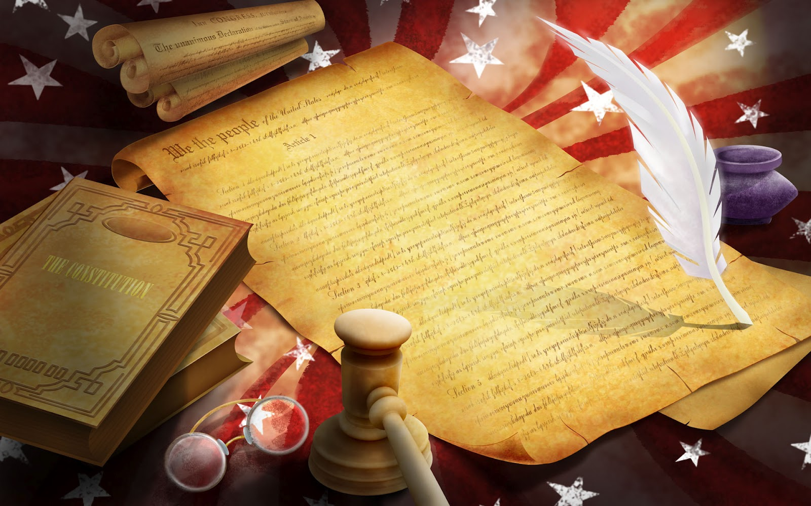
The United States Constitution

Slide 2
Why Does the Constitution Matter?
Constitution – body of fundamental laws which say how a government is to operate
It is the supreme law of the land
It explains how the government works
It protects your civil rights

Slide 3
A Brief Outline
The Preamble – lays out the purpose and introduces the Constitution
The Articles – the substance of governmental law
The Amendments
Uncle Sam needs you to study harder!

Slide 4
The Seven Articles
I. The Legislative Branch
II. The Executive Branch
III. The Judicial Branch
IV. Relations Among States
V. The Amendment Process
VI. National Debts, National Supremacy, Oaths of Office
VII. Requirements for Ratification

Slide 5
The Six Basic Principles of the Constitution
1. Popular Sovereignty – supreme power rests with and only with the people
Some parts of the Constitution mitigate popular sovereignty
Electoral College chooses the president, not popular vote
State Legislatures chose the Senate, not popular vote
Later changed to direct popular election by 17th Amendment

Slide 6
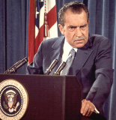
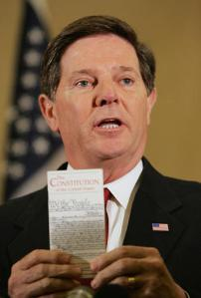
The Six Basic Principles of the Constitution
2. Limited Government
Also called constitutionalism, and rule of law
Government is not all-powerful
Powers government has and doesn’t have are listed

Slide 7
The Six Basic Principles of the Constitution
3. Separation of Powers
U.S. uses a presidential government, where the executive and legislative branches are chosen separately
Each branch has its own powers and responsibilities

Slide 8
The Six Basic Principles of the Constitution
4. Checks and Balances
Each branch is not totally independent of the others

Slide 9
The Six Basic Principles of the Constitution
4. Checks and Balances
They have powers to override each other when necessary

Slide 11
The Six Basic Principles of the Constitution
5. Judicial Review
Courts may determine whether or not what the President or Congress does is Constitutional

Slide 12
The Six Basic Principles of the Constitution
5. Judicial Review
If court declares an act unconstitutional, the act is not a law, and the decision cannot be overridden

Slide 13
The Six Basic Principles of the Constitution
6. Federalism
The national government is given certain powers by the Constitution
Whatever is left is a power for the states to use

Slide 14
Article I---Legislative Branch
Section One—What is a Congress?
1. Bicameral Legislature---There are two houses, a Senate and House of Representatives.
Section Two---House of Representatives
1. Clause One
A Representative serves a two year
term

Slide 15
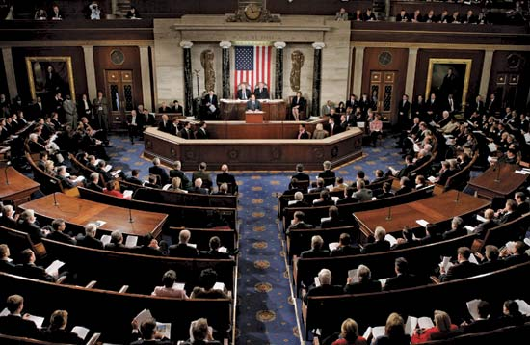
2. Clause Two---What are the Qualifications for a member of the U.S. House of Representatives?
•25 years old
•7 year citizen of the United States
•Resident of the state one is elected in

Slide 16
Section Three---The Senate
How is a Senator different from a member of the House of Representatives?
Senators term is 6 years
1 voter per Senator
2 Senators per state (all states get the same amount)
Originally Senators were chosen by state legislatures
Today chosen by direct election (17th Amendment)

Slide 17
Clause Two--Is it possible for both Senators from one state to be up for re-election at the same time? (No)
All of the members from the first Senate did not get a 6 year term.
The founding fathers wanted the Senate to have experienced members so they created a staggered election.
First class = 2 year term
Second class = 4 year term
Third class = 6 year term
Never will the Senators term from one state be up for re-election at the same time

Slide 18
Clause Three - What are the qualifications for a Senator?
30 years old
9 year citizen of the United States
Be a resident of the state you are elected from
Clause Four—
The Vice-President (Joe Biden) of the U.S. is the President of the Senate (very little power and seldom is seen on the Senate Floor )
President of the Senate (Biden) only votes if there is a tie

Slide 19
Key Parts of Article I
Impeachment
Where does the impeachment process start?
The House of Reps. will start the impeachment process
Andrew Johnson---First U.S. President to be impeached, but fell one vote shy of the Senate’s conviction
Richard Nixon---Resigned before official impeachment could take place
Bill Clinton---Impeachment articles were passed by the U.S. House of Reps, but the Senate found him NOT guilty of those articles

Slide 20
Key Parts of Article I
Section 8
List of all expressed powers Congress has
Also includes the “necessary and proper” clause
Gives Congress additional “implied powers”
Section 9
Prohibits certain actions Congress may take
No ex post facto laws – punishment for doing something before it was illegal
No suspension of habeas corpus – the right to challenge one’s own detention in court

Slide 21
Article II—Executive Branch
Section One—President &
Vice President
Clause one—How long is the President in office?
Four year terms
1951—22 Amendment changed it to a maximum of 2 terms or ten years
FDR served the most years in office (12)
Grover Cleveland served 2 nonconsecutive terms (22nd & 24th President of the United States)

Slide 22
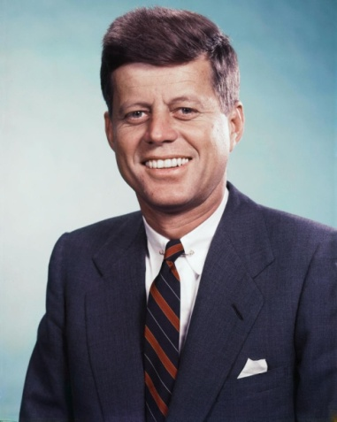
What are the qualifications for U.S. President?
35 years old, 14 year resident, natural born citizen
1st seven presidents were not natural born
1st natural born was Martin Van Buren
Youngest elected—John Kennedy=43
Oldest—Ronald Reagan=69

Slide 23
Can the Congress decrease the President’s salary midway through the term? (No)
Can not increase or decrease during the term
Can not receive any other salary from the federal government during the term
Pays taxes on the income
2001 - Salary doubled to $400,000/ year
The Presidential Oath
Any judge can swear a president into office, most common is the Chief Justice of the Supreme Court
Calvin Coolidge—Sworn in by his father - a Justice of the Peace
LBJ—sworn in on Air Force One by a Dallas judge
“So help me God.”---Washington added this to Oath

Slide 24
Key Parts of Article II
Section 2
President is Commander and Chief-head of military
President can appoint people to many positions
Must have “advice and consent” of the Senate
Senate takes a majority vote to confirm appointment
Section 3
State of the Union Address
Section 4
Can only be removed by impeachment for “high crimes and misdemeanors”

Slide 25
Article III—Judicial Branch Section One—Federal Courts
Who interprets the law?
Judicial branch interprets the law (Courts)
Legislative makes the law (Congress)
Executive enforces the law (President)
Judicial powers—the power to hear cases
Federal Judges are appointed by the President and approved by the Senate

Slide 26
Section Two—Jurisdiction of the Federal Courts
Jurisdiction
Jurisdiction—power and right to apply law
Plaintiff—one who brings charges
Defendant—one being charged
Criminal case—when government is plaintiff (California vs. O.J. Simpson)
Civil case—between two or more people (O. J. Simpson vs. Goldman family)

Slide 27
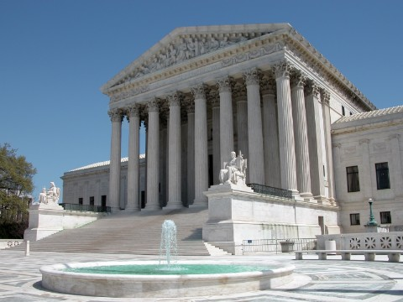
How does a case reach the Supreme Court?
Supreme Court has two kinds of jurisdiction:
a. Original—a case is first heard by the SC
b. Appellate—cases that are appealed by a lower court (Most cases come to the SC through appellate jurisdiction)
Thousands of cases are brought to the SC each year
About 75 are heard each year
Writ of Certiorari—an order from a higher court to a lower court to see the records and proceedings of a previous case

Slide 28
Section Three--Treason
What is treason?
Only crime defined in the Constitution (helping a nation’s enemies or carrying out war against your country)
2 ways of being convicted:
1. Confession in court room
2. Having two witnesses testify against you
What is the penalty for treason?
Treason can only happen during time of war
Maximum penalty is death
Espionage, Sabotage, conspiracy to overthrow the government are all similar to treason but happen during times of peace

Slide 29
Article IV
Section 1 – Full Faith and Credit Clause
States must grant each other “full faith and credit” on “public acts, records, and judicial proceedings”
Means legal decisions of states must be respected and held to by other states
Section 2 – Privileges and Immunities Clause
States must grant residents of other states all “privileges and immunities” they give to their own residents

Slide 30
Article V - Formal Amendment Process
Step 1 – Must Be Proposed (happens at the national level)
Step 2 – Must Be Ratified (happens at the state level)
This is a reflection of federalism

Slide 31
2 Ways to Propose an Amendment
1. 2/3 vote in both houses of Congress
All 27 Amendments were proposed this way
2. Constitutional Convention requested by 2/3 of the states
Has not ever been used

Slide 32
2 Ways to Ratify an Amendment
1. 3/4 of state legislatures approve it
26 of the 27 Amendments were ratified this way
2. 3/4 of conventions called by the states approve it
Only the 21st Amendment was ratified this way

Slide 33
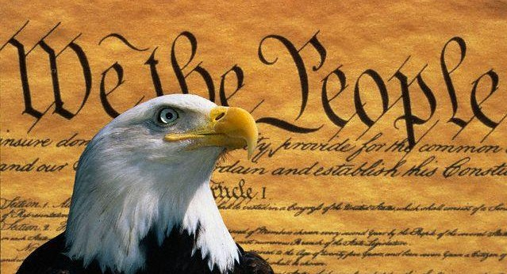
Article VI
Supremacy Clause
Federal laws are always supreme over state laws, U.S. Constitution is supreme over all state constitutions
Supreme Law of the Land

Slide 34
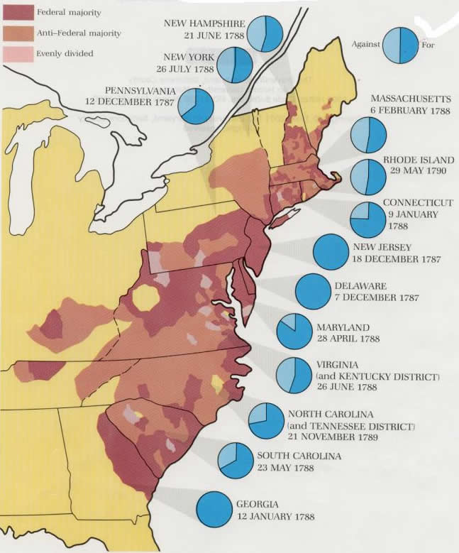
Article VII
" The Ratification of the Conventions of nine States, shall be sufficient for the Establishment of this Constitution between the States so ratifying the Same.“
Just one long sentence

Slide 35
Ratification
• Maryland on April 28, 1788 • South Carolina on May 23, 1788 • New Hampshire on June 21, 1788 • Virginia on June 25, 1788 • New York on July 26, 1788 • North Carolina on November 21, 1789 • Rhode Island on May 29, 1790
Delaware on December 7, 1787 • Pennsylvania on December 12, 1787 • New Jersey on December 18, 1787 • Georgia on January 2, 1788 • Connecticut on January 9, 1788 • Massachusetts on February 6, 1788

Slide 36
The First Ten Amendments…
The Bill of Rights…

Slide 37
First Amendment
Amendment I
Congress shall make no law respecting an establishment of religion, or prohibiting the free exercise thereof; or abridging the freedom of speech, or of the press; or the right of the people peaceably to assemble, and to petition the Government for a redress of grievances.

Slide 38
Second Amendment
Amendment II
A well regulated Militia, being necessary to the security of a free State, the right of the people to keep and bear Arms, shall not be infringed.

Slide 39
Third Amendment
Amendment III
No Soldier shall, in time of peace be quartered in any house, without the consent of the Owner, nor in time of war, but in a manner to be prescribed by law.

Slide 40
Fourth Amendment
Amendment IV
The right of the people to be secure in their persons, houses, papers, and effects, against unreasonable searches and seizures, shall not be violated, and no Warrants shall issue, but upon probable cause, supported by Oath or affirmation, and particularly describing the place to be searched, and the persons or things to be seized.

Slide 41
Fifth Amendment
Amendment V
No person shall be held to answer for a capital, or otherwise infamous crime, unless on a presentment or indictment of a Grand Jury, except in cases arising in the land or naval forces, or in the Militia, when in actual service in time of War or public danger; nor shall any person be subject for the same offence to be twice put in jeopardy of life or limb; nor shall be compelled in any criminal case to be a witness against himself, nor be deprived of life, liberty, or property, without due process of law; nor shall private property be taken for public use, without just compensation.

Slide 42
Sixth Amendment
Amendment VI
In all criminal prosecutions, the accused shall enjoy the right to a speedy and public trial, by an impartial jury of the State and district wherein the crime shall have been committed, which district shall have been previously ascertained by law, and to be informed of the nature and cause of the accusation; to be confronted with the witnesses against him; to have compulsory process for obtaining witnesses in his favor, and to have the Assistance of Counsel for his defense.
(prove beyond reasonable doubt)

Slide 43
Seventh Amendment
Amendment VII
In Suits at common law, where the value in controversy shall exceed twenty dollars, the right of trial by jury shall be preserved, and no fact tried by a jury, shall be otherwise re-examined in any Court of the United States, than according to the rules of the common law.

Slide 44
Eighth Amendment
Amendment VIII
Excessive bail shall not be required, nor excessive fines imposed, nor cruel and unusual punishments inflicted.

Slide 45
Ninth Amendment
Amendment IX
The enumeration in the Constitution, of certain rights, shall not be construed to deny or disparage others retained by the people.
The Ninth Amendment is a constitutional safety net intended to make clear that individuals have other fundamental rights, in addition to those listed in the First through Eighth Amendments.
Not possible to list all your rights (or is it?)

Slide 46
Tenth Amendment
Amendment X
The powers not delegated to the United States by the Constitution, nor prohibited by it to the States, are reserved to the States respectively, or to the people.
The Tenth Amendment was included in the Bill of Rights to further define the balance of power between the federal government and the states.
The amendment says that the federal government has only those powers specifically granted by the Constitution.

Slide 47
Changes to the Constitution
An additional 17 amendments have been made to the Constitution.
The most recent change was made in 1992.

Slide 48
Signed and Ratified
George Washington was the first of the delegates to sign.
Delegates signed in order from the northern states to the southern states.
Only 39 of the delegates actually signed, not all approved of the document.
After being signed, it became part of a 6 page report sent to the Congress.
Congress accepted the report and sent it to the states for their approval.
It was ratified by nine of the 13 states by June 21, 1788
-- becoming the law of the land.
After the text of the Constitution had been agreed upon,
Jacob Shallus, an assistant clerk of the Pennsylvania
State Assembly, was the penman who wrote the
document prior to signing.

Slide 49
More on the Constitution
How long did it take to frame the Constitution?
It was drafted in one hundred working days.
Who was called the “Father of the Constitution?”
James Madison of Virginia
Which state was the first to ratify the Constitution?
Delaware
How many pages long is the Constitution?
Four
Which state didn’t send any delegates to the convention?
Rhode Island
Does the Constitution give us our rights and liberties?
No, it only guarantees them.

