Slide 1

The Roaring 20’s
1918-1929

Slide 2
Post WWI, (return to isolation) Americans are ready to make money and enjoy themselves!!!
Why were the 1920’s so
Prosperous?…..
Prosperous (definition) – Having success, flourishing, being well off

Slide 3
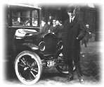
Reasons for Prosperity in the 1920s…
Reason #1-- Impact of the Automobile – Henry Ford developed the assembly line (parts can be made faster and can be made by unskilled workers)
What impact did Ford’s assembly line have on the U.S.?
**Ford’s assembly line makes car production cheaper
**Cars are much more affordable – no longer just
toys for the wealthy
**gas station, restaurant, and tourism businesses boom and it becomes easy to live in rural areas
Ford and his Model T

Slide 4
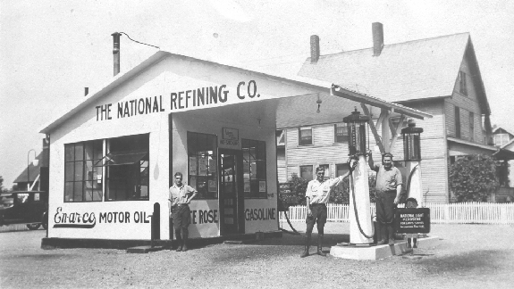
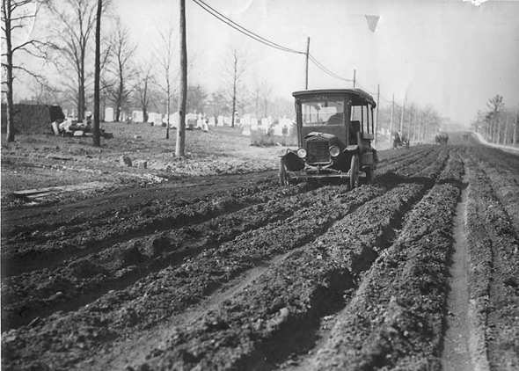
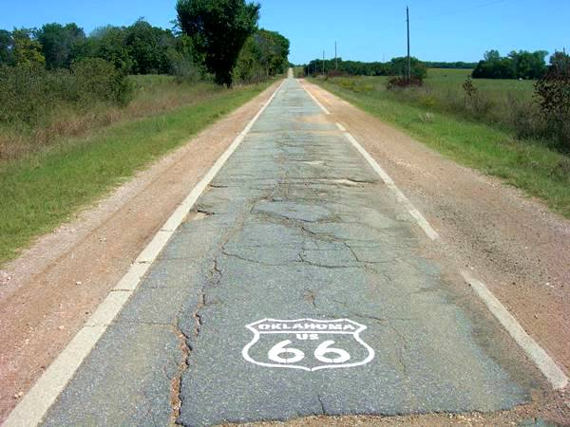
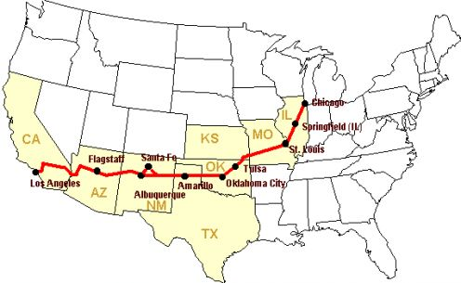

Slide 5

Reasons for Prosperity in the 1920s…
Reason #2 – The development of New Industries
**widespread use of electricity allows for many new industries, jobs, and profits
What are some of the new industries in the 1920s?
1. The automobile industry
2. The Electrical Industry
3. Radio and Motion Picture Industries

Slide 6
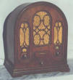
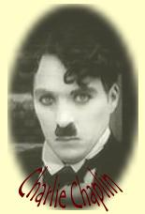
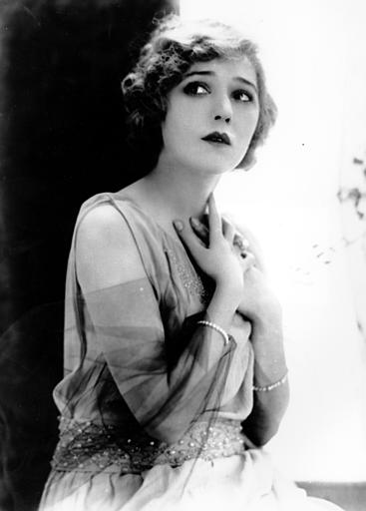
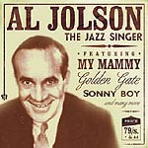
Radio
KDKA Pittsburgh
GE, Westinghouse,& RCA form NBC
Silent Movies
Charlie Chaplin
“Talkies”
The Jazz Singer
Starring Al Jolson
Mary Pickford
“America’s Sweetheart”

Slide 7
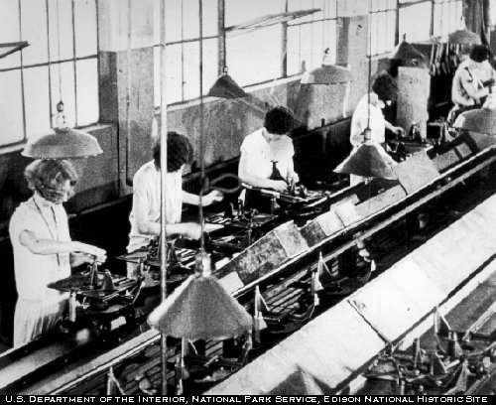
Reasons for Prosperity in the 1920s…
Reasons #3 – More Efficient Production Techniques
New techniques in manufacturing and industrial production (such as the assembly line) allow industry to be more efficient
What is an assembly line?
Workers stay in one place
doing the same job, as products
come to them on a conveyor belt

Slide 8
**Efficient Production Techniques make huge quantities of goods available and people have money to spend on them – It is a time of
MASS CONSUMPTION!!!!
Mass Consumption – (definition)
A large amount of items are being produced, purchased, and used

Slide 9
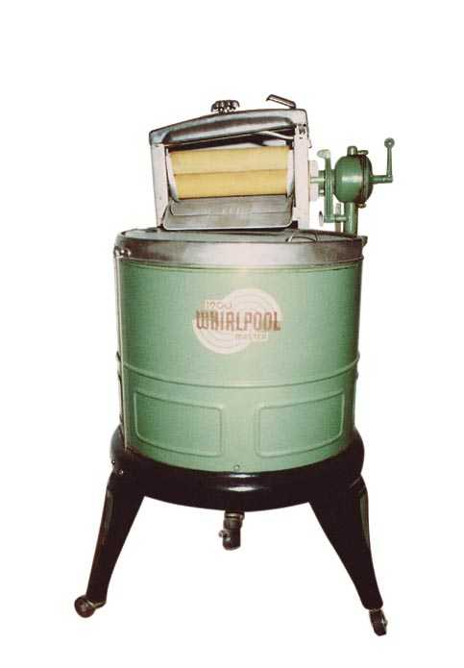
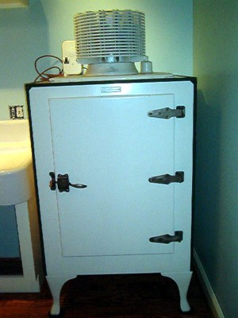
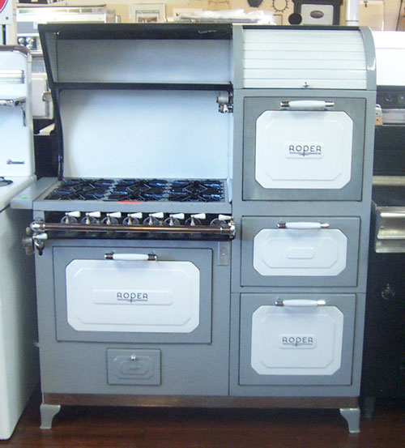

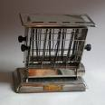
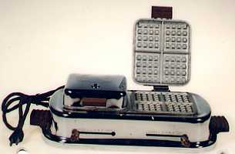
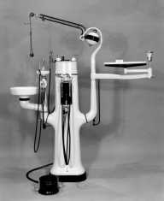
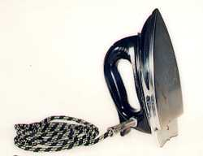

Consumer Economy

Slide 10
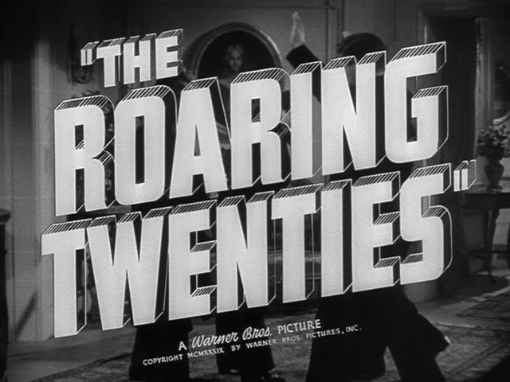
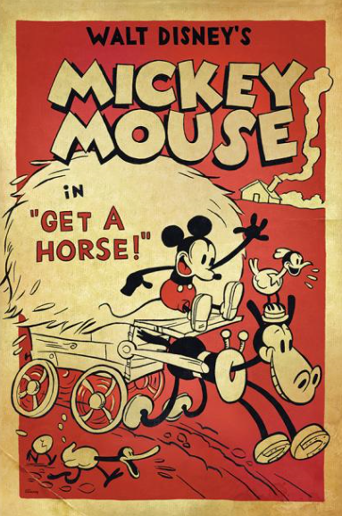
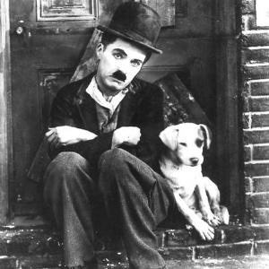
Changing Society….maybe not all Good

Slide 11
Political Changes during the 1920s
Politically, the U.S. was led between 1920-1930 by 3 Republican Presidents… Can you name them??
Warren Harding (1921-1923)--Republican
Calvin Coolidge (1923-1929) -- Republican
Herbert Hoover (1929-1933) --Republican

Slide 12
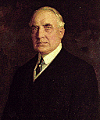
President Warren Harding (1920-1923)
“A Return to Normalcy” –Harding’s campaign motto when he won the 1920 election: promises to get America back to normal after the war and to run a government less involved in business and foreign affairs (wants to end the postwar recession)
Harding’s Presidency is most remembered for it’s scandals:
Teapot Dome Scandal: Government officials accepted bribes from business men (money in exchange for government oil fields in Teapot Dome, Wyoming)

Slide 13
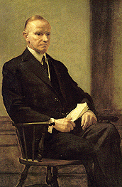
President Calvin Coolidge 1923-1929
"Stay Cool with Coolidge"
Took over after Harding's death
Committed to business
Laissez Faire approach to the economy
"Coolidge Prosperity" -- the economy
improves under Coolidge
The Kellogg-Briand Pact -- passed in 1928 during Coolidge's presidency. This was an agreement among nations to outlaw war except in self-defense. Nations agree to settle disputes through peaceful means and not through war.
(Problem: there was no way to enforce the pact)

Slide 14
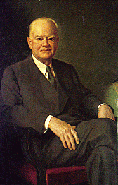
President Herbert Hoover (1929-1933)
Promised to help end poverty and unequal distribution of wealth in the U.S.
Laissez faire government
Wanted to "help people help themselves"
PROBLEM!!!!!!
Hoover was President during the Stockmarket Crash in October of 1929 (Black Tuesday) --- leading to the start of the great depression
Also the creation of Hoovervilles

Slide 15
Economic Changes during the 1920s
Republican presidents are Pro-business and follow a laissez-faire policy
Many people experience economic prosperity
An Economic Boom!!!
However NOT everyone experienced economic prosperity
•Farmers
•Native Americans
•African Americans

Slide 16
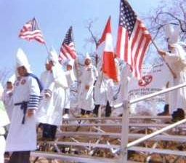
Who didn't prosper from the economy during the 1920s?
1. Farmers -- Small farmers are hurt by the economy. Post WWI when European farmers begin producing again , American farmers are producing too much and prices fall.
•Farmers can't afford all of the luxury consumer goods
and technology
Banks also repossessed Farms
African Americans still doing the sharecropping were kicked off land
2. Native Americans -- Most live on reservations and have few luxury goods
•high unemployment rate and short lifespan
3. African Americans -- faced discrimination ,
segregation is STILL LEGAL
•The KKK becomes active again (against African Americans)
Big corporations and the wealthy benefited the most from the economy!!

Slide 17
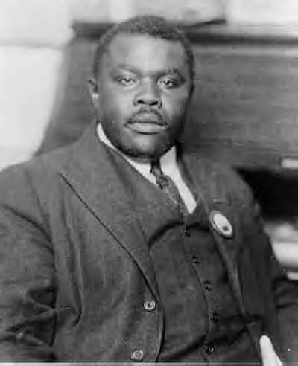
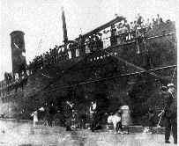
Marcus Garvey (Jamaican born immigrant) established the Universal Negro Improvement Association
believed in Black pride
advocated racial segregation b/c of Black superiority
Garvey believed Blacks should return to Africa
he purchased a ship to start the Black Star line
attracted many investments: gov't charged him with w/fraud
he was found guilty and eventually deported to Jamaica, but his organization continued to exist

Slide 18
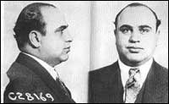
Social Changes during the 1920's
1.) 18th Amendment -- passed in 1919, made the sale and consumption of alcohol illegal
Why were people for prohibition?
•People blame high crime rates on alcohol
•People believe alcohol is evil
•Traditional, Rural, and religious people most often supported prohibition
What was the problem with prohibition?
1933-21st Amendment cancels out the 18th Amendment.
Prohibition was very hard to enforce, illegal drinking created a billion dollar industry (bootlegging), and speakeasies opened up
Famous gangster: Al Capone

Slide 19
Lives of Women
••In 1920 the 19th Amendment is passed,
giving women gain the right to vote
•Many more women join the workforce (although many still believed a woman's place was in the home, and women had a hard time finding jobs outside of traditional roles such as teaching and clerical work)
•face discrimination and low wages
•Rebellious, independent women were given the name flappers

Slide 20
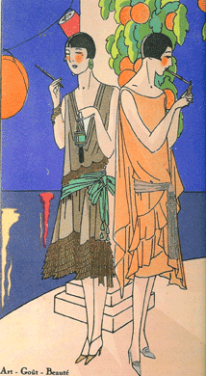
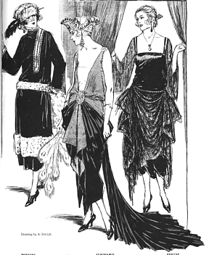
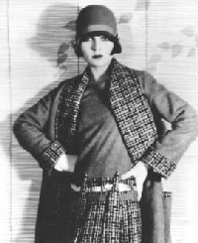
Flapper – The nickname given to modern and rebellious women during the 1920’s, they often:
-had short hair cuts
-short skirts
-visited speakeasies
-danced
-wanted the same freedom as men
However!!!!!!!
Most women WERE NOT flappers and still were very restricted by economic, political and social limits!!!

Slide 21
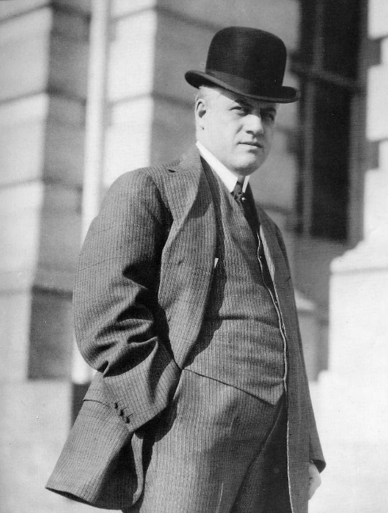
Other Problems
Palmer Raids: RED SCARE
Nativism=Hatred towards Immigrants
Attorney General Mitchell A. Palmer
  Wants to run for President, hopes this would help political gain
Witch hunt for so called Communist in the Country
Finally starts to fade away after nothing happens in country-smoke and mirrors
Immigration Laws are passed -- The National Origins Act and and Emergency Quota Act are passed to limit immigration into the U.S. These quotas kept immigration numbers from Eastern and Southern Europe and Asia low.
Sacco and Venzetti Trial
  No evidence were sentenced to death over a robbery and murder
Lindbergh Trial??

Slide 22
Religion vs. Education:
Scopes Trial…

