Slide 1
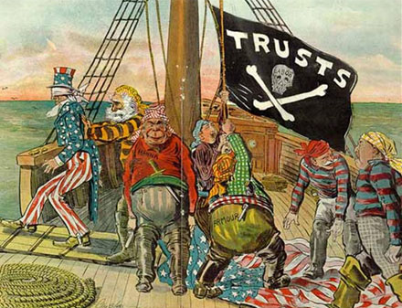
The Progressive Era
America Seeks Reforms in the Early 20th Century

Slide 2
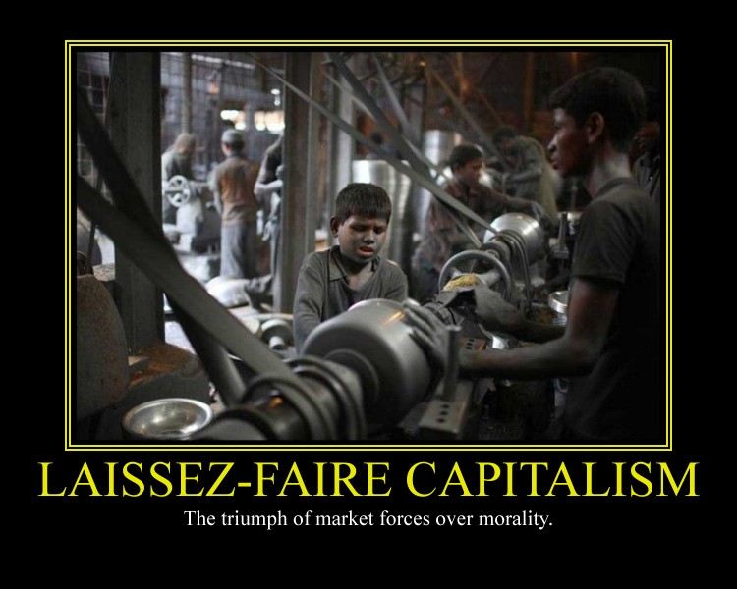
Problem???
When is Laissez-Faire too Laissez-Faire?

Slide 3
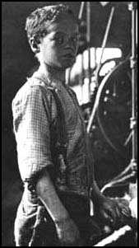
Origins of Progressivism
As America entered the 20th century, middle class reformers at the municipal, state, and national levels addressed the problems of the Gilded Age, including:
Economic inequities
Environmental issues
Social welfare
Working conditions
Rights for women and children

Slide 4
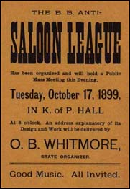
Four Goals of Reformers
Protect social welfare
Promote moral development
Secure economic reform
Foster efficiency

Slide 5
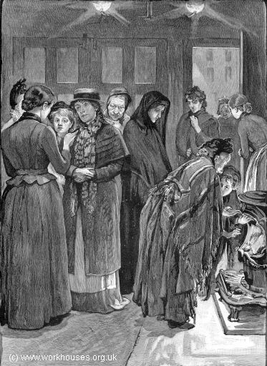
Protect Social Welfare
Industrialization in the late 19th century was largely unregulated. Employers felt little responsibility toward their workers.
As a result, settlement houses and churches served the community and organizations like the YMCA and the Salvation Army took on service roles.
Salvation Army Shelter

Slide 6
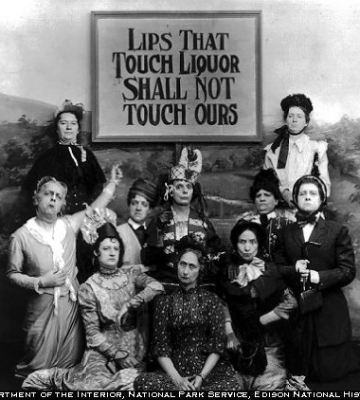
Promote Moral Development
Some reformers felt that the answer to society’s problems was personal behavior. They proposed such reforms as prohibition.
Groups wishing to ban alcohol included the Woman’s Christian Temperance Union (WCTU)

Slide 7
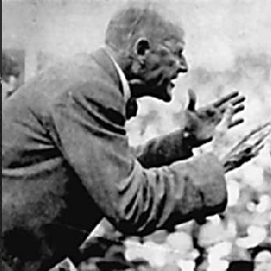
Secure Economic Reform
The Panic of 1893 prompted some Americans to question the capitalist economic system.
As a result, some workers embraced socialism. Eugene Debs organized the American Socialist Party in 1901.
Debs encouraged workers to reject American capitalism

Slide 8
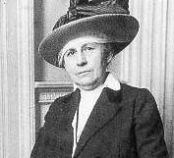
Muckrakers Criticize Big Business
Though most Progressives did not embrace socialism, many writers saw the truth in Debs’ criticism.
Investigative journalists, known as “Muckrakers,” exposed corruption in business. For example, Ida Tarbell exposed Standard Oil Company’s cut-throat methods of eliminating competition.

Slide 9
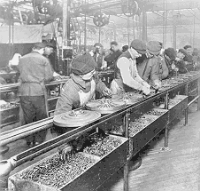
Fostering Efficiency
Many Progressive leaders put their faith in scientific principles to make society better.
In industry, Frederick Taylor began using time and motion studies to improve factory efficiency. Taylorism became an industry fad as factories sought to complete each task quickly.

Slide 10
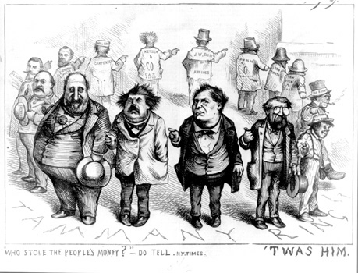
Cleaning Up Local Government
Efforts at reforming local government stemmed from the desire to make government more efficient and responsive to citizens.
Some believe it also was meant to limit immigrants’ influence on local governments.

Slide 11
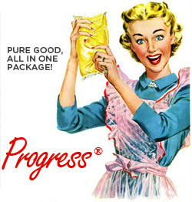
Amending the Country
15th Amendment (1870)
Right to vote no matter of what color
16th Amendment (1913)
Congress can collect income tax
17th Amendment (1913)
Santa Clause (I mean Senate: 2 from each state)
18th Amendment (1919)
Liquor Bad
19th Amendment (1920)
Women’s right to vote

Slide 12
Regulating Big Business
Under the progressive Republican leadership of Robert La Follette, Wisconsin led the way in regulating big business and implementing the Wisconsin Idea – a partnership between government and the experts at the University of Wisconsin.
Robert La Follette

Slide 13
Protecting Working Children
As the number of child workers rose, reformers worked to end child labor.
Children were more prone to accidents caused by fatigue.
Nearly every state limited or banned child labor by 1918

Slide 14
Efforts To Limit Hours
The Supreme Court and the states enacted or strengthened laws reducing women’s hours of work.
Progressives also succeeded in winning worker’s compensation to aid families of injured workers.

Slide 15
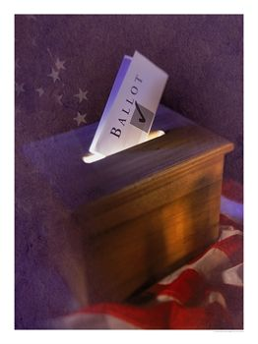
Election Reform
Citizens fought for and secured such measures as secret ballots, referendums, and recalls. Citizens could petition and get initiatives on the ballot.
In 1899, Minnesota passed the first statewide primary system.

Slide 16
Direct Election Of Senators
Before 1913, each state’s legislature had chosen U.S. senators. To force senators to be more responsive to the public, Progressives pushed for the popular election of senators.
As a result, Congress passed the 17th Amendment in 1913.

Slide 17
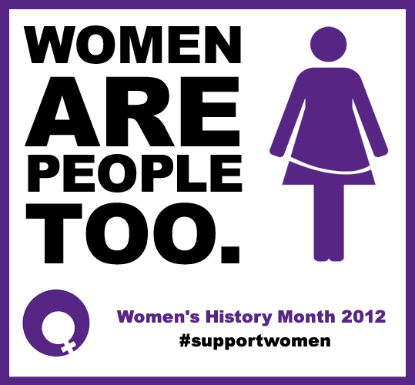
Women fighting Back…

Slide 18
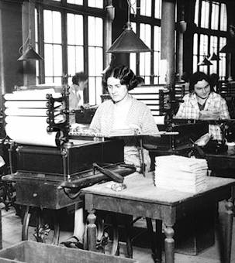
Women in Public Life
Before the Civil War, American women were expected to devote their time to home and family.
By the late 19th and early 20th century, women were visible in the workforce.

Slide 19
Domestic Workers
Before the turn-of-the-century women without formal education contributed to the economic welfare of their families by doing domestic work.
Altogether, 70% of women employed in 1870 were servants.

Slide 20
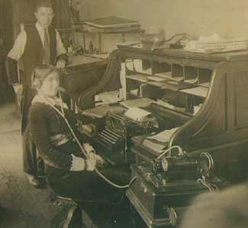
Women in the Work Force
Opportunities for women increased especially in the cities. By 1900, one out of five women worked.
The garment industry was popular as were office work, retail, and education.

Slide 21
Women Lead Reform
Many of the leading Progressive reformers were women. Middle and upper class women entered the public sphere after graduating from the new women’s colleges.
Colleges like Vassar and Smith allowed women to excel

Slide 22
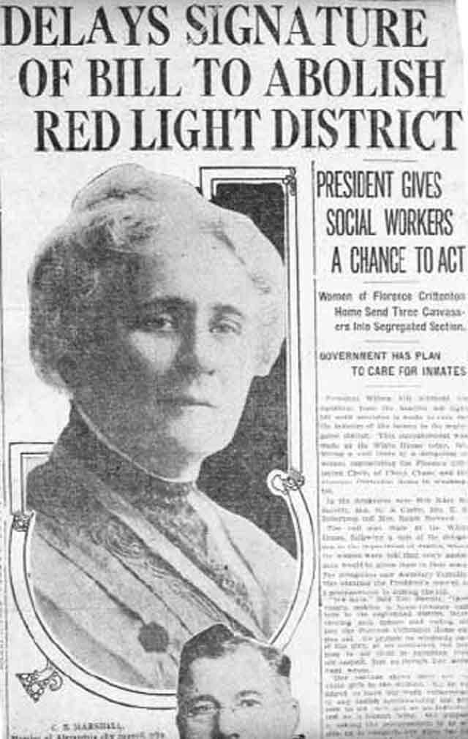
Women and Reform
Women reformers strove to improve conditions at work and home.
In 1896, black women formed the National Association of Colored Women (NACW).
Suffrage was another important issue for women.

Slide 23
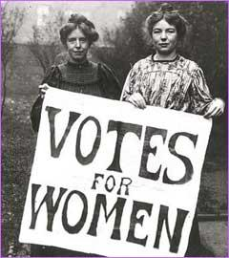
Three-Part Strategy for Winning Suffrage
Suffragettes tried three approaches to winning the vote:
Convincing state legislatures to adopt the vote.
Pursuing court cases to test 14th Amendment.
Pushing for national Constitutional amendment.

Slide 24
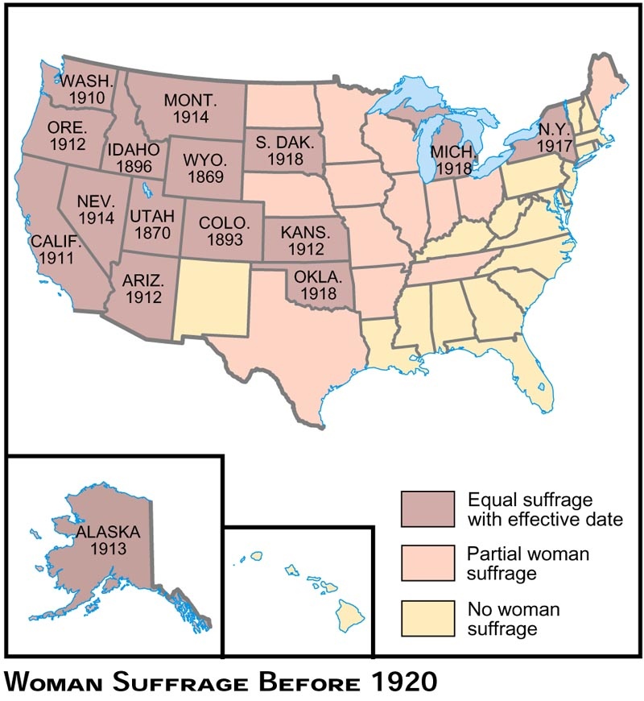

Slide 25
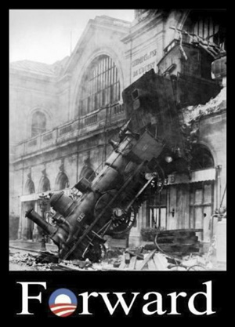
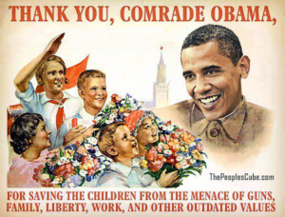
Progressive Presidents..??...
Well not just yet….

Slide 26
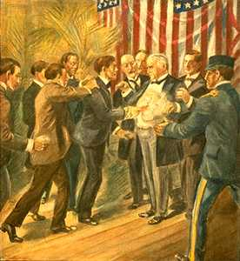
Teddy Roosevelt’s Square Deal
When President William McKinley was assassinated six months into his second term, Theodore Roosevelt became the nation’s 26th president
Square Deal: domestic program formed upon three basic ideas: conservation of natural resources, control of corporations, and consumer protection.
McKinley was assassinated by an anarchist in Buffalo in September of 1901

Slide 27
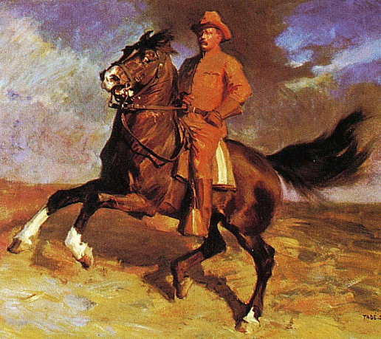
Roosevelt and the Rough Riders
Roosevelt captured national attention by advocating war with Spain in 1898. His volunteer cavalry brigade, the Rough Riders, won public acclaim for its role in the battle of San Juan Hill in Cuba.
Roosevelt returned a hero and was soon elected governor of NY and later McKinley’s vice-president.

Slide 28
Imperialism…
Imperialism: a policy of extending a country's power and influence through diplomacy or military force.
Spanish American War
Puerto Rico, Guam, and Philippines

Slide 29
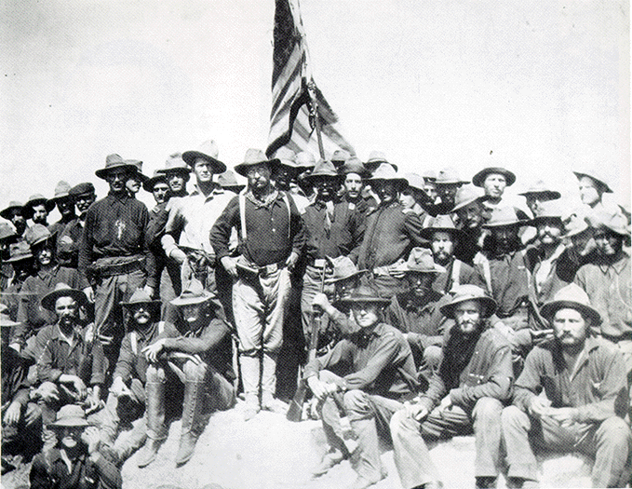
Teddy Roosevelt and the Rough Riders

Slide 30
The Modern President
When Roosevelt was thrust into the presidency in 1901, he became the youngest president ever at age 42.
He quickly established himself as a modern president who could influence the media and shape legislation.

Slide 31
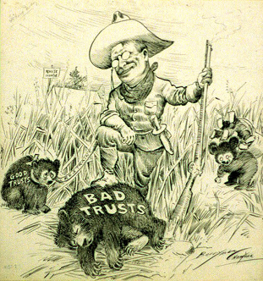
Trust-Busting
By 1900, trusts – legal bodies created to hold stock in many companies – controlled 80% of U.S. industries.
Roosevelt filed 44 antitrust suits under the Sherman Anti-Trust Act

Slide 32
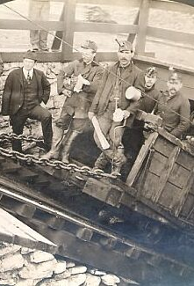
1902 Coal Strike
In 1902, 140,000 coal miners in Pennsylvania went on strike for increased wages, a 9-hour work day, and the right to unionize. Mine owners refused to bargain.
Roosevelt called in both sides and settled the dispute. Thereafter, when a strike threatened public welfare, the federal government was expected to step in and help.

Slide 33
“The Jungle” Leads to Food Regulation
After reading The Jungle by Upton Sinclair, Roosevelt pushed for passage of the Meat Inspection Act of 1906.
The act mandated cleaner conditions for meatpacking plants.

Slide 34
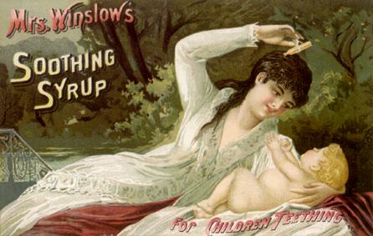
Pure Food and Drug Act
In response to unsubstantiated claims and unwholesome products, Congress passed the Pure Food and Drug Act in 1906. The Act halted the sale of contaminated foods and medicines and called for truth in labeling.

Slide 35
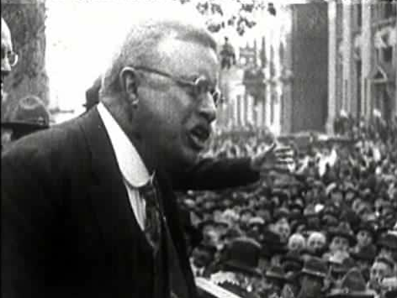
Roosevelt and the Environment
Before Roosevelt’s presidency, the federal government paid very little attention to the nation’s natural resources. Roosevelt made conservation a primary concern of his administration.

Slide 36
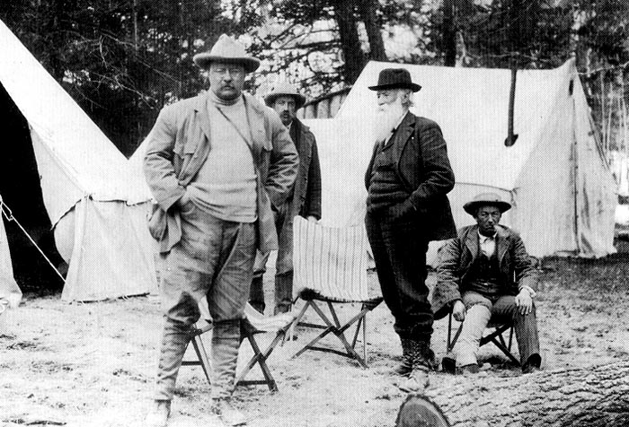

Slide 37
Roosevelt’s Environmental Accomplishments
Roosevelt set aside 148 million acres of forest reserves, 1.5 million acres of water-power sites, 50 wildlife sanctuaries, and several national parks.

Slide 38
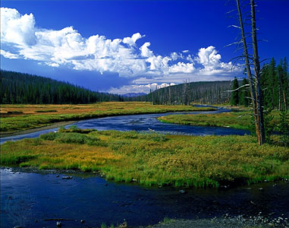
Yellowstone National Park, Wyoming

Slide 39
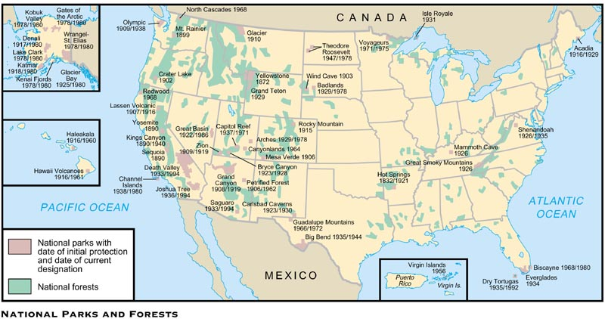

Slide 40
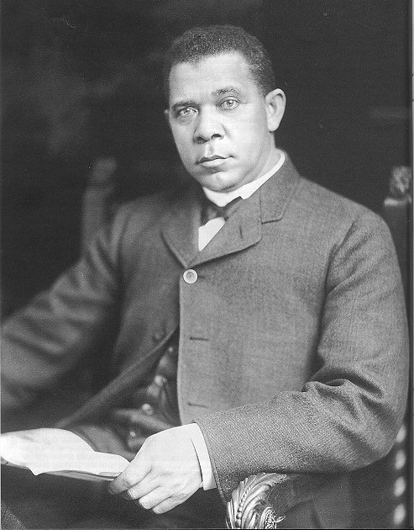
Roosevelt and Civil Rights
Roosevelt failed to support Civil Rights for African Americans. He did, however, support a few individuals such as Booker T. Washington, who founded the Tuskegee Institute to provide a technical education for African Americans.

Slide 41
Dinner with Booker T. Washington…
Dinner was behind closed doors.
Papers like the Memphis-Scimitar reported: The most damnable outrage which has ever been perpetrated by a citizen of the United States was committed by the President, when he invited a n****r to dine with him at the White House… It would not be worth more than a passing notice if Theodore Roosevelt had sat down to dinner on his own time with a Pullman car porter, but Roosevelt the individual and Roosevelt the President are not to be viewed in the same light.

Slide 42
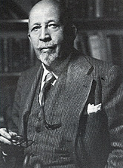
NAACP Formed to Promote Rights
In 1909 a number of African Americans and prominent white reformers formed the National Association for the Advancement of Colored People. The NAACP had 6,000 members by 1914.
The goal of the organization was full equality among the races through the court system, a position supported by W.E.B. Du Bois.

Slide 43
Progressivism under President Taft
Republican William Howard Taft easily defeated Democrat William Jennings Bryan in the 1908 presidential election.
Among his accomplishments, Taft “busted” (the tub) 90 trusts during his four years in office – more than Theodore Roosevelt during his eight years in office.
Taft, right, was Roosevelt’s War Secretary

Slide 44
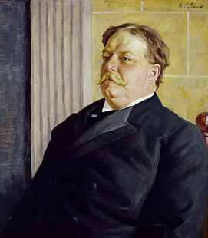
Taft Loses Power
Taft was not popular with the American public or reform-minded Republicans. He called the Presidency, the “lonesomest” job in the world.” By 1910, Democrats had regained control of the House of Representatives.

Slide 45
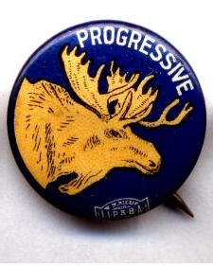
1912 Election
Republicans split in 1912 between Taft and Roosevelt (who returned after a safari to Africa).
Convention delegates nominated Taft and discontented Republicans formed a third party, the Progressive Party (nicknamed the Bull Moose Party), and nominated Roosevelt.
The Democrats put forward a reform-minded New Jersey governor, Woodrow Wilson.

Slide 46
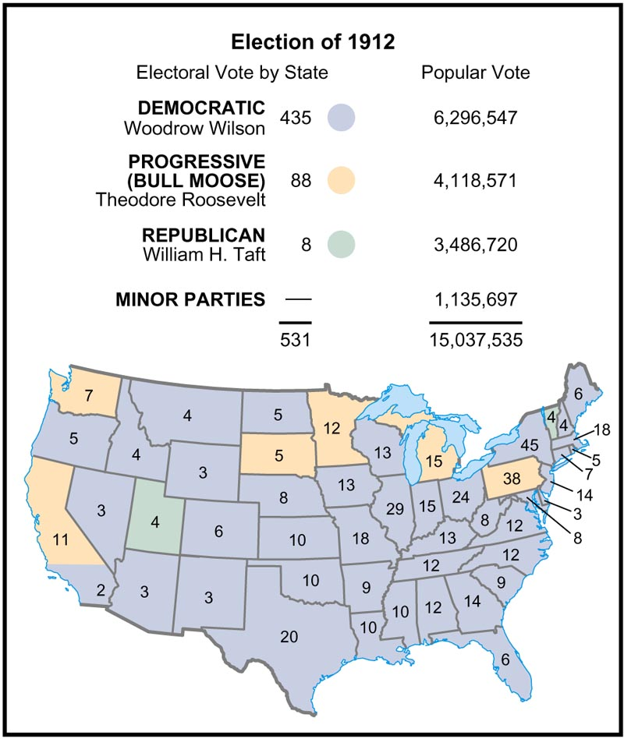

Slide 47
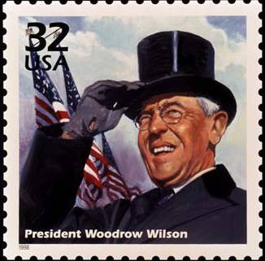
Wilson’s New Freedom
With a strong mandate from the American people, Wilson moved to enact his program, the “New Freedom.”
He planned his attack on what he called the triple wall of privilege: trusts, tariffs, and high finance (or banks).

Slide 48
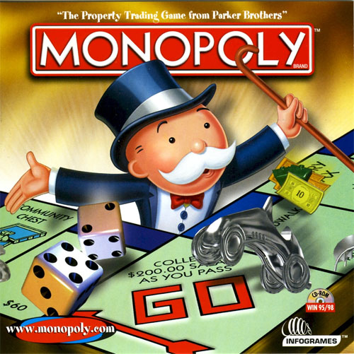
Clayton Anti-Trust Act
In 1914 Congress enacted the Clayton Anti-Trust Act that strengthened the Sherman Act.
It had an anti-trust provision that prevented companies from acquiring stock from another company and supported workers’ unions.

Slide 49
Federal Trade Commission Formed
The FTC was formed in 1914 to serve as a “watchdog” agency to end unfair business practices. The FTC protects consumers from business fraud.

Slide 50
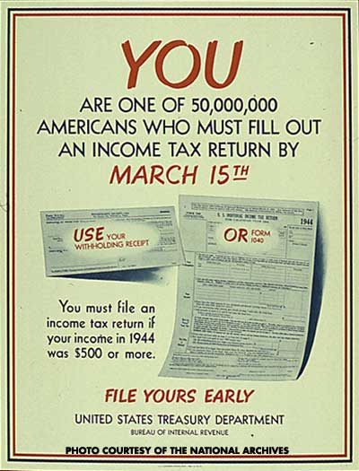
Federal Income Tax Arrives
Wilson worked hard to lower tariffs, however, the lost revenue had to be made up and was when the 16th Amendment instituted a graduated federal income tax.

Slide 51
Women Win Suffrage
Native-born, educated, middle-class women grew more and more impatient. Through local, state, and national organization, as well as vigorous protests, women finally realized their dream in 1920.

Slide 52
Limits of Progressivism
While the Progressive era was responsible for many important reforms, it failed to make gains for African Americans. Like Roosevelt and Taft, Wilson retreated on Civil Rights when he entered office.
The KKK reached a membership of 4.5 million in the 1920s

