Slide 1
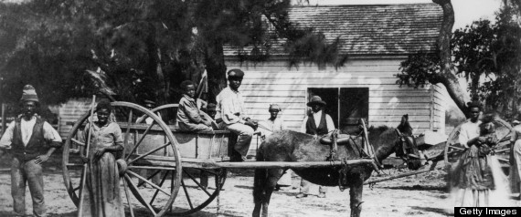
Slavery

Slide 2
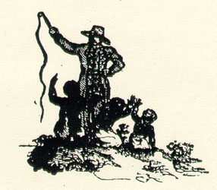
Slavery in Antebellum America
Antebellum: existing before a war (used more commonly with the American Civil War)
Despite the hopes of some of the Founding Fathers that slavery might die out, in fact the institution survived the crisis of the American Revolution and rapidly expanded westward.
On the eve of the Civil War, the slave population had risen to 4 million.

Slide 3
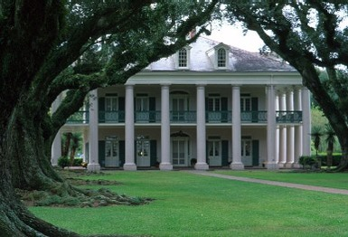
Slavery in Antebellum America
In the South as a whole, slaves made up 1/3 of the total population and in the cotton producing states of the Deep South about ½.
1850: Slavery had crossed the Mississippi River and was expanding rapidly in AK, LA, and eastern TX.
1860: 1/3 of the nation’s cotton crop was grown west of the Mississippi River.

Slide 4
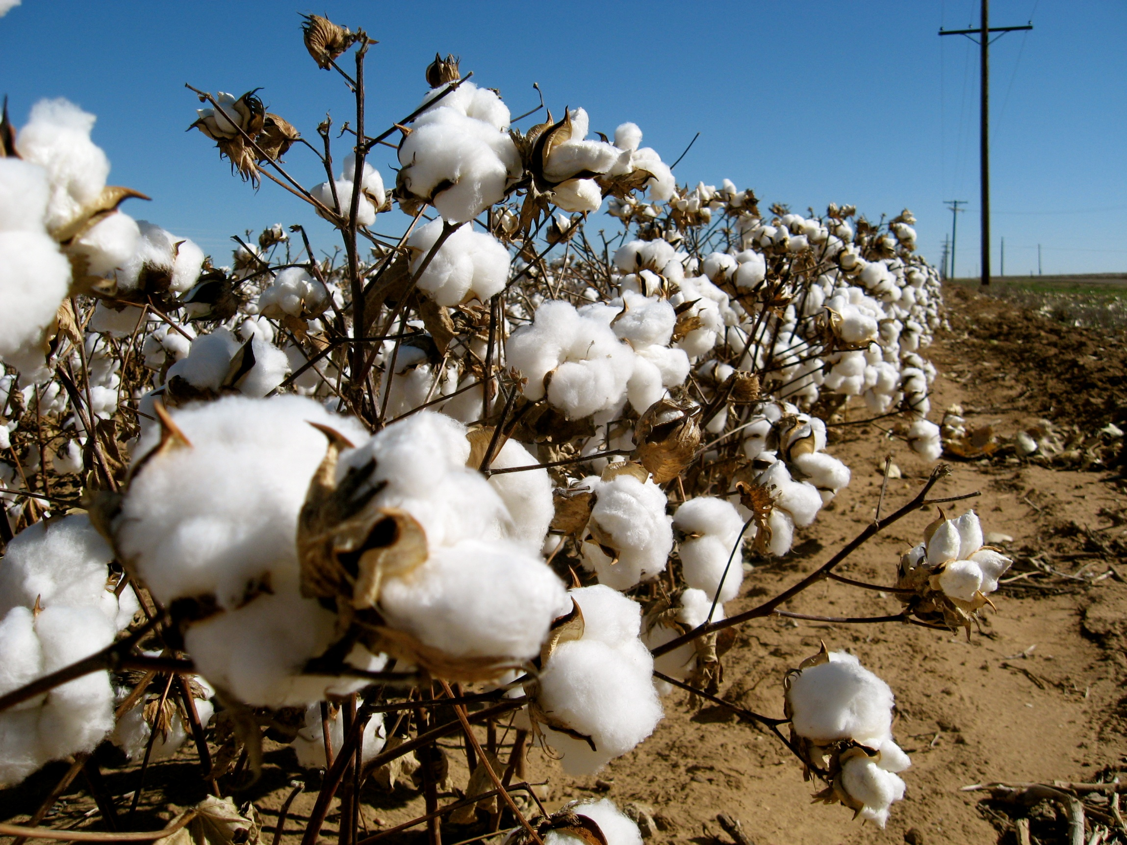
“White Gold”
The Old South was the largest and most powerful slave society the modern world has known.
Its strength rested on a virtual monopoly of cotton, the South’s “white gold.”

Slide 5
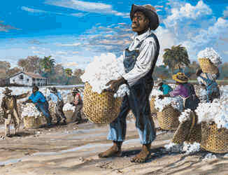
“Cotton is King”
About ¾ of the world’s cotton supply came from the Southern USA.
1830: Cotton had become the most important American export.
On the eve of the Civil War, it represented well over ½ the total of American exports.
1860: The economic investment represented by the slave population exceeded the value of the nation’s factories, railroads, and banks combined.

Slide 6
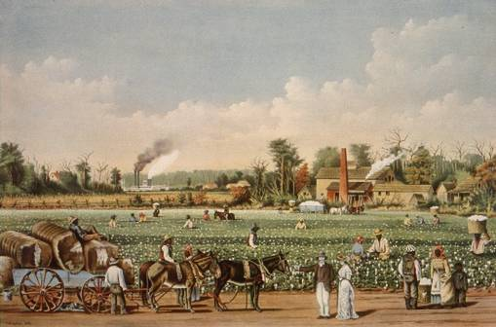
Side Note: Whites in the South
There was a huge gap between rich and poor.
South had a very poor public education system thus planters sent their children to private schools.
Planters carried on the “cavalier” tradition of early VA.
Planters: a landed genteel class

Slide 7
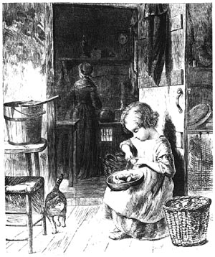
Majority Whites
75% of white Southerners owned no slaves.
Mostly subsistence farmers and did not participate in the market economy.
Poorest were called “white trash”, “hillbillies”, or “crackers.”
Fiercely defended the slave system as it proved white superiority.

Slide 8
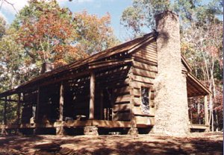
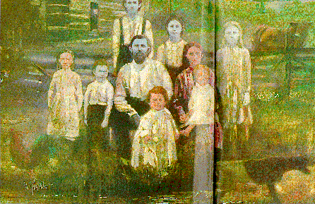
Mountain Whites
Lived in the valleys of the Appalachian Mountain range.
They were independent small farmers located far from the Cotton Kingdom.
Hated wealthy planters and slaves.
During the Civil War, they were Unionist. This significantly hurt the Confederacy.

Slide 9
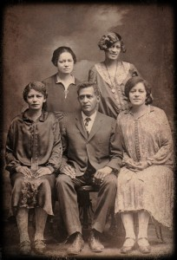
Free Blacks
By 1860: Numbered about 250,000.
In the Border South, emancipation increased starting in the late 18th century.
In the Lower South, many free blacks were mulattos – white father and black mother. This was evidence of the sexual intimidation and abuse by male slaveholders.

Slide 10
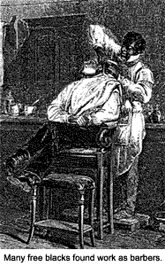
Free Blacks in the South
Some were able to buy their freedom from their labor after hours. (Task System)
Some owned property.
Faced discrimination in the South.
They were prohibited from certain occupations and from testifying against whites in court.
They had no political rights.
They were always in danger of being forced back into slavery by slave traders.

Slide 11
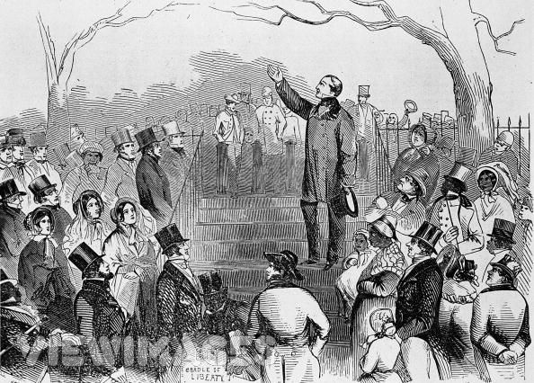
Free Blacks in the North
Free blacks numbered about 250,000.
Some states forbade their entrance or denied them public education.
Some states segregated blacks in public facilities.
They were especially hated by Irish immigrants with whom they competed with for jobs.
Racist feelings often stronger in the North than in the South.

Slide 12
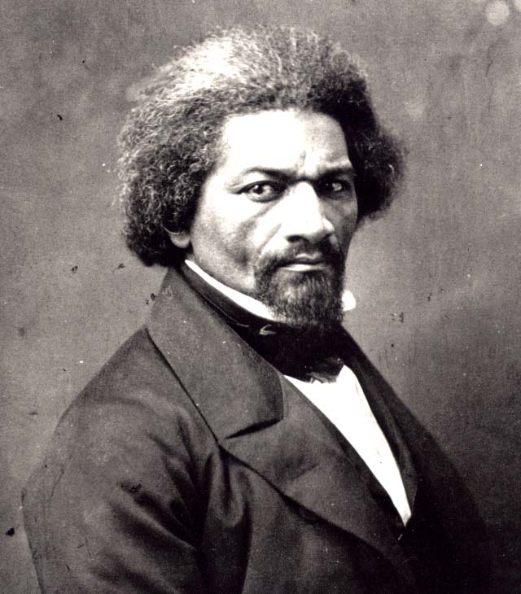
Free Blacks
“The distinction between slave and the free is not great.”
Frederick Douglass

Slide 13
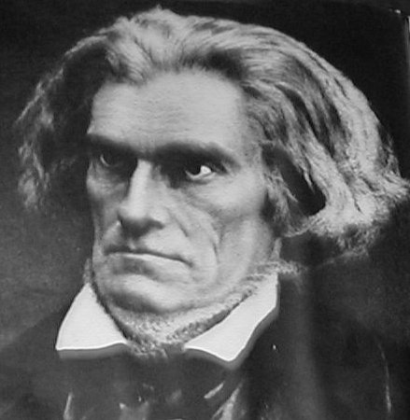
Pro-Slavery Ideology
1837: John C. Calhoun:
“Many in the South once believed that slavery was a moral and political evil… That folly and delusion are gone; we see it now in its true light, and regard it as the most safe and stable basis for free institutions in the world.”

Slide 14
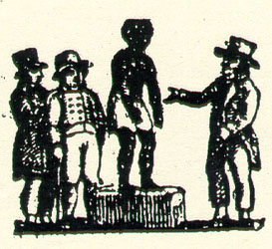
Pro-Slavery Ideology
Even those who had no direct stake in slavery shared with planters a deep commitment to white supremacy.
Indeed, racism – the belief that blacks were innately inferior to whites and unsuited for life in any conditions other than slavery – formed one pillar of the pro-slavery ideology.

Slide 15
Pro-Slavery Ideology
Most slaveholders also found legitimation for slavery in Biblical passages such as the injunction that servants should obey their masters.
Others argued that slavery was essential to human progress. Without slavery, planters would be unable to cultivate the arts, sciences, and other civilized pursuits.

Slide 16
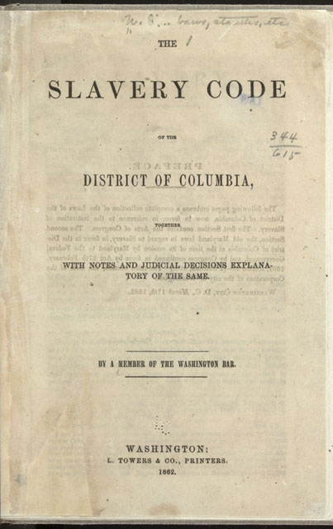
Slaves and the “Law”
For slaves, the “peculiar institution” meant a life of incessant toil, brutal punishment, and the constant fear that families would be destroyed by sale (slavery’s greatest psychological horror).
Before the law, slaves were property.
By 1830, it was a crime to teach a slave to read or write. Not all these laws were rigorously enforced.
Some members of slaveholding families taught children to read and write – although rather few since well over 90% of the slave population was illiterate in 1860.

Slide 17
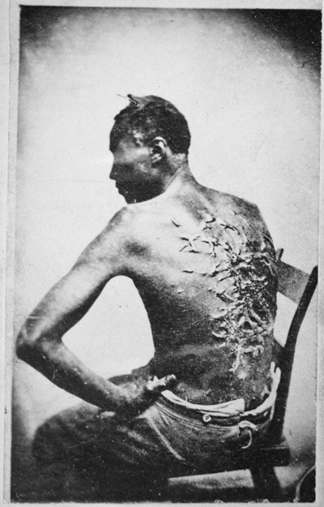
“Order”
Slave owners employed a variety of means in their attempt to maintain order and discipline among their human property and persuade them to labor productivity.
Their system rested on force. Masters had almost complete discretion in inflicting punishment, and rare was the slave who went through his or her life without experiencing a whipping.
Any infraction of plantation rules, no matter how minor, could be punished by the lash.

Slide 18
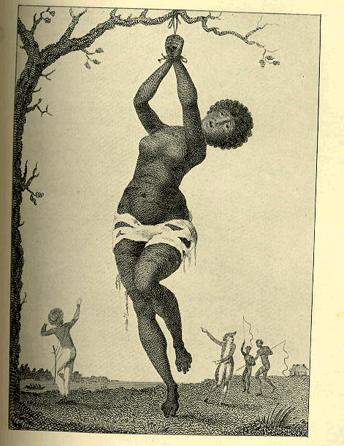
The “Crime” of Celia
Celia was a slave who killed her master while resisting a sexual assault.
Missouri state law deemed “any woman” in such circumstances to be acting in self-defense.
But, the Court ruled that Celia was not a woman.

Slide 19
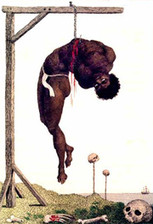
The “Crime” of Celia
She was a slave, whose master had complete power over her person.
The Court sentenced her to death.
However, since Celia was pregnant, her execution was postponed until her child had been born, so as to not deprive her owner’s heir of their property rights.

Slide 20
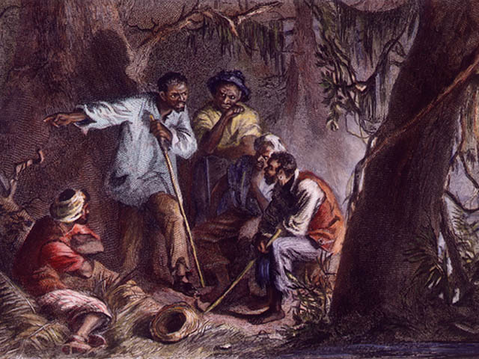
“Fighting Back”
The most widespread expression of hostility to slavery was “day-to-day resistance” or “silent sabotage” -doing poor work, breaking tools, abusing animals, and in other ways disrupting the plantation routine.
Many slaves made believe that they were to ill to work – although almost no slaves reported themselves sick on Sunday, their only day of rest.
Then there was the theft of food, a form of resistance so common that one southern physician diagnosed it as a hereditary disease unique to blacks.
Less frequent, but more dangerous, were serious crimes committed by slaves, including arson, poisoning, and armed assaults against individual whites.

Slide 21
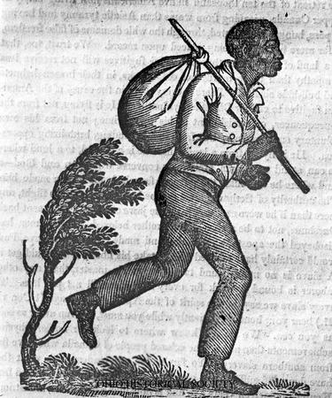
Run Away
Even more threatening to the ability of the slave system was running away.
Most of these were Male, women did not want to leave children.

Slide 22
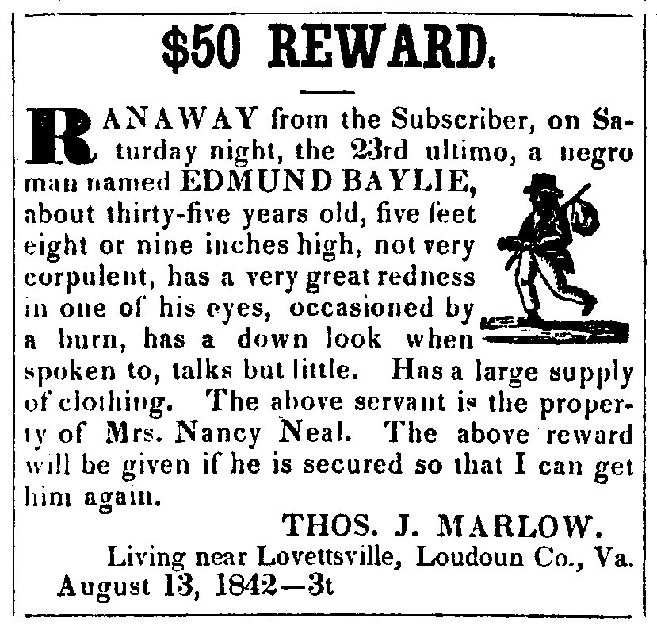
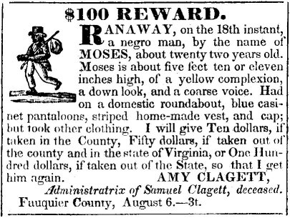
Run Away Ads

Slide 23
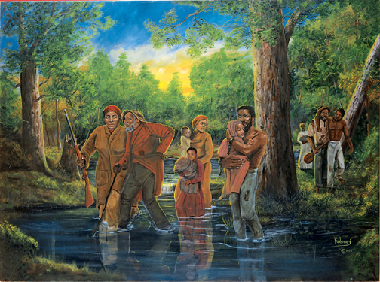
Underground Railroad
The Underground Railroad was a loose organization of sympathetic abolitionists who hid fugitives in their homes and sent them to the next “station” assisted some runaway slaves.

Slide 24
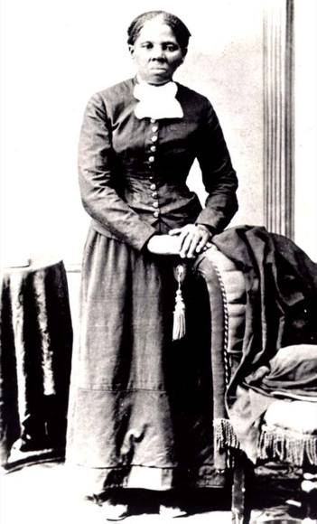
Underground Railroad
A few courageous individuals made forays into the South to liberate slaves.
The best known was Harriet Tubman.
Born in Maryland in 1820, she escaped to PA in 1849.

Slide 25
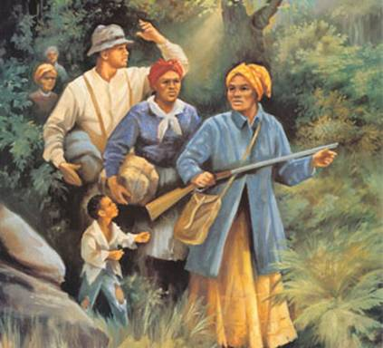
Underground Railroad
During the next decade of her life, she risked her life by making some 20 trips back to her state of birth to lead relatives and other slaves to freedom.

Slide 26
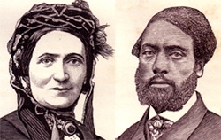
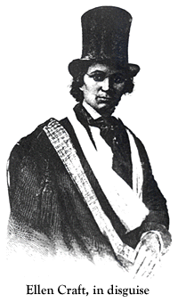
Underground Railroad
But most who managed to reach the North did so on their own initiative, some showing remarkable ingenuity.
William and Ellen Craft impersonated a sickly owner traveling with her slave.

Slide 27
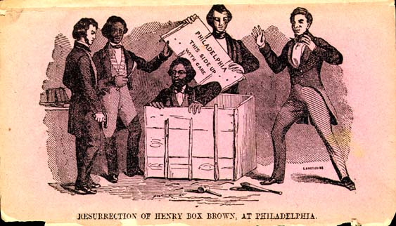
Underground Railroad
Henry “Box” Brown packed himself inside a crate and literally had himself shipped from Georgia to freedom in the North.

Slide 28
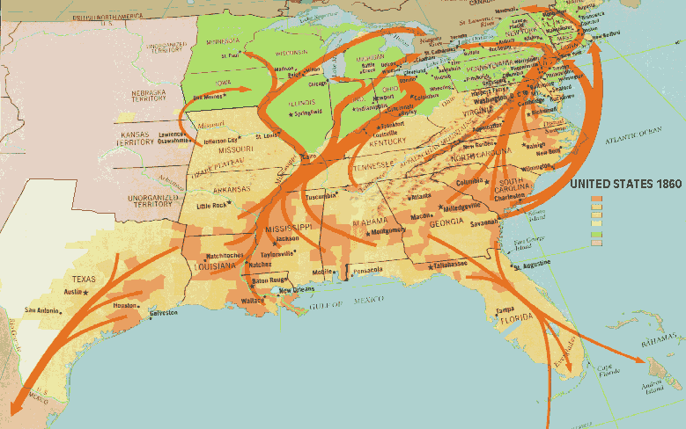
Underground Railroad

