Slide 1
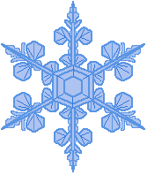
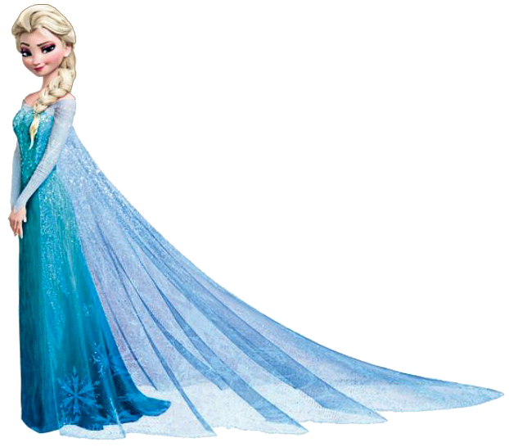
Rise of the cold war

Slide 2
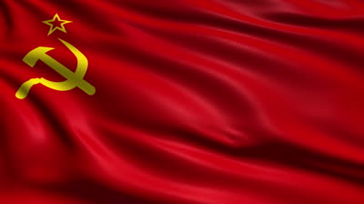
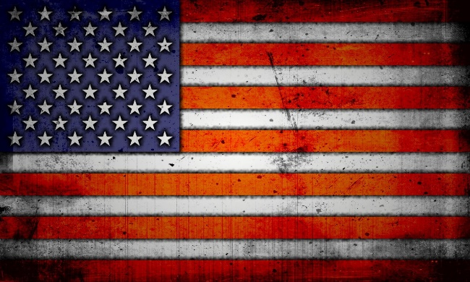
Roots of the Cold war
Definition: Cold War was a competition that developed between the U.S. and the U.S.S.R.
Lasted until the collapse of the Soviet Union in 1991
Characterized by political, economic, and military tension
Communism
Dictatorship
Totalitarian
Free-Enterprise
Capitalism
Republic

Slide 3
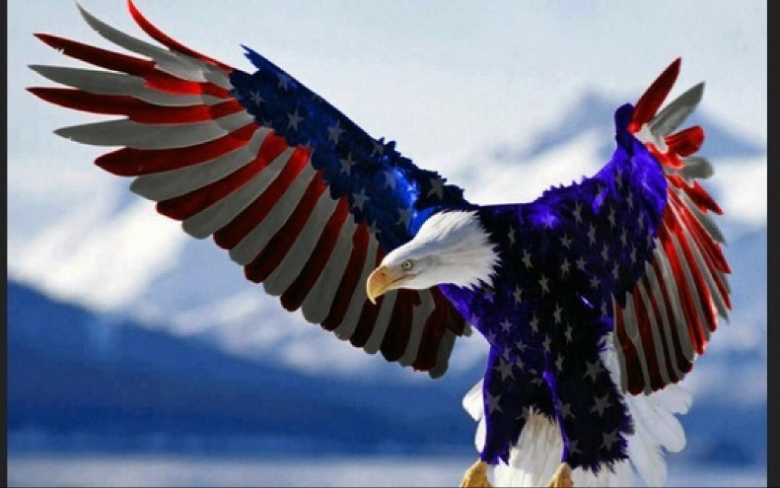
World War II conflicts
Russia and the U.S. were allies during World War II
Soviets wanted America and British to open second front earlier in the war
Believed America wanted Germany to weaken Russia
Soviets distrust Americans because of Manhattan Project
Truman would not tell Stalin about the A-Bomb, just that they had a special weapon
Wings of Justice

Slide 4
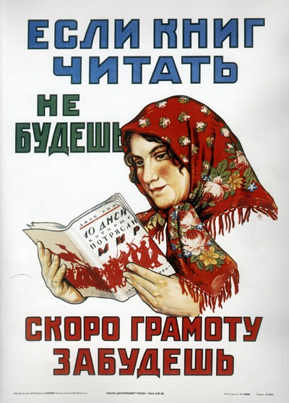
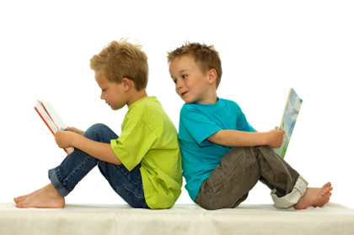
Reading is Amazing…
Your turn: on my weebly under Unit 5 you will be assigned an article to read.
Read the article and write in your notes a summary of article.
When instructed share with your shoulder pal your summary of the article.
Want to hear a joke?
Sure
Russia!

Slide 5
Conferences…
Yalta Conference: U.S., Great Britain, and Russia discussed the end of the war with Germany
Churchill and Roosevelt did not think Germany should pay U.S.S.R. $10 billion in war damages
Soviet Union refuses to live up to their promise of free elections in Poland
Potsdam Conference: U.S. (Truman), Great Britain, and Russia discussed the end of the war with Japan
Truman’s first meeting with Stalin
At first Truman is willing to compromise, but later hardens

Slide 6
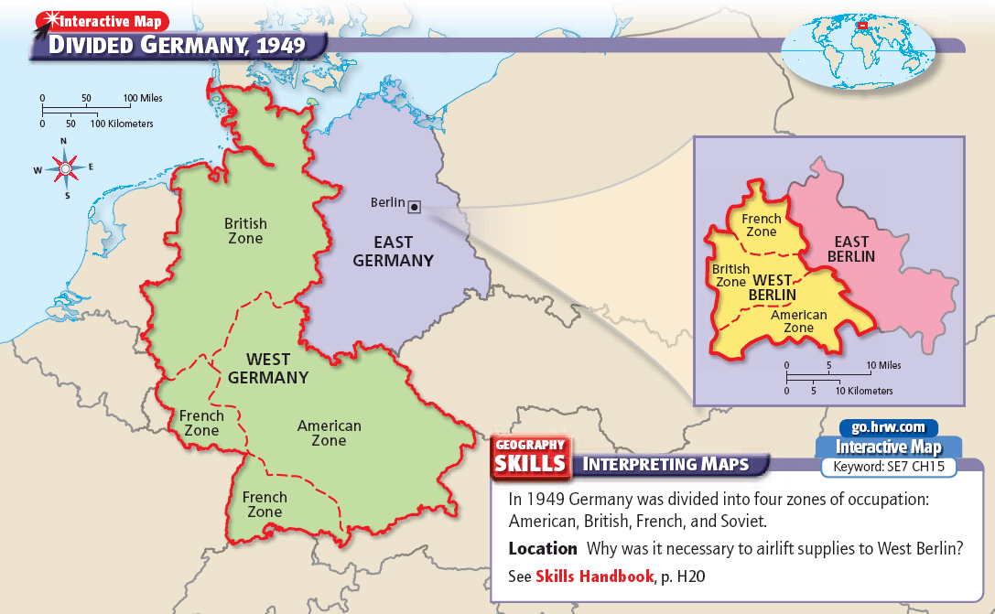

Slide 7
The Berlin Wall
The city of Berlin in Germany was in the Eastern part of Germany.
Instead of giving the whole city to the Soviet Union, the city was split in two.
One side was Democratic, the other side was Communist.

Slide 8
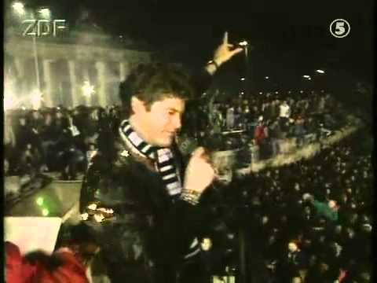
The Berlin Wall
People kept fleeing East Berlin to be in West Berlin, so the Communists built a wall to keep people from going there.
This was the Berlin Wall.
Germans love the Hoff, so the Hoff brought down the wall.

Slide 10
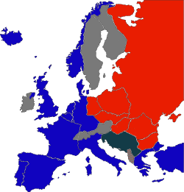
The Iron Curtain
The imaginary line that separated Communist Eastern Europe from Democratic Western Europe was called the Iron Curtain.
Both sides feared one another.
Each side began preparing for another war.

Slide 11
Iron Curtain
Stalin wanted to retain power and economic control over Eastern Europe
The Soviets managed to install Communist governments throughout Eastern Europe
Stalin outlawed political parties or newspapers that opposed the Communists
The Soviets jailed or killed some political opponents
The Soviets rigged elections to ensure the success of Communists
The Soviet Union relocated Germans living in Poland and other countries of Eastern Europe

Slide 12
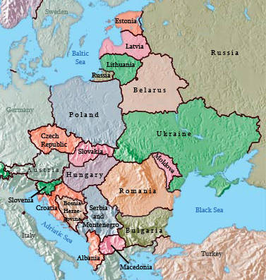
Iron Curtain
Soon every nation in Eastern Europe had a Soviet friendly communist government in place
Established satellite nations
Countries subject to Soviet domination
Czechoslovakia
Tried to hold onto their democratic system
When didn’t win election, communists plotted and replaced
all non-communist police officers with those belonging to
the party
Hungary
Communists lost the election so Soviets stayed and arrested
anti-Communists in order to win the next election
Romania
Soviets stayed there and forced the King to name a Communist
Prime Minister and less than 2 years later, he forced the King to resign

Slide 13
Iron curtain
East Germany
Stalin determined Germans would never threaten his nation again
Finland
Signed a treaty of cooperation with U.S.S.R. which said they must remain neutral in foreign affairs but could manage domestic affairs
Yugoslavia was the one Eastern European nation that was not under the direct control of Stalin and the Soviet Union
Josip Broz Tito, President and a Communist, refused to take orders from the Soviet Union

Slide 14
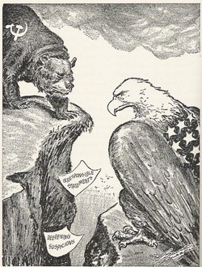
Western view of Iron curtain
Winston Churchill attacked the Soviet Union for creating an Iron Curtain
The term reflected Churchill’s belief that communism had created a sharp division in Europe
Harry S. Truman urged his secretary of state to get tough with the Soviets
Americans fought to bring democracy and economic opportunities to Europe

Slide 15
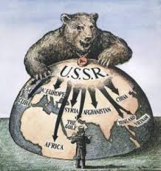
Soviet Views on Iron Curtain
Stalin believed that the Iron Curtain was necessary to protect the Soviet Union from western attacks
Justified-based on sound reasoning
Stalin used Churchill’s words to help persuade his people that the United States and Great Britain were their enemies
He also used this as an excuse to rebuild the military

Slide 16
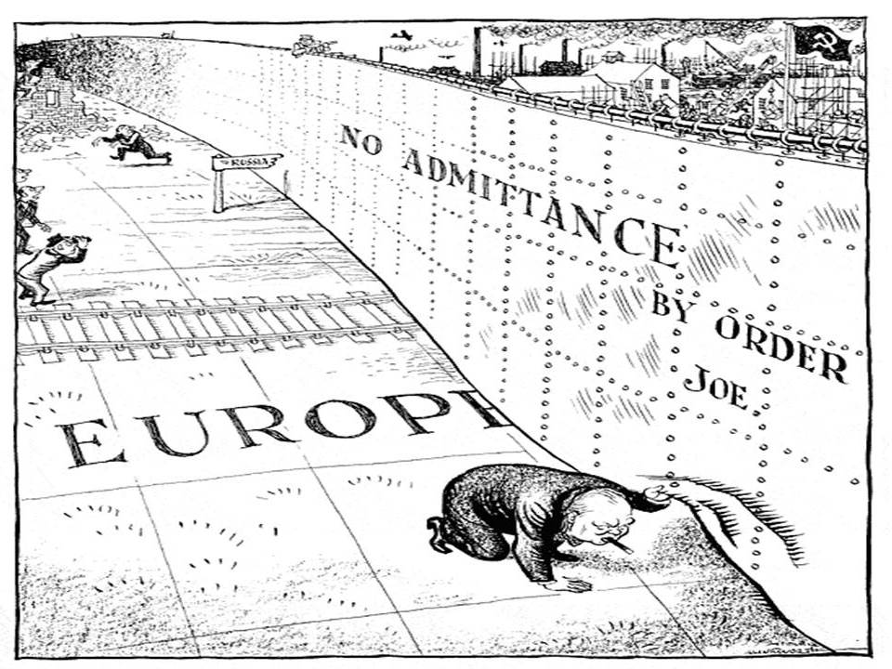

Slide 18
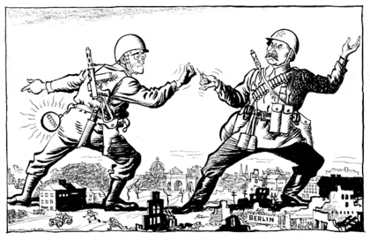
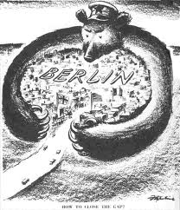
Crisis in berlin
With the start of the Cold War, it became clear that the Soviets planned to keep their German zone under Communist control
The British, Americans, and French began to take steps to set up a free, democratic government within their German zones
The western zone eventually became known as the Federal Republic of Germany, or West Germany
The British, Americans, and French also tried to set up a democratic government in West Berlin
The Soviets were not happy with the idea of a Western-style government and economy in the middle of the Soviet zone of occupation

Slide 21
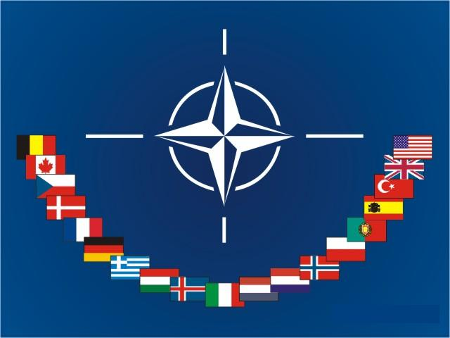
NATo???
What is NATO?
Homework, read article found on my weebly under Unit 5

