Slide 1
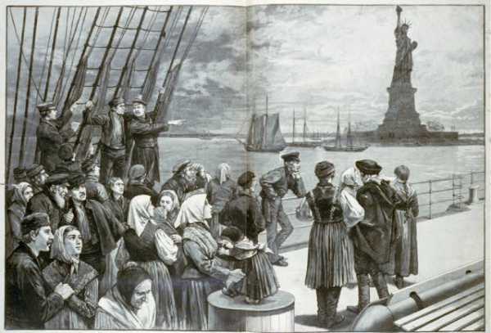
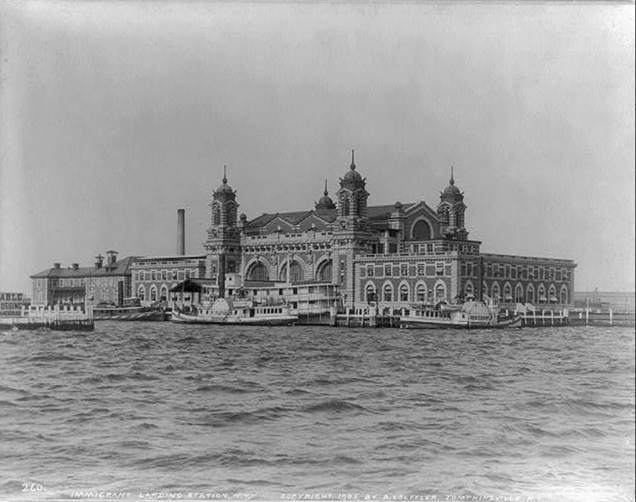
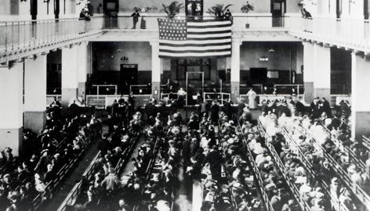
New Immigration and Urbanization
Livin the Dream

Slide 2
The New Immigrants
New Immigrants -Between 1870 and 1920-20 million Europeans-mostly from Southern and Eastern Europe came to America- (Jews/Catholics)
Hundreds of thousands more came from Mexico, Caribbean, and China
Looked and sounded different than natives
Nativism-Movement to ensure that native-born Americans received better treatment than immigrants
Russian Jews

Slide 3
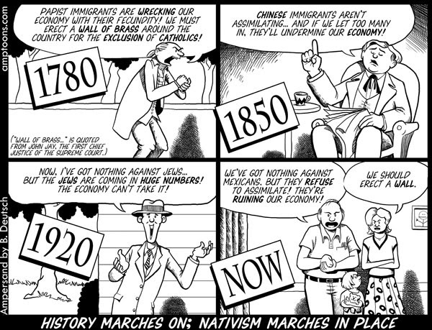
Nativism:

Slide 4
1888 Puck Magazine cartoon about American businessmen encouraging immigration for cheap labor which hurts Americans

Slide 5
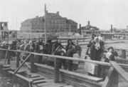
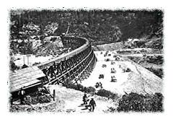
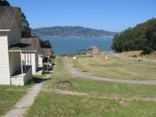
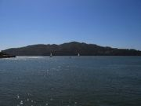
The New Immigrants
Ellis Island- In New York harbor where most European immigrants came to get processed
Angel Island- In San Francisco where most Asians entered US
Culture Shock
Melting Pot

Slide 6
The New Immigrants
1882-Chinese Exclusion Act- prohibited Chinese laborers from entering the country. Was not lifted until 1943.
Gentlemen’s Agreement 1907– was reached between U.S. and Japan in which Japan agreed to restrict immigration to the U.S.

Slide 8
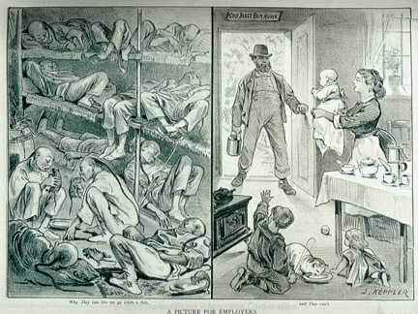
Political Cartoon depicting how Chinese immigrants workers lived and regular American workers lived. Rats, Yummy!

Slide 10
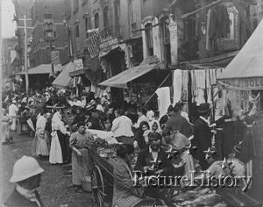
Problems of Rapid Urbanization
Urbanization- growth of cities
3 reasons cities grew in late 1800’s and early 1900’s
New immigrants arrived in cities for work
As farm machines replaced farmers they moved to cities
African Americans left South after Civil War and came to Northern cities.

Slide 11
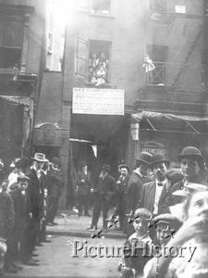
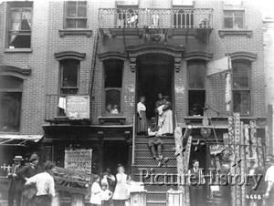
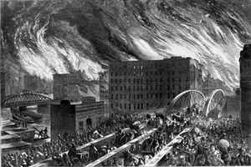
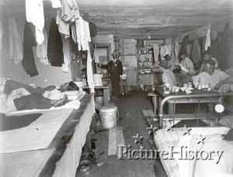
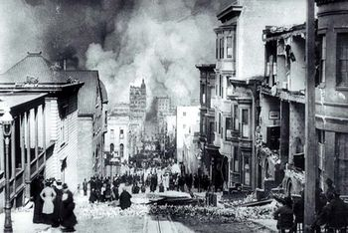
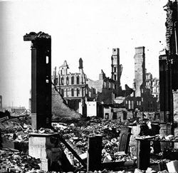
Problems in Cities
1. Housing shortages- Tenement – crowded apartment building with poor standards of sanitation, safety, and comfort
2. Transportation –struggled to keep up with growth
3. Clean water – was difficult to produce and transport
4. Waste and garbage removal was a challenge and often neglected
5. Fires were very common
Great Chicago Fire -1871
San Francisco Earthquake 1906
6. Crime rose with urbanization

Slide 12
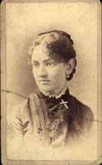
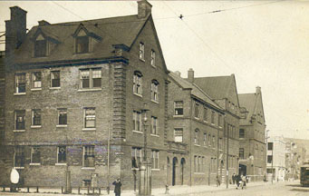
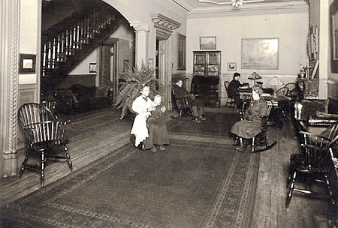
Early Reforms to fix problems of Urbanization
Settlement House –Community center organized to provide various services to urban poor
Hull House -1889 – most famous settlement house established by Jane Addams and Ellen Gates Starr
Social Gospel Movement –social reform movement that sought to fix social problems in the name of Jesus

