Slide 1
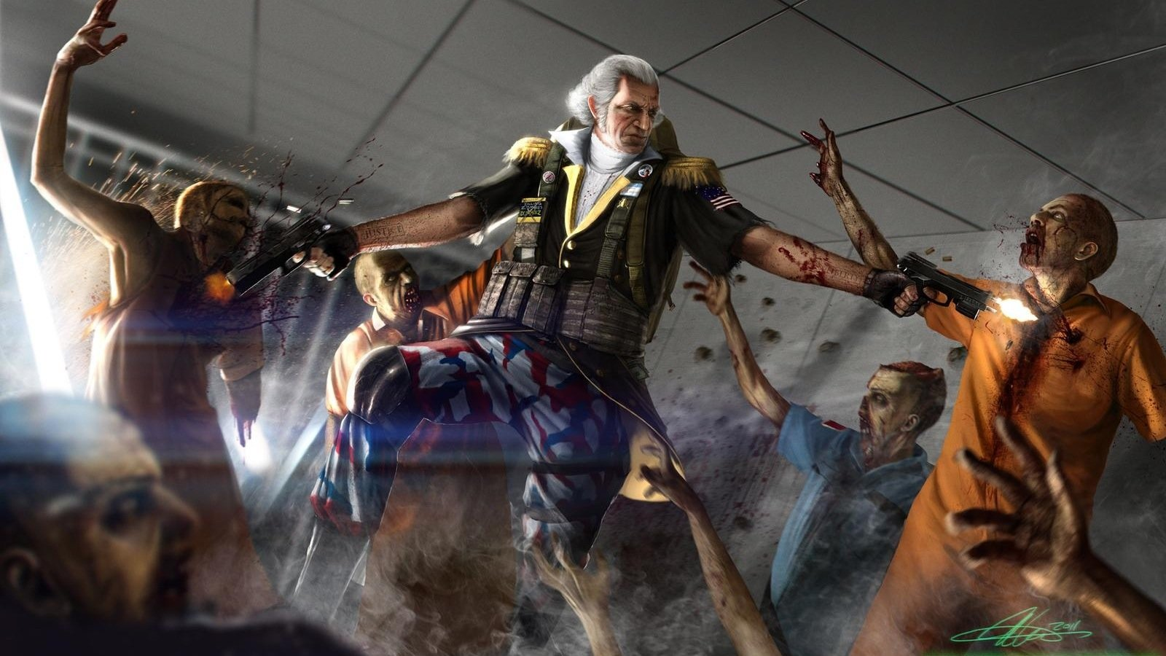
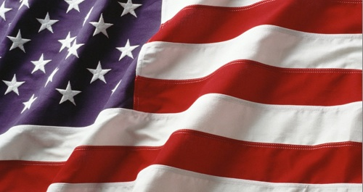
Meeting of the Minds
Take that, British Scum!

Slide 2
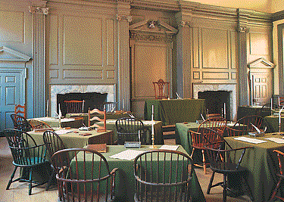
Continental Congress
First Continental Congress meets in Philadelphia
September 5th to October 26, 1774
1st Continental Congress~ Formed in response to intolerable acts.
~ Hoped to persuade Parliament to restore self-government in colonies & abandon direct supervision.
~Made up of 2 delegates from every colony except Georgia (they were hoping for help from the British from Native America attacks)

Slide 3
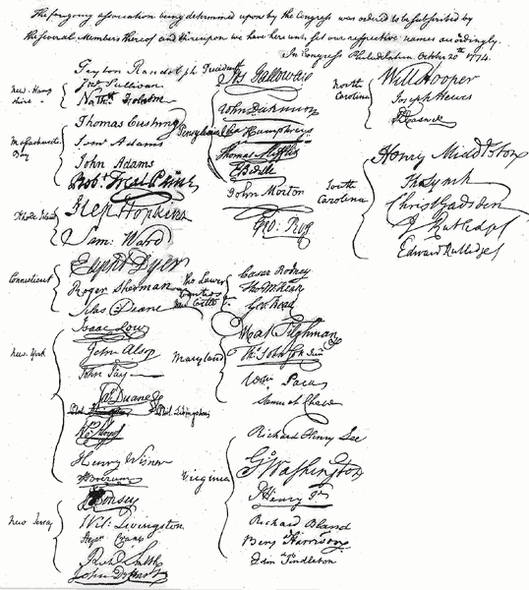
Some Members that Attended
George Washington (Virginia)
Patrick Henry (Virginia)
John Adams (Massachusetts)
Samuel Adams (Massachusetts)
Richard Caswell (North Carolina)
Joseph Hewes (North Carolina)
William Hooper (North Carolina)
Philip Livingston (New York)
William Livingston (New Jersey)
In all there were 56 men that attended.

Slide 4
Petition
Write to King George of England
Mention the problems with the Coercive Act (Intolerable Acts)
They want to stay loyal to the Crown
But…
King George never responds to the petition
So…
Second Continental Congress meets

Slide 5
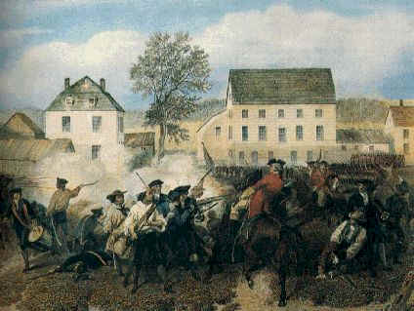
“Shot Heard Around the World”
~ April 1775
~ British General Gage heard about hidden weapons in Concord
~ Battle of Lexington & Concord
~ Minute Men

Slide 6
Second Continental Congress (May 1775)
Called Washington to head colonial army
While not a military genius (he lost more battles than he won), he was trusted implicitly by his soldiers
He refused to be paid, though his records indicate expenses of over $100,000
Shrewd political choice by Congress: Virginian, wealthy, aristocratic, above reproach

Slide 7
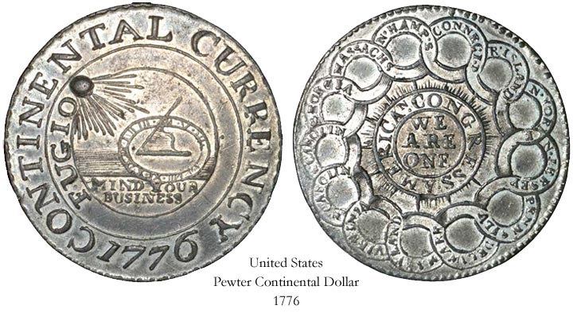
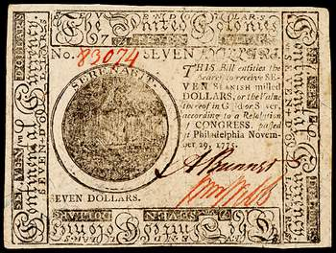
Other Congress Measures
Began printing paper $ to pay soldiers
Organized a committee to deal with foreign nations.

Slide 8
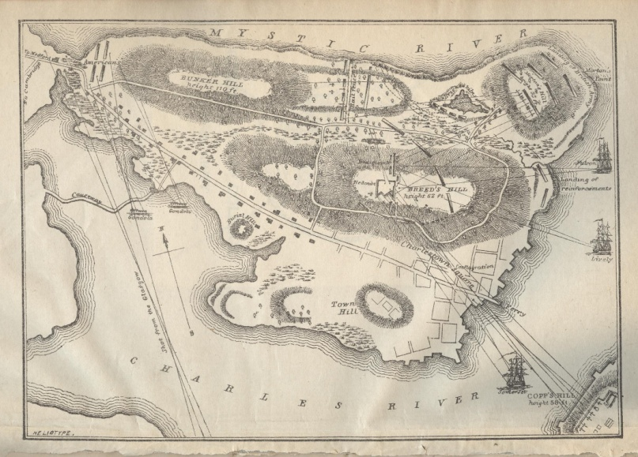
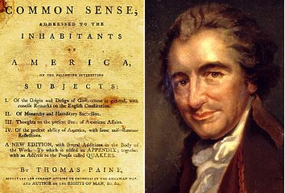
Happenings Elsewhere…
Following Bunker Hill (costly victory for British), King George III proclaimed colonies in rebellion and hired Hessians to crush rebels
Thomas Paine published Common Sense, a pamphlet selling 120,000 copies.
Appealed to natural law ("an island should not rule a continent")
King George was brutish and undeserving of colonials' respect
America had a moral obligation to the world to be independent and democratic

Slide 9
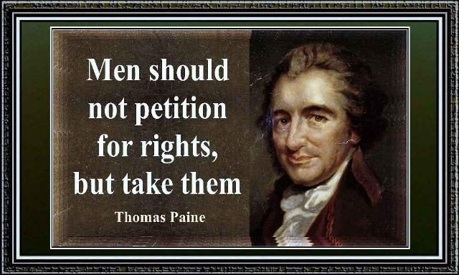

Slide 10
Declaration of Independence
Second Continental Congress declared independence July 2, 1776.
Jefferson headed the committee drafting the written statement. Arguments were based on John Locke's contract theory of government:
All people have natural rights ("Life, liberty, and the pursuit of happiness")
When a government abuses rights, the people have a right to "alter or abolish" it
King George has acted tyrannically. Long list of wrongs done by King to colonists.
The colonies are independent.
Declaration gave a clear position for rebellious colonists, forcing others to choose rebellion or declare as Loyalists (Tories).

Slide 11
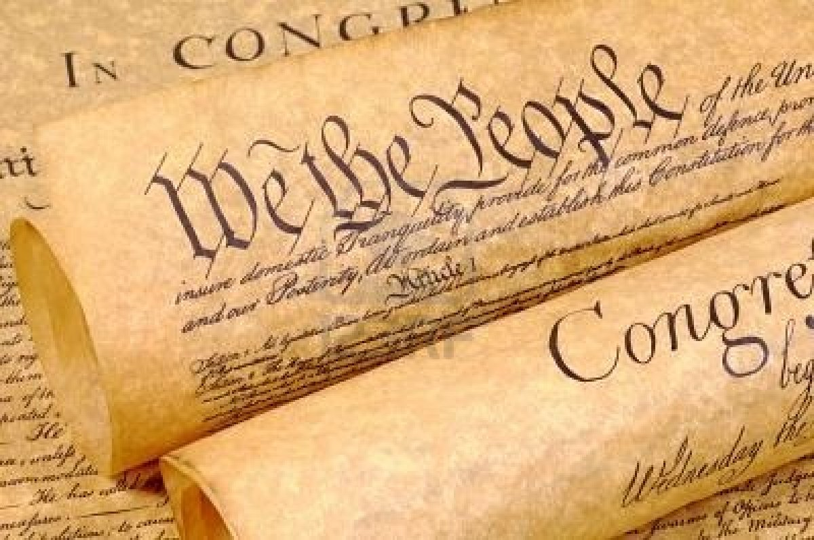
Declaration of Independence
declaration : (n)
an official statement
independence : (n)
the freedom to govern on one’s own.

Slide 12
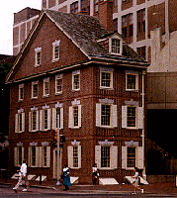
Declaration of Independence
This is a replica of the Graff house where Jefferson wrote the majority of the 1st draft of the Declaration of Independence. The original building (at this location) was destroyed in 1888.

Slide 14
Articles of Confederation
Created by the 2nd Continental Congress in 1777, but not approved by the states until 1781
Congress was dominant force, but it was weakened by rules
All bills required 2/3 vote for passage
Any amendment tot eh Articles required an unanimous vote
Each state had 1 vote regardless of its population or number of representatives in congress
No power to regulate commerce (trade)
No tax enforcement power (states paid taxes voluntarily)
The Congress was weak while the states remained strong politically

Slide 15
Treaty of Paris
American negotiators (Franklin, Jay, John Adams) sought to advance American interests in lengthy negotiations
Original demands were for independence, large territorial concessions (Franklin wanted all of Canada), and fishing rights in North Atlantic.
Americans feared the French and Spanish would bargain with British at the expense of the U.S.
Ignoring the instructions of Congress, they made a separate peace with the British before full negotiations took place.

Slide 16
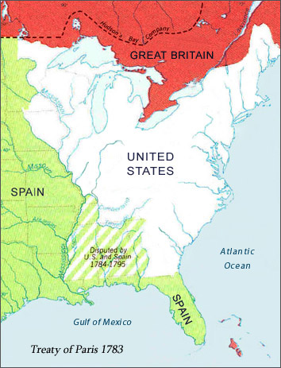
Treaty of Paris
Major provisions
Britain formally recognized independence of U.S.
Boundaries set from Great Lakes on the North to the Mississippi River on the West to Florida on the South. No access to the Gulf of Mexico
No further persecution of Loyalists and restitution for confiscated property "recommended" to states.
Fishing access for Americans in waters off East Canada
No reference to ending slave trade, an original goal of the Americans

Slide 17
Treaty of Paris
The follow through
British did recognize American Independence; however they gave little respect to the US. The same from Allies
We had no access to the Gulf of Mexico
British troops continued to occupy outposts and forts in the (old) Northwest Territory (Ohio Country)
Congress never gave any restitution to Loyalists, some 80,000 fled to Nova Scotia, Eastern Canada and England
Many states forbade slavery in their state constitutions but continued to thrive in the agricultural South. Eventually Britain would band slavery in its Empire

