Slide 1
Marvel vs DC =Happy America
Comic Nerds Roll Out…………….the money $$$

Slide 2
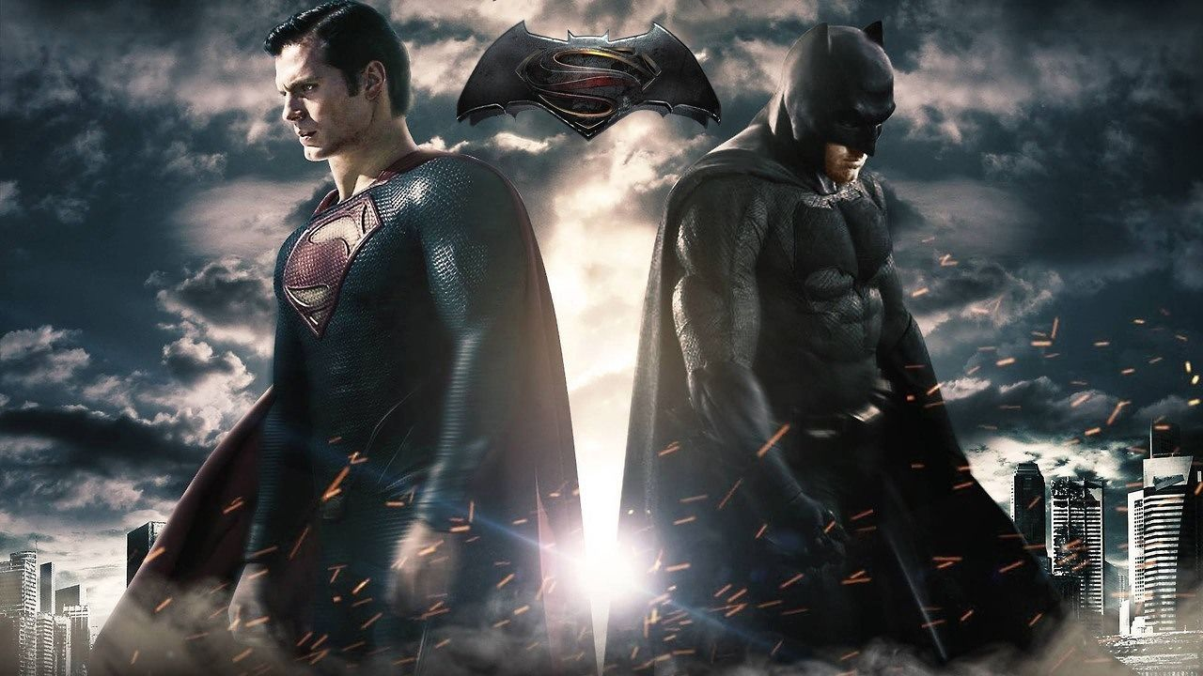
DC (Detective Comics)
1934: Started out as National Allied Publications
1937: Launched Detective Comics-issue #27 introduced the world to Batman
Shortly after: Action Comics introduces the world to Superman
~1960’s: the logo superman-DC is used…which eventually causes the company to become known as DC comics

Slide 3
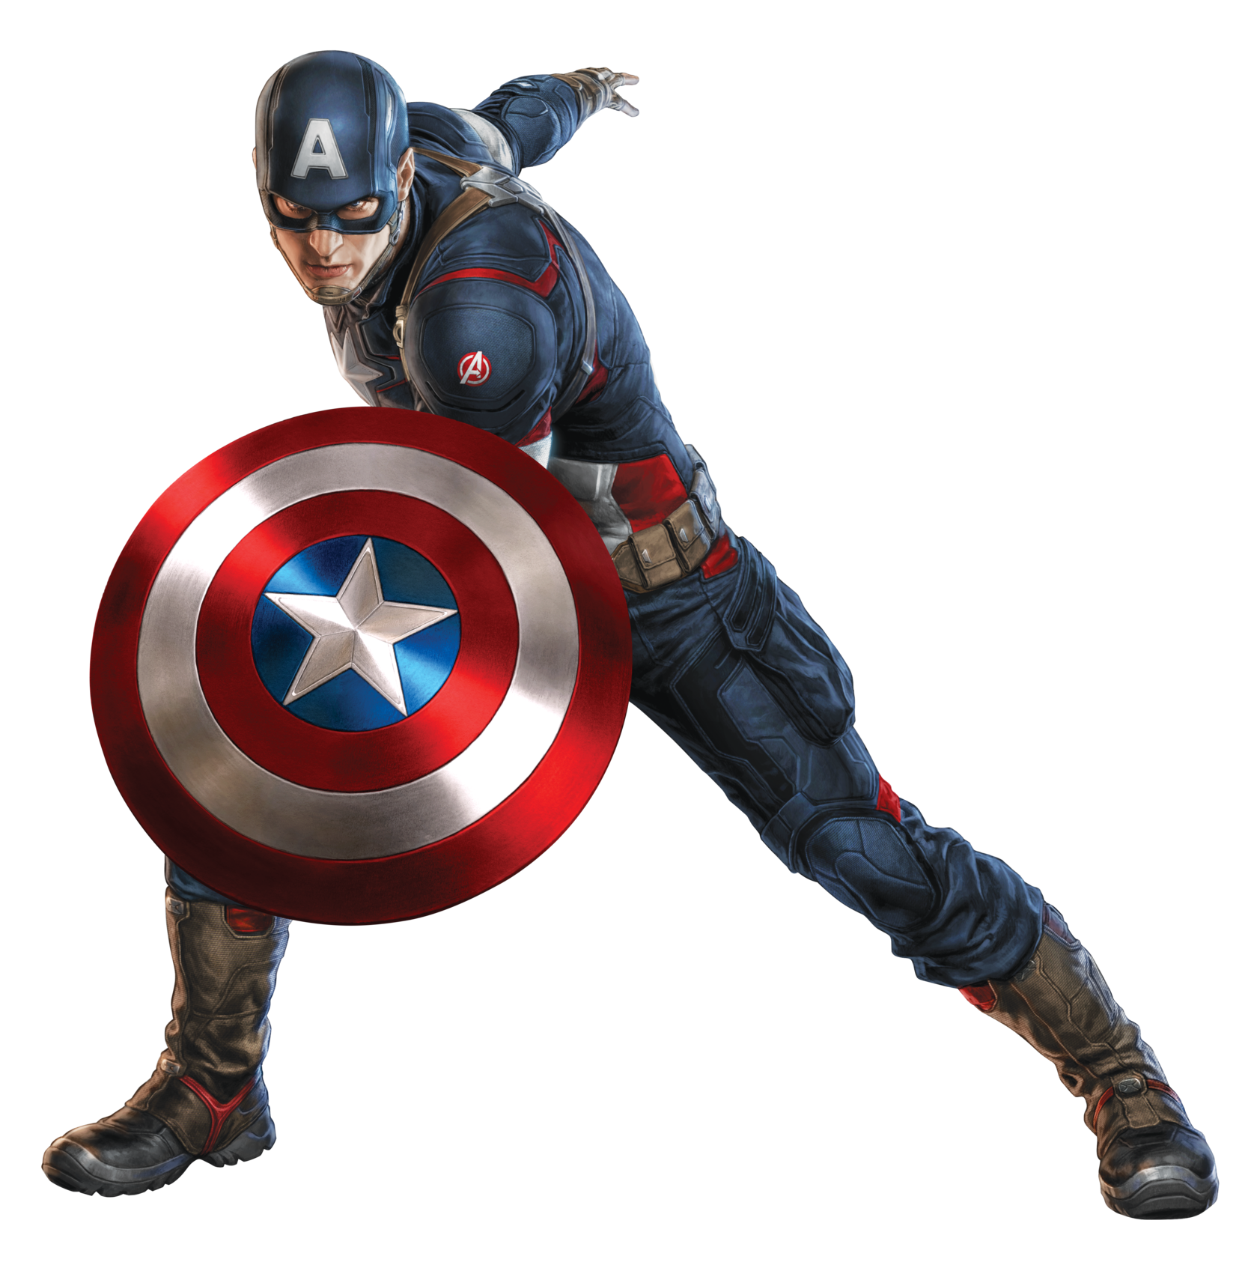
Marvel Comics
1939: Started out as Timely comics
Marvel Comics #1 introduces the human torch
1941: Captain America is introduced to the world
Stanley Lieber is hired-goes by the name Stan Lee
~1950’s: Became known as Atlas Comics
1961: Becomes known as Marvel Comics
Stan Lee along with Jack Kirby introduce the Fantastic Four and Amazing Spider Man

Slide 4
Major characters: Similarities
DC Characters First Appearance | Marvel Characters First Appearance
Justice League (1960) | Avengers (1963)
Batman (1939) | Iron Man (1963)
Superman (1938) | Thor/Captain America (1962)/(1941)
Zatanna (1964) | Scarlet Witch (1964)
Plastic Man (1941) | Mr. Fantastic (1961)
Catwoman (1940) | Black Cat (1979)
Green Arrow (1941) | Hawkeye (1964)
Flash (1940) | Quicksilver (1964)
Darkseid (1970) | Thanos (1973)

Slide 5
American Pop culture
DC strikes first-along with comics DC pushes their characters to the big and little screens
1953: The adventures of Superman starring George Reeves as Clark/superman
1966: Batman tv show airs starring Adam West as Bruce/Batman
1978: Superman the movie releases starring Christopher Reeves as Clark/superman
1980: Superman II
1983: Superman III
1987: Superman Iv the Quest for peace
1989: Batman the movie releases starring Michael Keaton as Bruce/Batman

Slide 6
Superman 1978

Slide 7
Batman 1989

Slide 8
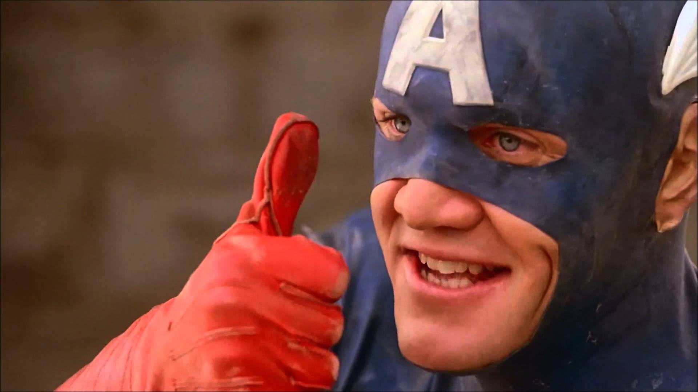
American Pop Culture Continued
Marvel hits back with its own shows and movies
1977-The amazing spider man tv show on cbs (only 14 episodes)
1977-The incredible Hulk tv show on cbs (83 episodes and 3 reunion tv films. Starred Lou ferrigno
1986-Howard the Duck Movie
1990-Captain American Movie
1994-Fantastic four movie (unreleased)
1998-Blade Movie
1998-Nick Fury: Agent of Shield
2000-X-men movie

Slide 9
Fantastic Four 1994

Slide 10
Captain America 1990

Slide 11
Today: $$$$
Thanks to movies like spider man, Iron man, the Avengers, Batman Begins, etc superheroes/comic books have impacted America greatly.
Boxoffice results:
Title | Lifetime Gross
Avengers | $623,357,910
The Dark Knight | $534,858,444
Age of Ultron | $459,005,868
Deadpool | $362,558,800

Slide 12
Today: Shows
DC: arrow, Flash, Supergirl, DC Legends of tomorrow
Marvel: Daredevil, Jessica Jones, Agents of Shield

Slide 13
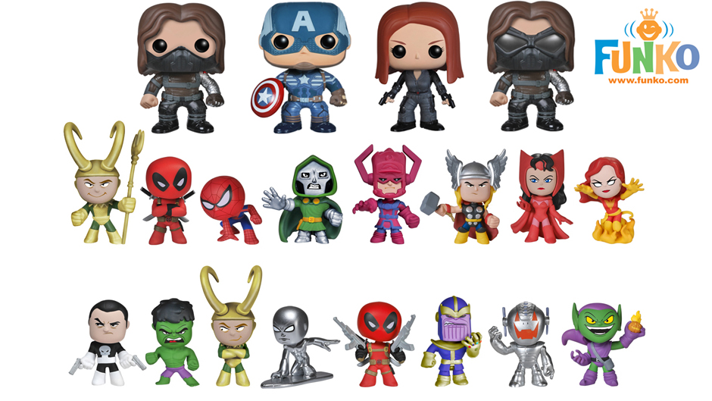
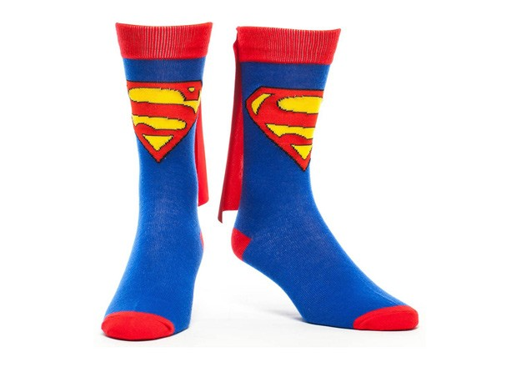
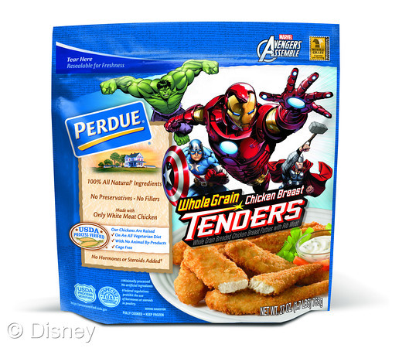
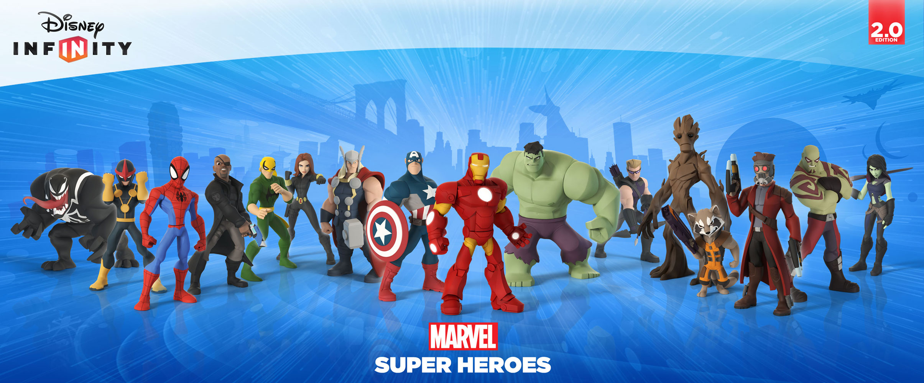
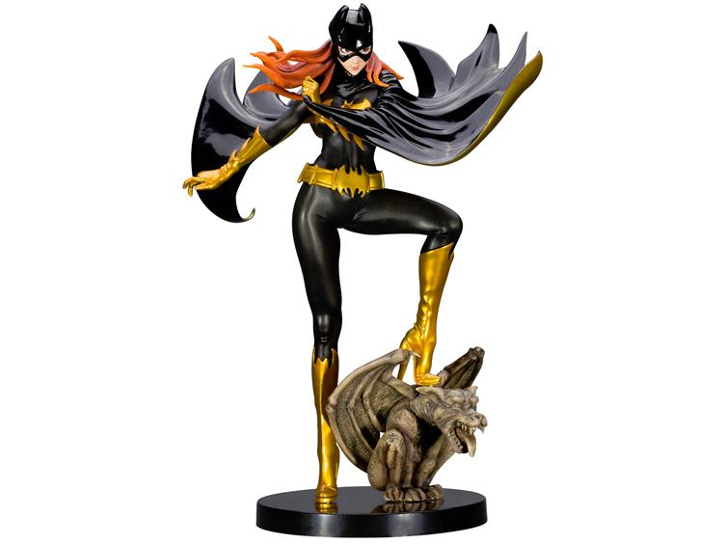
Consumerism=more$$$$$

Slide 14
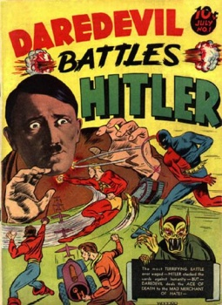
Your turn
With a partner: pick a superhero from either dc or marvel
Create a comic book cover depicting your character in an event from American history that we have studied from this whole year. Pick an event you like the most.
Be creative and have fun.

