Slide 1
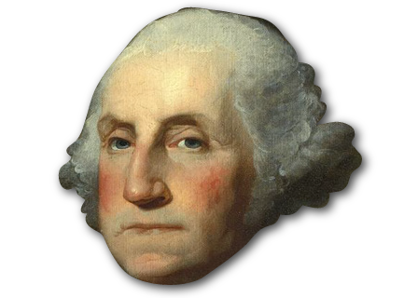
Famous Battles during the American Revolution
Just the Basics…

Slide 2
Siege of Ticonderoga May 10th, 1775
Located near the Canadian Line, good distance to plan attack on Boston and the British in Canada
Lead by Ethan Allen and Benedict Arnold (Green Mountain boys-militia)
Surprise attack, crossed Lake Champlain that morning while British were still sleeping.
Provided cannons, guns, ammunition.

Slide 3
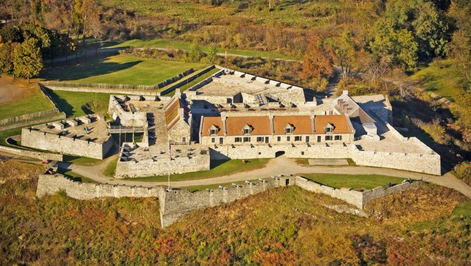
Fort Ticonderoga (First official victory)

Slide 4
Battle of Saratoga (Freeman’s Farm and Bemis Heights) Sept. 19th-Oct. 7th, 1777
British lead by Burgoyne swept in and recaptured Fort Ticonderoga
Trying to finish off the colonists in New York
Freeman’s Farm (due to lack of cooperation) the Colonists lost the battle but had taken out double the amount of British troops
Bemis Heights (second battle at Saratoga): Burgoyne had waited for reinforcements and supplies-never came…was defeated by Benedict Arnold and the Colonist.
Burgoyne surrendered
Important because the French supported the colonists afterwards

Slide 5
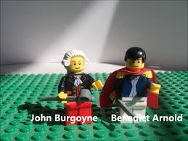
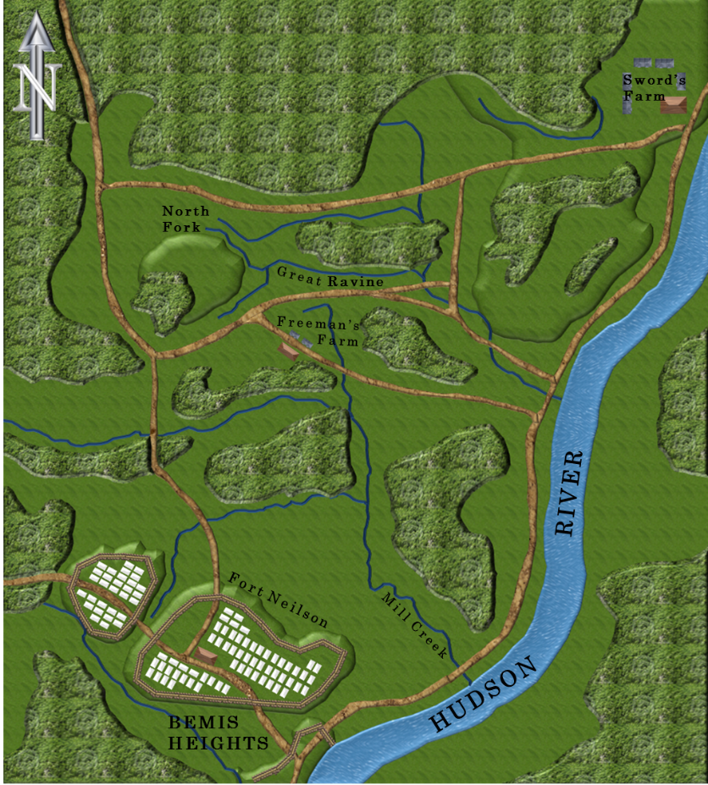
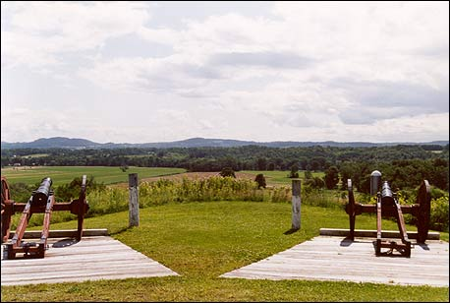
Battle of Saratoga

Slide 6
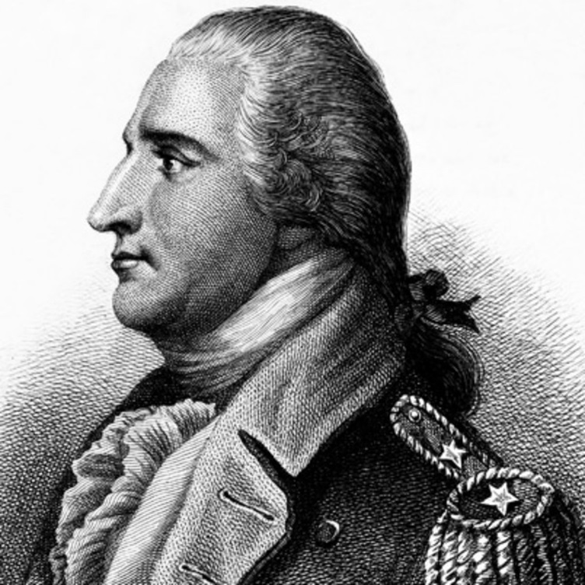
Who is Benedict Arnold???
One word: Traitor
Had an outing with George Washington, did not like his command later.
Many different reasons…
He decides to betray his countrymen.
Becomes a Loyalists and fights for the British

Slide 7
Battle of Trenton Dec. 26th, 1776
Darkest hours for the Colonists in the American Revolution, General Howe had taken over Manhattan and most of New York…forcing the colonial army south into New Jersey
Christmas Day, 1776 Washington crosses over the Delaware River
Dec. 26th, attacks Hessians lead by Johann Rall, who was fatally wounded…with the surprise attack Washington’s troops win victory having killed only 22 Hessians, wounding 92, and capturing 918 soldiers.
Charles Cornwallis tries to trap Washington at Trenton…
Being unable to get to Trenton, Cornwallis stations his men right outside the town. Washington has his men light camp fires well at the same time escaping to the North towards Princeton, which he takes on Jan. 3, 1777.

Slide 8
Battle of Trenton

Slide 9
Battle of Guilford Courthouse March 15th, 1781
Charles Cornwallis in hopes of taking the southern colonies had moved his men south (after the French start helping in the North)
The south had more loyalists, hoping to gain more support so latter British could take the North
Worked in that the British had taken Savanah, Georgia, and Charleston, SC.
Major victory at King’s Mountain for the Colonist…moved Cornwallis to Guildford county.
Colonists lead by Nathaneal Greene took out most of Cornwallis’ men and supplies making him retreat from taking the Carolinas-however colonist lost this battle due to the colonist retreating.
This forces Cornwallis to head to Virginia in hopes of getting more reinforcements.

Slide 10
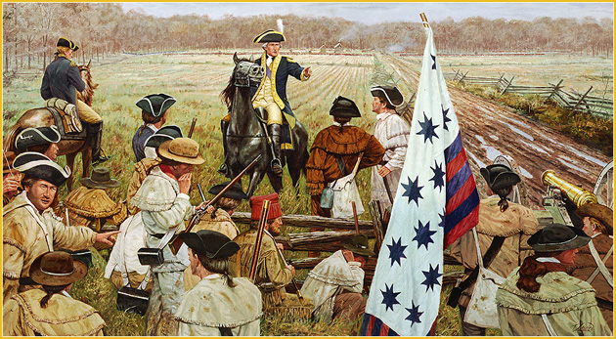
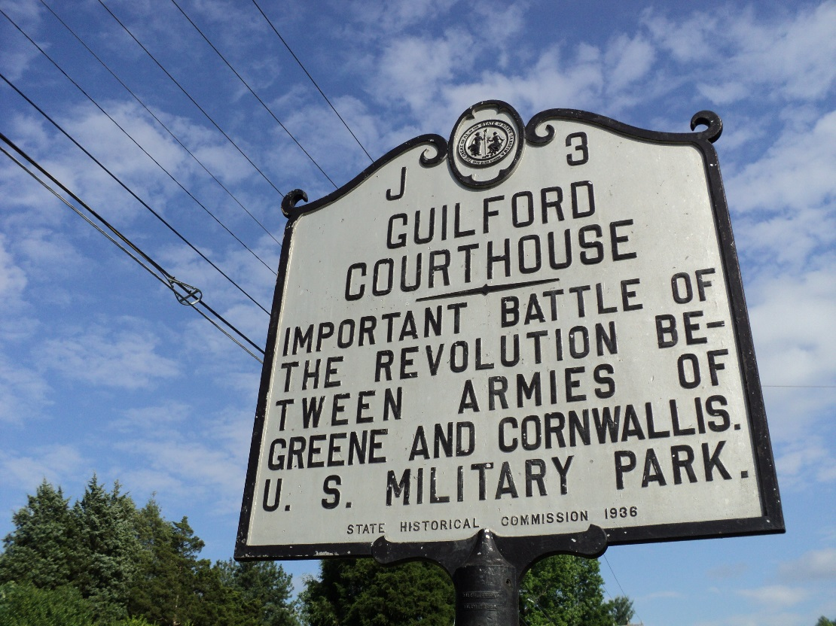
Battle of Guilford Courthouse

Slide 11
Battle of Yorktown Sept. 28th,-October 17th, 1781
Cornwallis had moved into Yorktown, Virginia in hopes of getting more supplies and men.
Surrounded by Colonists lead by Washington and Lafayette by land and French at Sea.
Cannon fire continued both day and night until Cornwallis surrendered.
Oct 19th, Cornwallis had second in command General Charles O’Hara deliver his sword to Washington…
Fighting still continued at sea but the War was over.

Slide 12
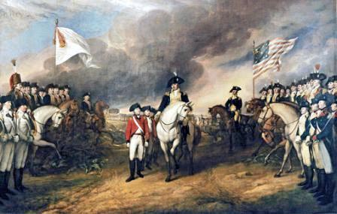
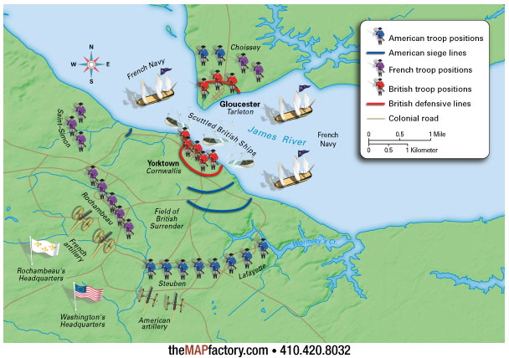
Battle of Yorktown

Slide 13
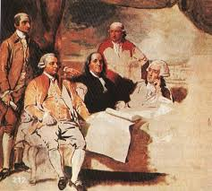
Treaty of Paris 1783
September 3rd, 1783 the Treaty of Paris was signed, recognizing the United States as an independent nation.
Supposedly the portrait was never
finished because the British wouldn’t
pose.

