Slide 1
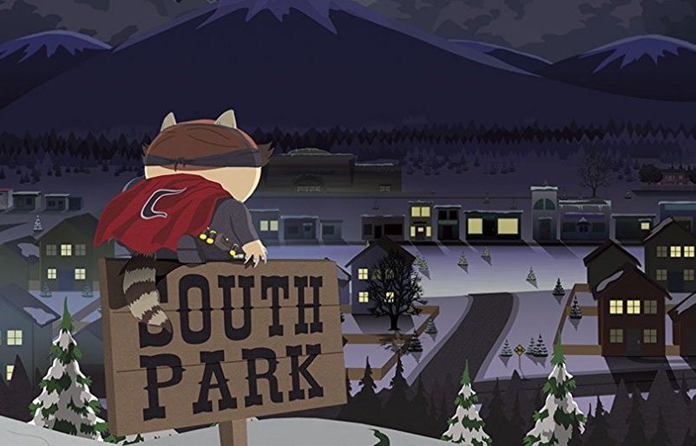
Assemble

Slide 2
Well…ok so we are not the Freedom Pals, so….
Students in American History Assemble...for some awesome instruction.

Slide 3
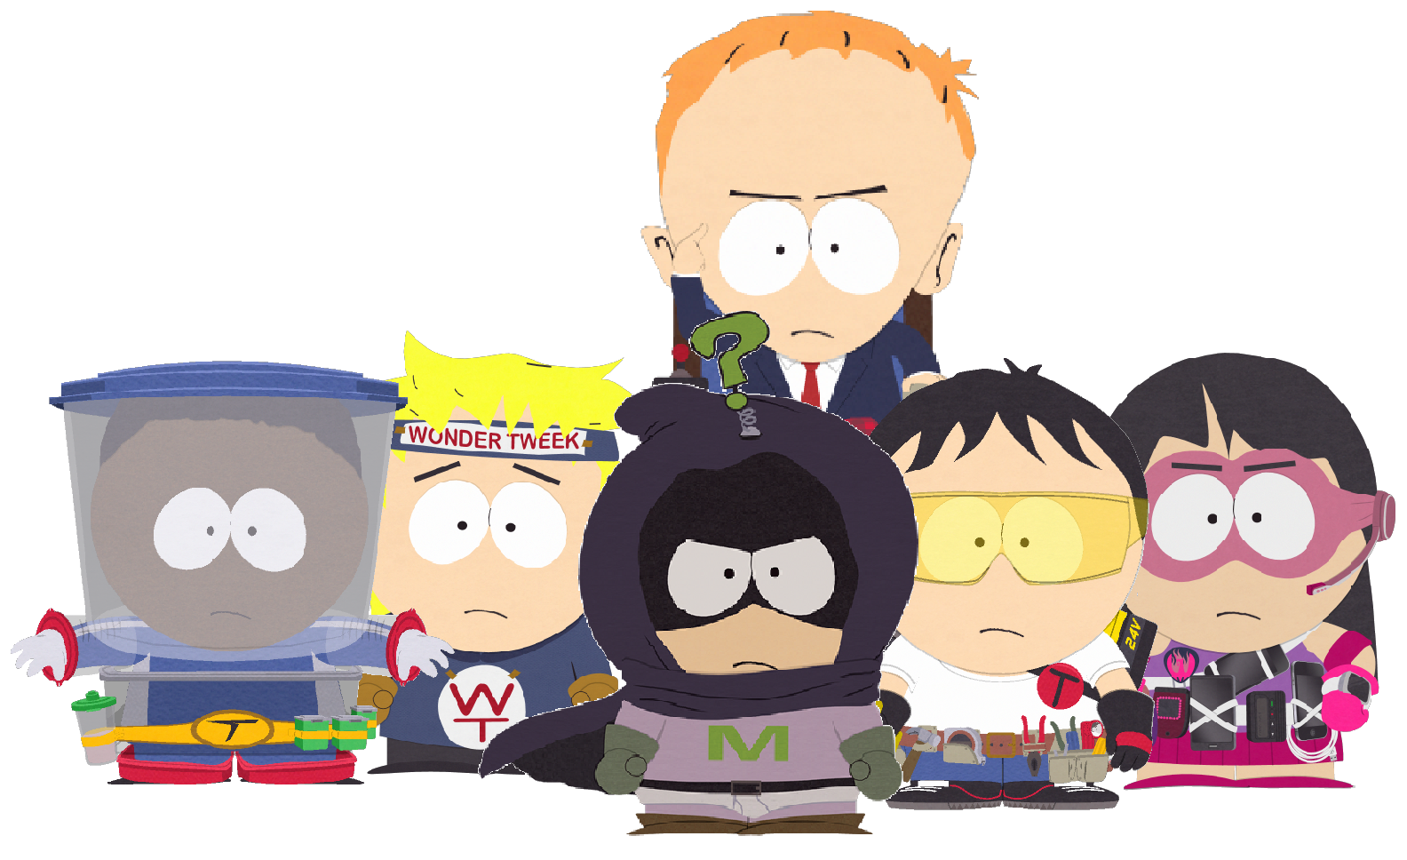

Slide 4
Era of Good Feelings
As you can recall from your field training history seems to always repeat itself. So to help us defend and prepare for the future your mission is to assemble a team of reliable agents (Four groups) to research into the time period in America known as the Era of Good Feelings.
You will receive a packet of Primary Documentation. As a team try to figure out what the documentation is on. Once that has happened contact Director Byers for further instruction.
Also you only have 30 minutes per packet. Good luck.

