Slide 1
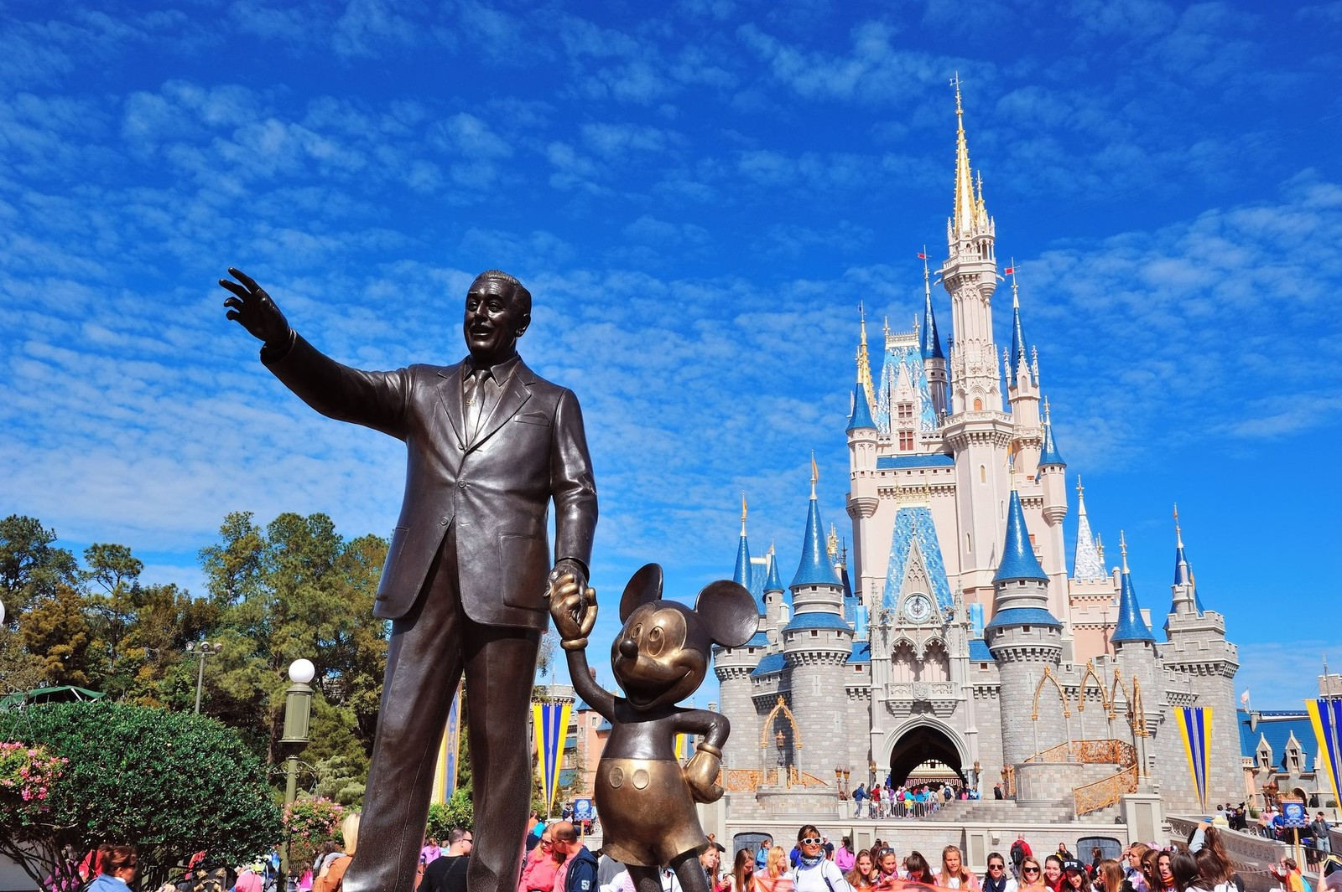
Wilkes Early College’s
Disney Club

Slide 2
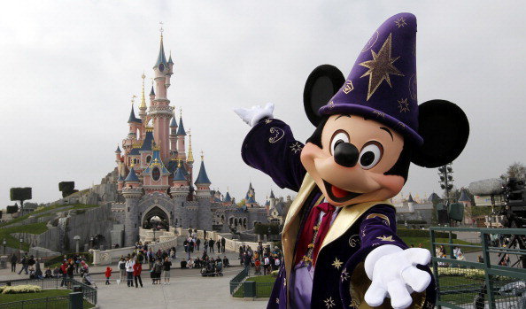
Here are the 5 tenets of the Disney Club:

Slide 3
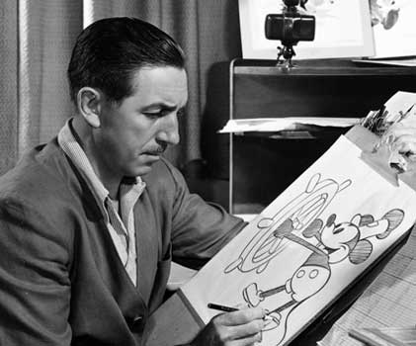
1: Do what you Love (as long as it is legal)
-Life is to short to be miserable.

Slide 4

2: Take what you do Seriously
-Pay attention to the world around you, to the little details
-Don’t take things for granted

Slide 5
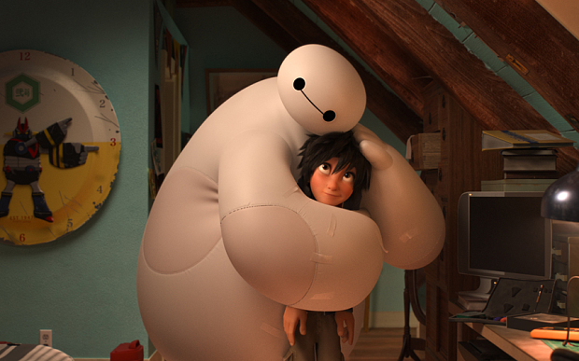
3: Do it for others
-Share, value love of family and friends
-hope for the good

Slide 6

4: Never just Settle
-want to achieve more and grow with your dreams

Slide 7

5: Don’t let obstacles stop you
-be patient
-persevere

Slide 8

Last but not least:
Disney’s famous quotes

Slide 9

All your dreams can come true, if we have the courage to pursue them.

Slide 10

Why worry? If you’ve done the very best you can, worrying won’t make it any better.

Slide 11

Crowded classrooms and half-day sessions are a tragic waste of our greatest national resource-the minds of our children.

Slide 12

That’s the real trouble with the world. Too many people grow up.

Slide 13

First, think. Second, believe. Third, dream. And finally, dare.

Slide 14

The way to get started is to quit talking and begin doing.

