Slide 1
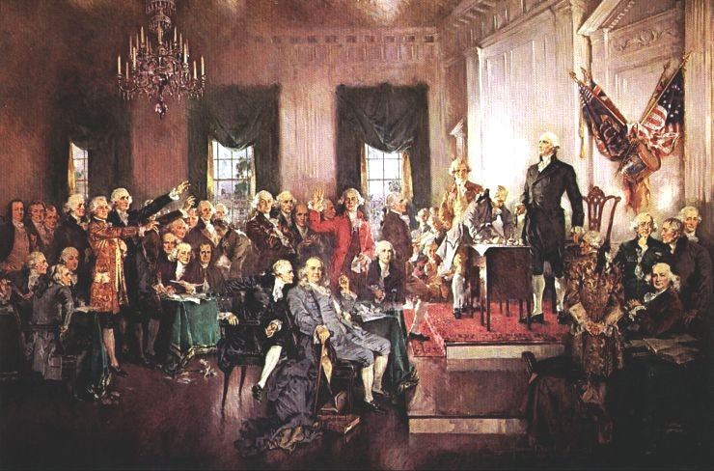
Constitutional Convention

Slide 2
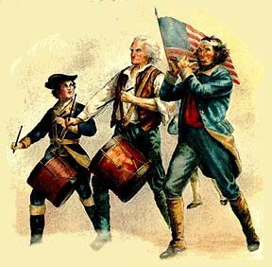
Events and Economic conditions after the Revolutionary War
Economic depression
No states south of Pennsylvania abolished slavery
Shay’s Rebellion

Slide 3
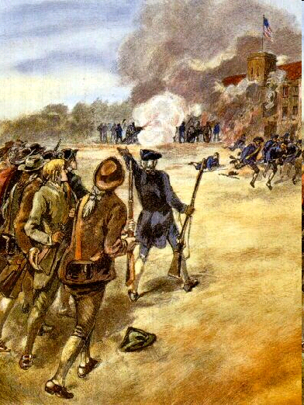
Shays’ Rebellion
Started in 1786
Hard taxes to pay off the States war debt made Massachusetts farmers rebel.
Led by Daniel Shay
Created panic
This made many people feel that a strong government was needed to control such violent acts

Slide 4
The Constitutional Convention
Where?
53 delegates met in absolute secrecy in Philadelphia in Independence hall
30 delegates attended every day
When?
Summer of 1787
The Purpose?
The goal was to revise the Articles of Confederation
It was quickly decided to replace it

Slide 5
Key people and their contributions to the Constitutional Convention
George Washington
President of Convention
May 25 and present through signing
Supported ratifying the Constitution
Ben Franklin
Arrived May 28 and present through signing
Attendant of Pennsylvania
James Madison
Arrived may 25 through signing of Constitution
Writing Virginia Plan
Kept notes on Constitution that public would see
Alexander Hamilton
Presented through signing May 25
Introduction and defense of the Hamilton Plan-June 18, 1787
Secretary of Treasury
John Jay
Governor of New York
Leader of Federalist Party
Chief Justice of Supreme Court
Abolitionist
Did not attend the Convention

Slide 6
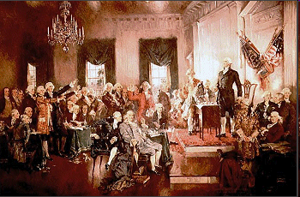
Key people and their contributions to the Constitutional Convention
Thomas Paine
Founding Father of the United States
Secretary of Foreign Affairs
Patrick Henry
Anti-Federalist
Opposed replacement of Articles of Confederation (endangered individual freedom)

Slide 7

Constitutional
Compromises

Slide 8
Problem 1
Representation in Congress

Slide 9
Large states wanted representation based on population.
"Virginia Plan"

Slide 10
Small states wanted equal representation no matter the population.
"New Jersey Plan"

Slide 11
Connecticut Plan
Or
The Great Compromise

Slide 12
Solution
Two Houses
1. One based on population – “House of Representatives”
2. One based on equal representation – “Senate”

Slide 13
Problem 2
How to count slaves in state’s population

Slide 14
Southern States want to count their slaves as part of their population.

Slide 15
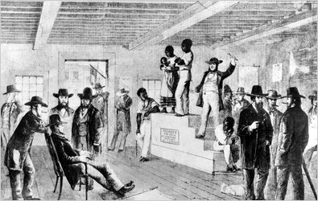
Northern States did not want to count slaves in order to keep control of Congress.

Slide 16
Solution
Three-Fifths Compromise
Each slave would count as 3/5’s of other persons.

Slide 17
Problem 3
Slave Trade

Slide 18

Northern States wanted Congress to have the power to control trade with other countries.

Slide 19
Southern States were afraid that Congress would stop the slave trade.

Slide 20
Solution
“Commerce and Slave Trade Compromise”
Congress can control trade and tax imports but will leave slave trade alone for 20 years.

Slide 21
Problem 4
How to elect a President

Slide 22

Some felt that Congress should elect the President.
The average person does not know enough to elect a President.

Slide 23

Others felt that the citizens should elect the President.

Slide 24
Solution
“Electoral College”
Citizens would vote for electors and the electors would elect the President

Slide 25
Problem 5
National Government Becoming too Powerful

Slide 26
Anti-Federalists afraid states would lose power and people would lose rights.

Slide 27
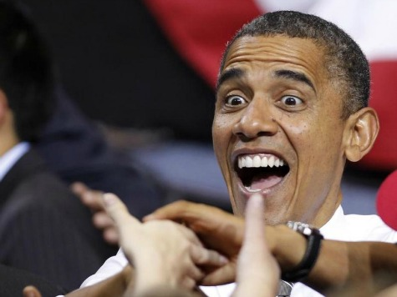
Federalists felt a strong national government was the only way to survive.

Slide 28
Solution
Assembly
Religion
Bill of Rights
Speech
Petition
Press

Slide 29
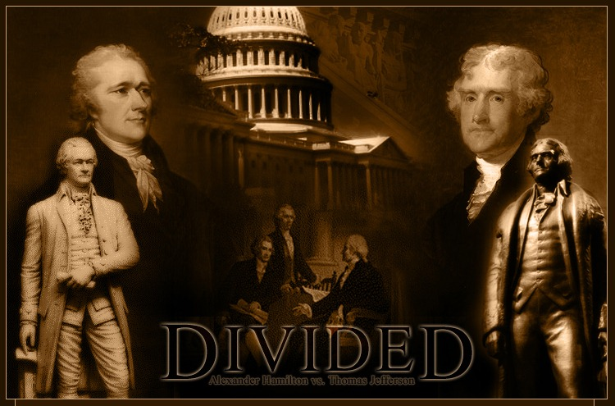

Federalist vs. Anti-Federalist

Slide 30
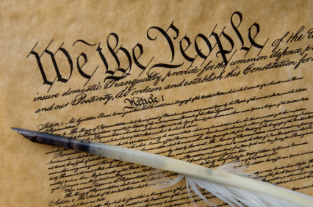
Enter the Constitution
At the Constitutional Convention, representatives from each state (except Rhode Island) begin to write a list of rules to replace the weak Articles of Confederation
Most delegates want a strong national government
However, they also wanted to have strong local governments
After much debate, the Constitution was finally signed in September 1787
It was then sent to the states to be approved
        But the story doesn’t end there…

Slide 31

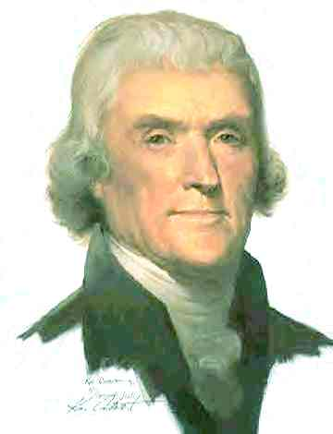
Enter the Anti-Federalists
Some framers thought the Constitution gave the government too much power
They argued that states should have more power because they were closer to the people…what could a national government possibly know about state and city problems?
Also, there was no Bill of Rights – nothing that said what people can and cannot do
Those opposed set out to campaign against the Constitution, arguing that it would create a government with so much power, it would just be like having a king again.

Slide 32
So…Do You Agree?
What do you think…
  Is the national government too big?
  Do we really need a Bill of Rights?
  What’s better for the people – a strong national government or a strong state government?
  At this point…would you vote to approve the Constitution as it is?
        You have to wonder what the other side thinks…

Slide 33
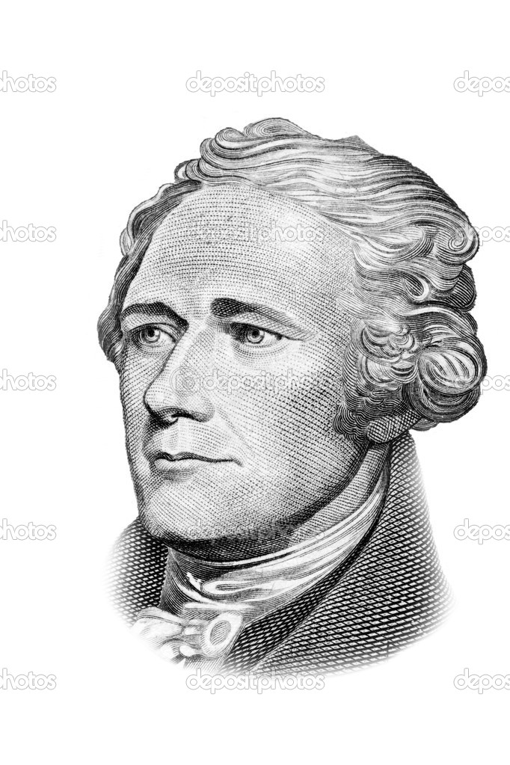
Enter the Federalists
The Federalists supported the Constitution as it was. After all, it was decided upon by representatives from each state
The Constitution had a strong sense of CHECKS AND BALANCES, or a balance of power between the three branches of the national government and the local and state governments
The Federalists wrote the “Federalist Papers” to encourage states to approve the Constitution

Slide 34
So…Do You Agree?
What do you think…
  Does the national government work fine the way it is?
  Do we really need a Bill of Rights if everything is so well done in the Constitution?
  At this point…would you vote to approve the Constitution as it is?
        Wonder what happens next…

Slide 35

Enter the “Fight”
The Constitution needed 9 of the 13 states to approve it in order for it to become law
Both sides (the Federalists and the Anti-Federalists) tried to convince people their side was correct…both writing papers, The Federalist and Anti-Federalist papers
After great debate, the states finally ratified the Constitution…only if there was a Bill of Rights

Slide 36
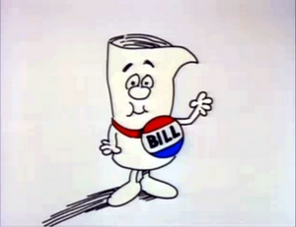
Enter the Bill of Rights
While Federalists didn’t think it was really necessary, they agreed to add a Bill of Rights so that both sides would be happy
The rights would be added as amendments…meaning they were seen as “official changes, corrections, or additions”
The Bill of Rights were based upon the constitutions developed by the states
There were a total of ten amendments added…and they became known as “The Bill of Rights”
    Now let’s debrief all of this…

Slide 37
Who Was Right?
Which side had the best argument…the Federalists or the Anti-Federalists?
Why?
Does the Constitution really need a Bill of Rights? Why or why not?
If you were alive back in 1787, how would you vote?

Slide 38

Constitution
June 21, 1788, New Hampshire becomes the ninth state to ratify.
Ratified

Slide 39
We Have a Constitution.

Slide 40


Assignment
In partners, create two posters on publisher. One poster create an advertisement for the Federalist position. The other poster create an advertisement for the Anti-Federalist position. You must include at least two arguments made by each side along with pictures that are relevant.
My partner won’t work!
Get to Work!!!

