Slide 1
Social Studies Through Conceptual Lenses

Slide 2
5 Lenses
Below are the following lenses that we will use as we go through history together:
The Historian
The Geographer
The Economist
The Political Scientist/Government Official
The Cultural Anthropologist

Slide 3
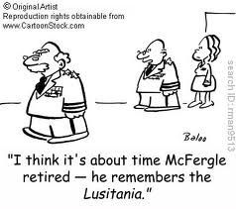
The Historian

Slide 4
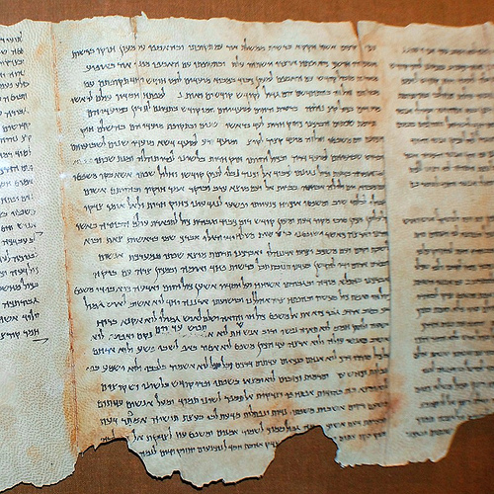
Historians
Examine written records to understand the past.
Students should be able to :
Think chronologically.
Understand historical events.
Analyze historical documents.
Conduct historical research.

Slide 5
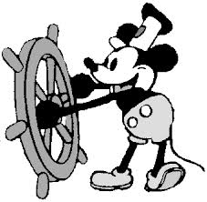
The Historian
Some possible questions the historian might ask:
What are the causes and effects of the situation or phenomena being considered?
How might past events have affected the present situation?
How might present decisions affect future outcomes?
Has this type of thing or situation occurred before? If yes, then what did people learn?
What types of relationships might be developed?

Slide 6
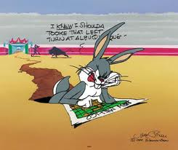
The Geographer

Slide 7
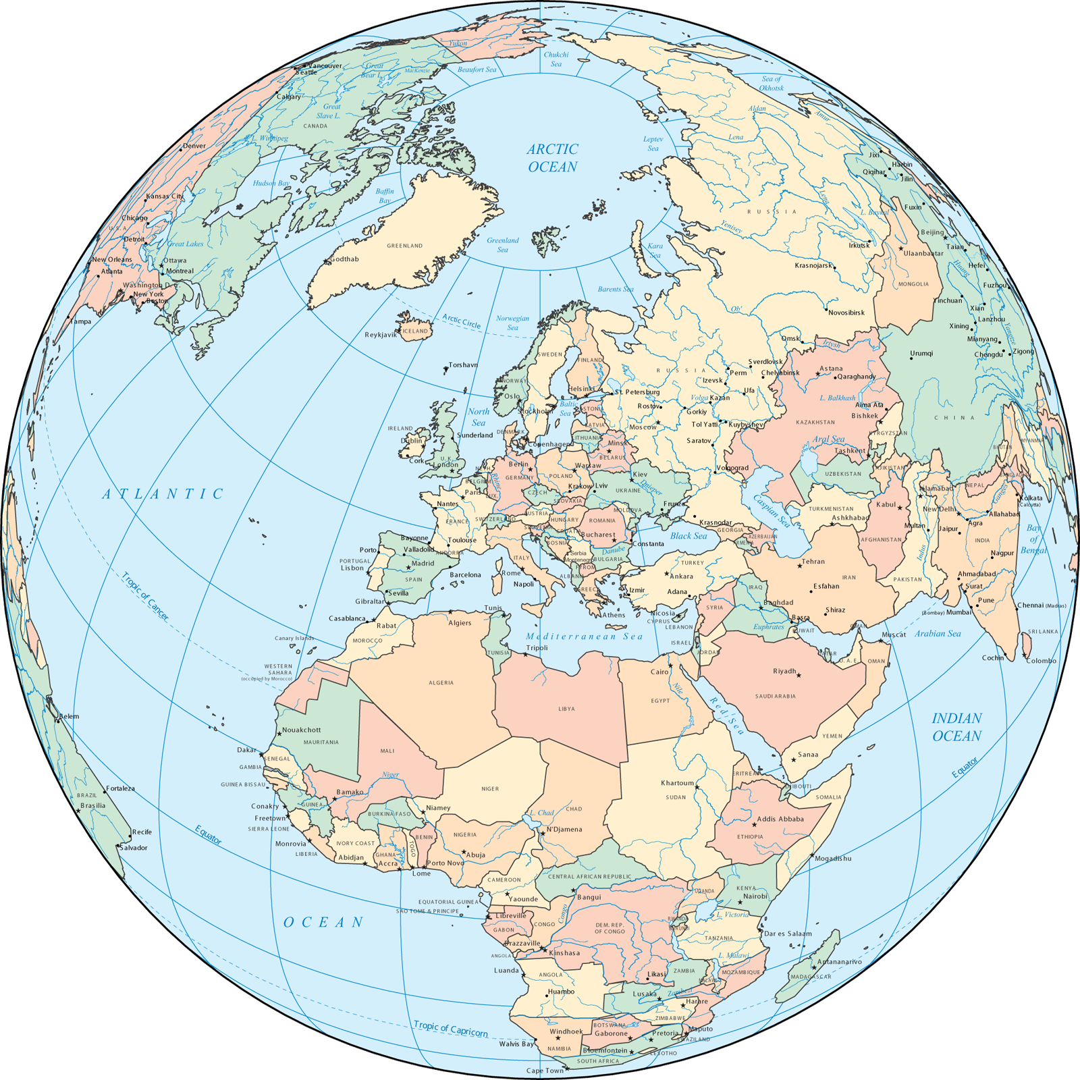
Geographers
Examine the Earth’s physical environment and habitat.
Students should be able to:
Understand the world in spatial terms.
Identify physical and human systems.
Analyze the impact of Human-Environment interaction.

Slide 8
The Geographer
Some possible questions the geographer might ask:
What is important or critical about the geographic characteristics and features of a location?
Might the decisions and actions that occur in one location or region in some way affect another location or region? How?
Will changes the environment have any implications on the culture, economics or politics of a place?

Slide 9
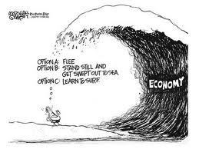
The Economist

Slide 10
Economists
Analyze , interpret, and predict future trends in the economy.
Students should be able to :
Understand the concepts of economics.
Analyze domestic and international economic trends.
Practice personal finance literacy skills.

Slide 11
The Economist
Some possible questions the economist might ask:
What are the benefits/costs that might come from any decisions made?
What can be gained?
What type of advantage will be acquired by any decisions made?
What type of economic system might the dominant power want to put in place? Why?
What types of relationships might be developed?

Slide 12
Quantitative analysis – the examination of measurable and verifiable data such as earnings, revenue, population, movement, trade, etc. Quantitative analysis is used to explore such topics as migration patterns, changes in the economy, wealth distribution, changes in family size and composition, etc.

Slide 13
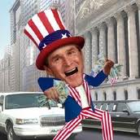
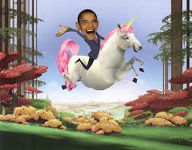
The Political Scientist/Government Official

Slide 14
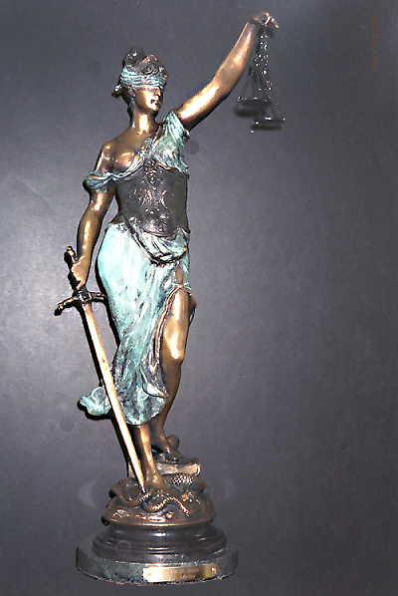
Political Scientists
Examine politics, governments, and the political process.
Students should be able to:
Understand the foundations of America’s political system.
Analyze international affairs.
Participate in civic life and government activity.

Slide 15
The Political Scientist/Government Official
Some possible questions the political scientist or government official might ask:
What are the political advantages for the decision being made?
What laws or rules will need to be in place?
How do you provide protection? Is it needed? Why or why not?
How might the dominant power utilize its authority or that of the sub-ordinate player(s)?
What types of relationships might be developed?

Slide 16
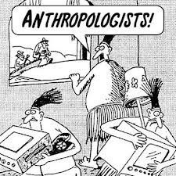
The Cultural Anthropologist

Slide 17
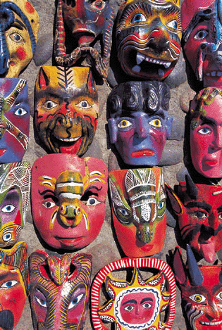
Cultural Anthropologists
Examine humans, past and present.
Students should be able to:
Interpret social practice across cultures.
Understand how people’s behaviors change over time.
Investigate artifacts.
Research through observation.

Slide 18
The Cultural Anthropologist
Some possible questions the cultural anthropologist might ask:
What are the benefits/costs to economic, political and/or geographic interaction?
How might culture change, positively or negatively? How might the society change, positively or negatively?
What types of relationships might be developed or destroyed?

Slide 19
Qualitative analysis – the examination of non-measurable data such as reputation, image, feelings, believes, values, etc. Qualitative analysis is used to explore such topics as a person or group’s feelings about a government or judicial decision, a president’s image or the beliefs about reasons justifying war, etc.

