Slide 1
CIVIL RIGHTS MOVEMENT

Slide 2
IN THE BEGINNING…
1857- Dred Scott Decision
African American people are "so far inferior...that they had no rights which the white man was bound to respect.”
1868- 14th Amendment
1870- 15th Amendment
1870- First Jim Crow Laws
1875- Civil Rights Act
1896- Plessy .V. Ferguson
Separate but Equal

Slide 3
1900-1953
Lynching take hold in the deep South
1886 and 1900, there are more than 2,500 lynchings in the nation, the vast majority in the Deep South. In the first year of the new century, more than 100 African Americans are lynched, and by World War I, more than 1100.
1910- NAACP (National Association for the Advancement for Colored People) is formed
1947- Jackie Robison becomes the first African American Baseball Player

Slide 4
BROWN .V. BOARD OF EDUCATION
1954
Chief Justice Earl Warren
Writes that to segregate children by race "generates a feeling of inferiority as to their status in the community that may affect their hearts and minds in a way unlikely ever to be undone.”
Thurgood Marshall
Heads the NAACP legal team winning the case in the Supreme Court
Many consider this the start of the Civil Rights movement

Slide 5
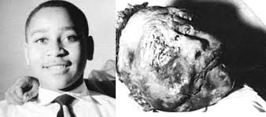
WHAT IS THE STORY BEHIND THIS PICTURE?

Slide 6
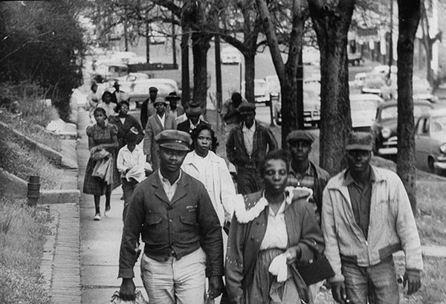
WHAT IS GOING ON HERE?
Notes:
https://www.youtube.com/watch?v=m8Occ7XSgQc&index=37&list=PLD7nPL1U-R5pSwKIcVaIQrG5BnGMbHI5H

Slide 7
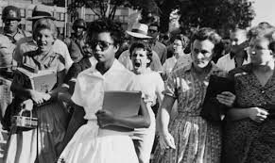

Slide 8
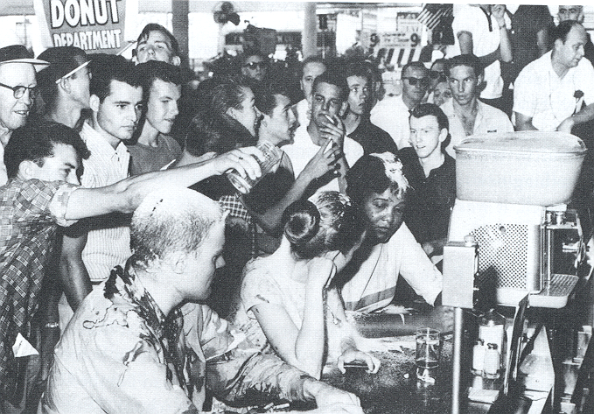
Why do these people have food on them?

Slide 9
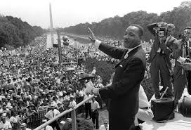
“ I have a Dream…”
Notes:
https://www.youtube.com/watch?v=3vDWWy4CMhE

Slide 10
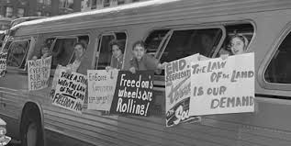
Going down South
Notes:
https://www.youtube.com/watch?v=d8CAKAXR-AM

Slide 11
Remember Me?

Slide 12
Civil rights Act of 1968

Slide 13
Important Court Cases
1968- Green V County School Board of New Kent County
1971- Swann V Charlotte-Mecklenburg School County

Slide 14
What else is going on at the same time?

