Slide 1
Causes of the Civil War
Top 10 Reasons…or at least something like that.
P.S.-Not Just SLAVERY

Slide 2
How things lie
North relies on industry and commerce
South relies on plantations and agriculture

Slide 3
Reason 1: Sectionalism
Sectionalism – the excessive devotion to local interests and customs to a region of a nation.
The intense feelings of sectionalism further divided the country into two separate sections- North and South.
North
South

Slide 4
Sectionalism
Prior to the Civil War, the United States was not really united.
Our country was more like two separate countries sharing the same land.
North
South

Slide 5
Sectionalism
The North had industry, large cities, a diverse population, and favored the politics of the Republican party which supported the abolition of slavery.

Slide 6
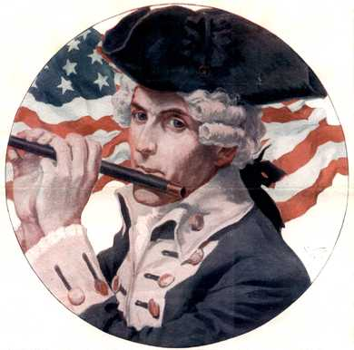
Sectionalism
Southerners were especially loyal to their section. They thought of themselves...
as citizens of their own state first,
as Southerners second,
and as U.S. citizens third.

Slide 7
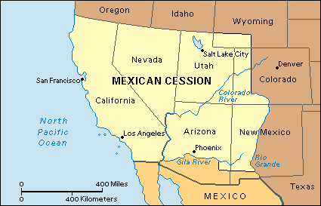
Reason 2: Wilmot Proviso…
A bill to outlaw any slavery in land obtained from the war with Mexico
It passed in the House of Representatives but not the Senate
Created major tensions between the North and the South

Slide 8
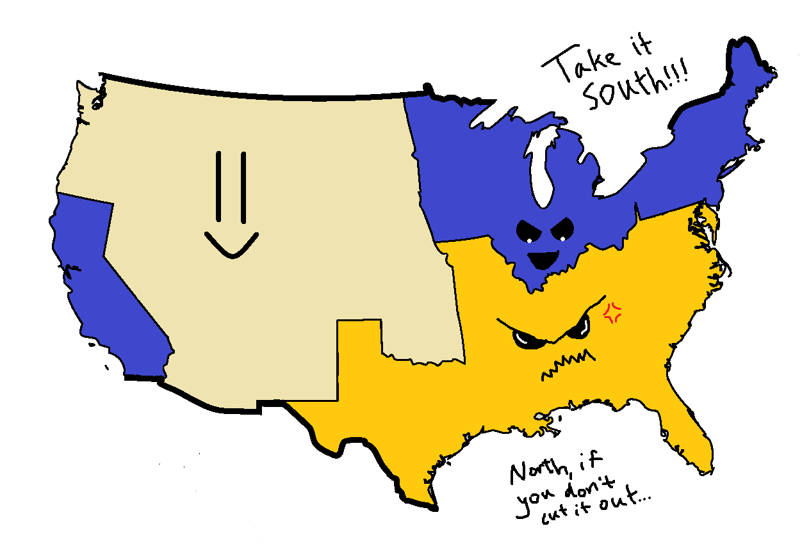
Reason 3: California…
Wants to enter as a free state-this would upset the balance of power between free and slave states

Slide 9
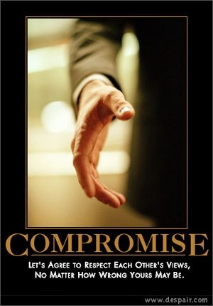
Compromise of 1850
A plan offered by Henry Clay, a senator from Kentucky
California enters as a free state and slave trade is abolished in Washington D.C.
In return Congress passes laws and agrees to not ban slavery in areas received in the Mexican War
Compromise of 1850-a temporary solution to the free state/slave state debate as the nation grew
Before this issue-Congress had a Gag Rule of 1836-in which Congress was not allowed to talk about slavery

Slide 10
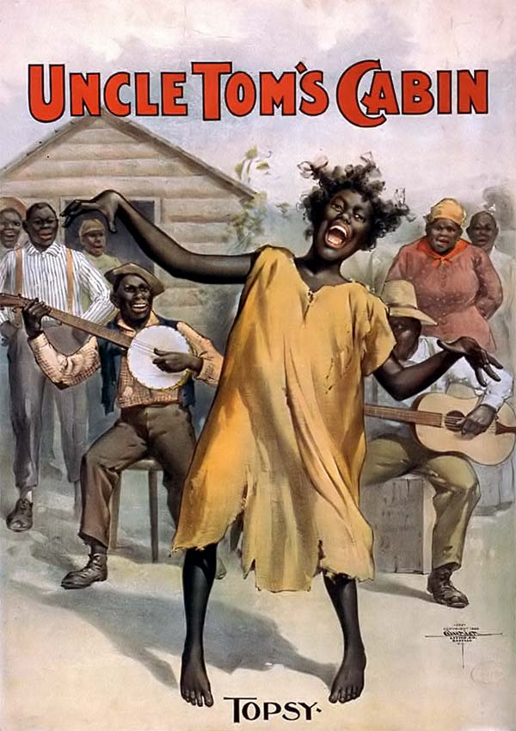
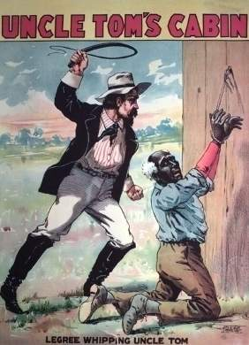
Reason 4: Uncle Tom’s Cabin

Slide 11
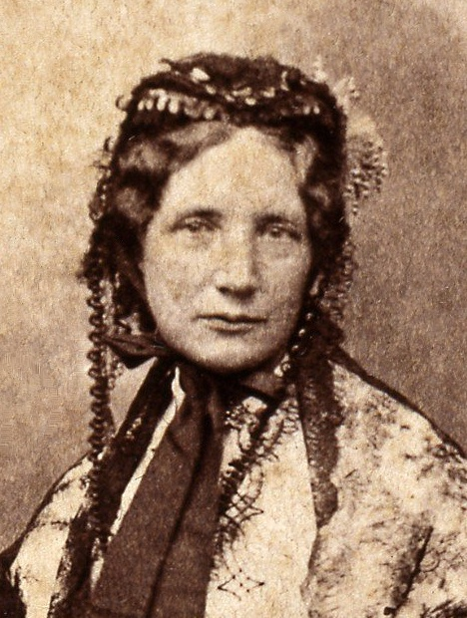
Uncle Tom’s Cabin
Harriet Beecher Stowe-author of Uncle Tom’s Cabin, an important book to the abolitionist movement
It was a novel about a runaway slave escaping to the North, makes people aware of the issue of slavery, sells hundreds of thousands of copies
President Lincoln once met her and said, “So, you’re the lady that started this whole war.”

Slide 12
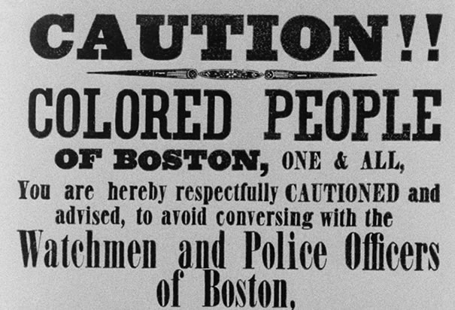
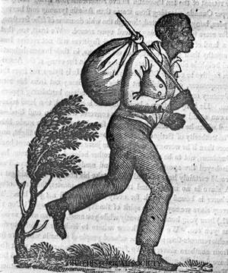
Reason 5: Fugitive Slave Act
A law that said slaves could be arrested without an arrest warrant and brought back to their owner in the South
Southerners felt the Fugitive Slave Act was justified because slaves were viewed as property
This act brought the issue of slavery to the North-Northerners now had to face the slavery issue

Slide 13
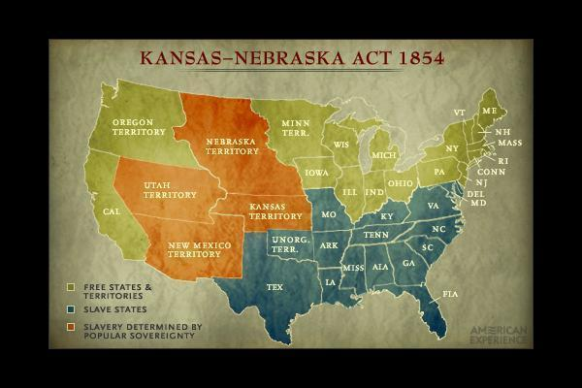
Reason 6: the Kansas-Nebraska Act

Slide 14
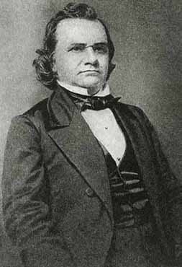
Kansas-Nebraska Act
Senator Stephen Douglas of Illinois proposes the Kansas-Nebraska Act to create Nebraska and Kansas Territories
Each territory will be able to decide whether they want to be a free or slave state - Popular Sovereignty
This act would replace the Missouri Compromise in deciding free or slave states
People for and against slavery now moved to this area to be able to vote on this issue

Slide 15
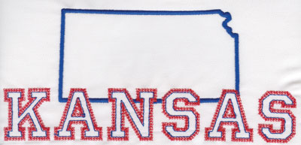
Bleeding Kansas
I was activated when I heard that you were bleeding.

Slide 16
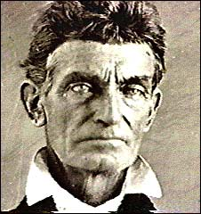
Bleeding Kansas
John Brown-becomes a strict abolitionist
Starts riots in Kansas-with the help of his sons he lead attacks on pro-slavery members
Believed it to be the will of God
Video: http://www.history.com/topics/john-brown

Slide 17
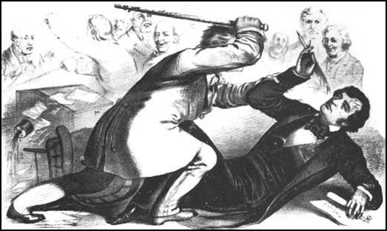
I’m just a Caine on Capitol Hill
Violence is not just happening in Kansas…
An attack even happened in Congress
Senator Charles Sumner of Massachusetts is attacked on the floor of the Senate and hit over 30 times with a cane by a slavery supporter

Slide 18
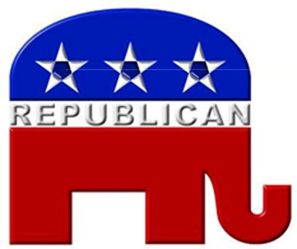
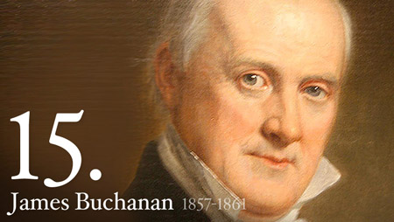
Reason 7: Republican Party
This political party was formed in the mid 1850’s, majority supported the end to slavery
However…a Democratic James Buchanan-a nominee for president (1856), said his main goal was to maintain the Union (keep the U.S. together)

Slide 20
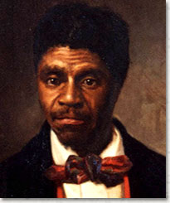
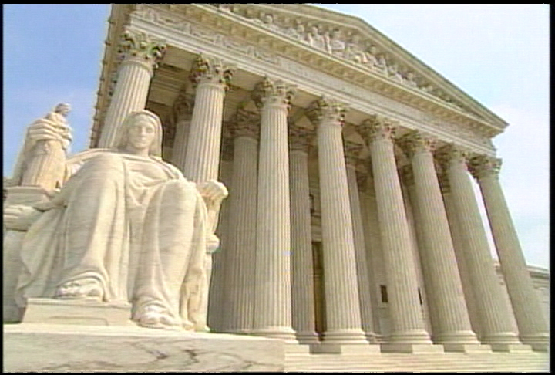
Reason 8: Dred Scott Case
Dred Scott was an African American who had been a slave and moved by his master to a state where slavery was illegal
Scott sued for his freedom, claiming that since he was held as a slave where it was illegal he should be free (1857)
Supreme Court ruled that blacks had no rights and could not be citizens, therefore Scott could not sue for his freedom
Roger B. Taney-Chief Justice of the Supreme Court ruled in the Dred Scott Case
He was also a slave owner from Frederick, Maryland

Slide 21
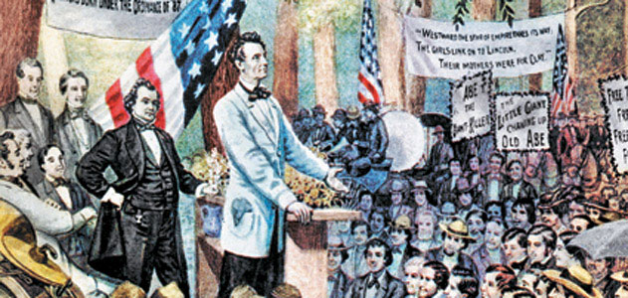
Reason 9: Abraham Lincoln
Politics 101: Abe ran for the Illinois senate seat in 1858, was a Republican
Running against Stephen Douglas, debates against slavery issues
Lincoln loses Senate seat to Douglas but gains national attention because of his debates
To be continued…

Slide 22
Reason 10: Harper’s Ferry
Harper’s Ferry-a United States weapon arsenal in Virginia
John Brown-his plan is to capture the weapons arsenal and then start a slave rebellion…problem no slaves join his rebellion
Brown is arrested and charged with treason and murder-sentenced to death by hanging
North feels Brown is a hero, South is glad he is dead
His death brings the slavery issue to the boiling point

Slide 23
Reason 9.2: Abe Lincoln (Slaver Hunter)
Presidential Election 1860: Republicans choose Abraham Lincoln as their presidential nominee
Democrats could not agree on how slavery would be explained in their platform
(Back to Civics) Platform-statements or beliefs usually on behalf of the political party, what they stand for
The Northern and Southern Democrats cannot agree so they have two nominees
Northern Democrats-support Stephen Douglas
Southern Democrats-support John Breckinridge

Slide 24
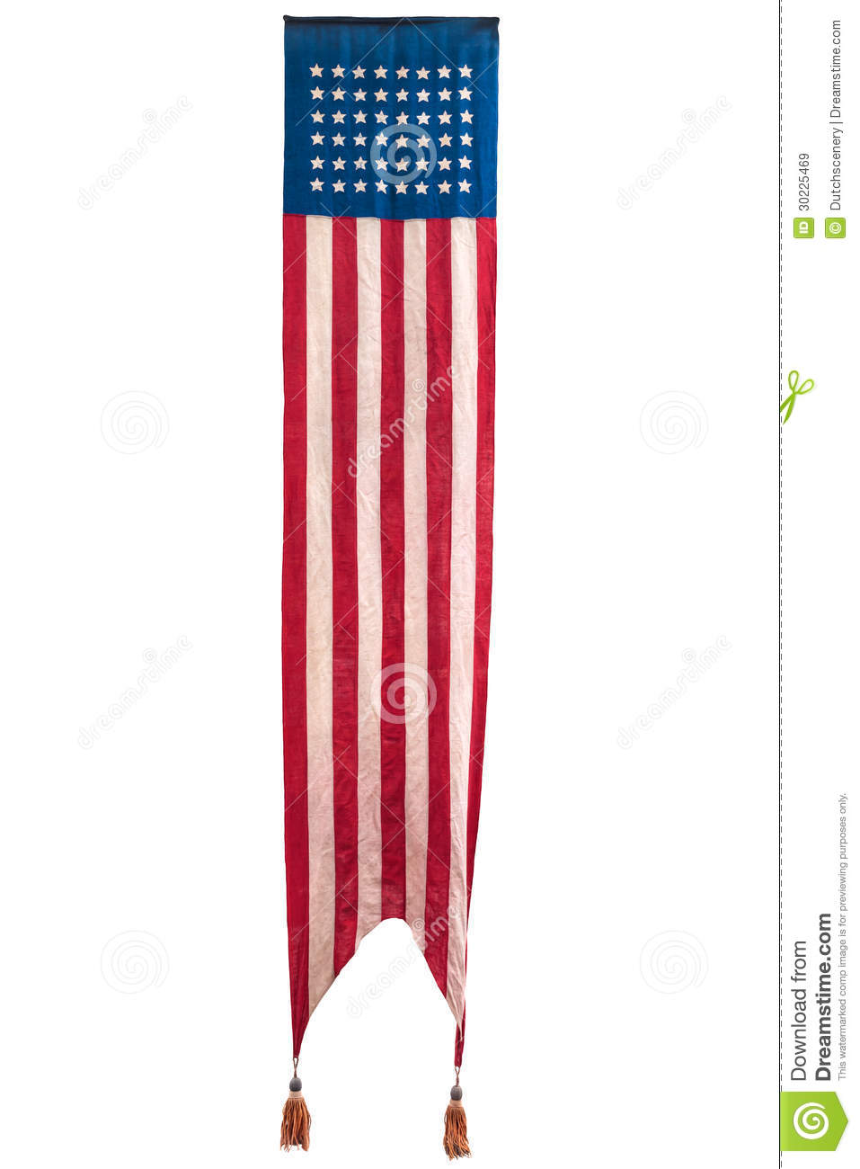

Slide 25
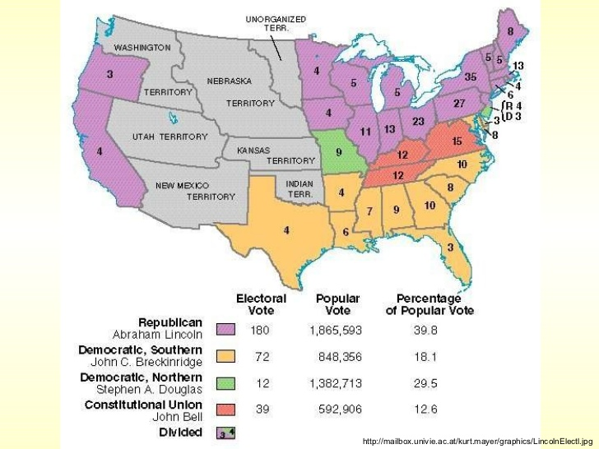

Slide 27
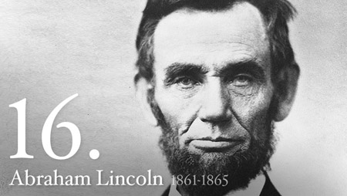
Abe Lincoln
Lincoln wins many votes in the North and since the North has a larger population he wins the election
South is afraid that Lincoln will now try to abolish slavery in the United States
So….

Slide 28
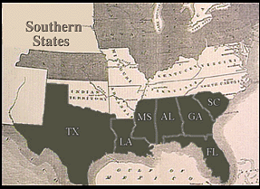
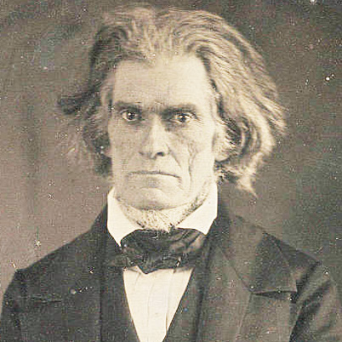
Secede
Secede-to withdraw from the Union, split with the country
South Carolina becomes the first to secede on December 20, 1860
In the next 6 weeks more states secede: Mississippi, Florida, Alabama, Georgia, Louisiana, and Texas
Told you, I’m too sexy for this Union

Slide 29
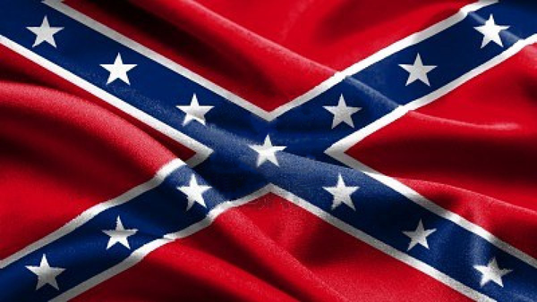
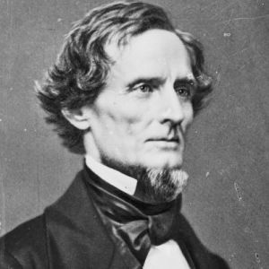
Confederate States of America
These states form what is now their own country…the Confederate States of America
Jefferson Davis is elected president of the Confederate States of America
Northerners felt that secession was unconstitutional and the South did NOT have the right to leave
I think that I look like Abe Lincoln, we could be Bros

Slide 30
What Now…
Lincoln becomes the 16th president in March of 1861
Lincoln tells the South in his Inaugural Address that he will not interfere with slavery where it already exists, and will not attack the South, but will protect and defend the US government if attacked
Hey South, Come at me Bro.

