Slide 1
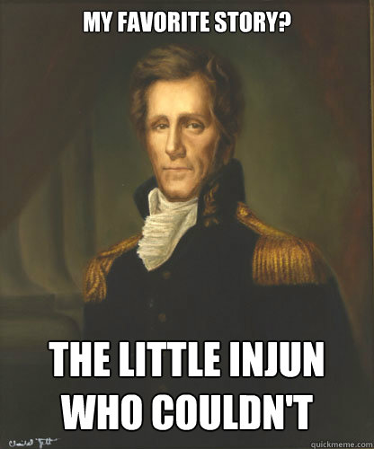
Andrew “King” Jackson
The People’s President

Slide 2
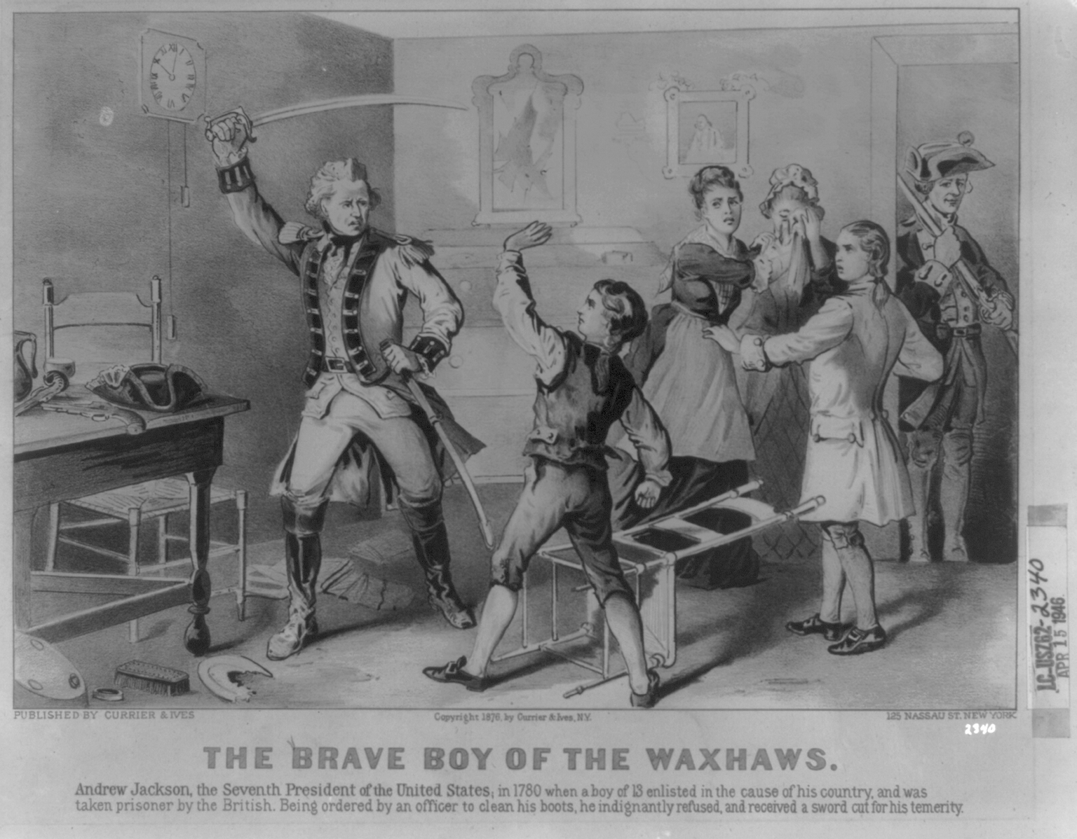
Legend States…
“At age 13, he joined the Patriots but was captured by the British. When a British officer ordered the young prisoner to clean his boots, the boy refused.”

Slide 3
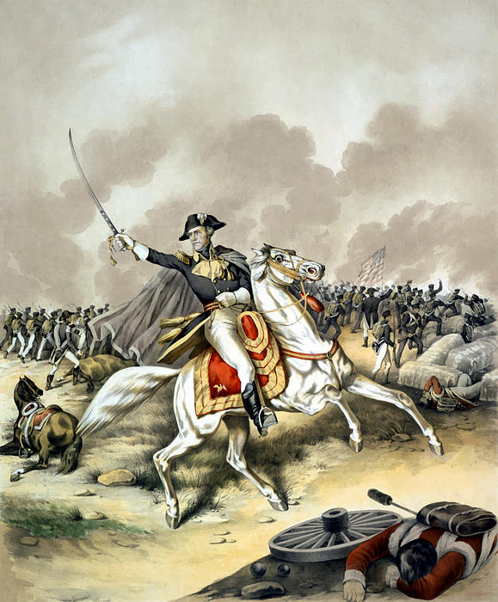
A Military Man…
Joined American Revolution at age of 13
Creek War Victory
  Indian battle during the War of 1812
War of 1812
  Victory at Battle of New Orleans
1818 Seminole Victories

Slide 4
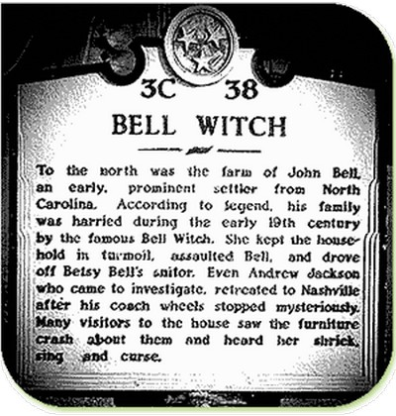
The Legend versus a Witch
1819-visited the Bell family in Tennessee to see what he could do to help his friends from a harmful entity.

Slide 5
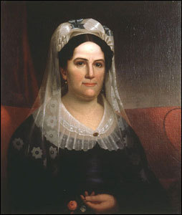
Personal Life…
Studied Law at North Carolina
  Practiced in Tennessee
Made money in real estate
  Buying and selling in Georgia & Alabama
Married Rachel Robards
  Recently divorced woman
  Controversy surrounding their marriage
    She was still married when they ran away together, her divorce was not final.

Slide 6
Nicknames for Jackson…
“Old Hickory”
  Given to him by soldiers he commanded
  Meant he was as tough as the wood on a hickory tree
“King Jackson”
  Given to him by his political opponents
  They thought he was trying to take over the country
“Sharp Knife”
  Given by Native Americans
  He was ruthless in dealing with them

Slide 7
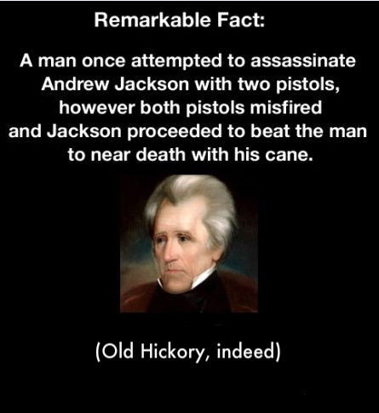

Slide 8
The People’s President
Another nickname for Jackson
He was the first president elected where most of the electoral college was chosen by US voters instead of representatives.
"Jackson was the first President to invite the public to attend the White House ball honoring his first inauguration. Many poor people came to the inaugural ball in their homemade clothes. The crowd became so large that Jackson's guards could not hold them out of the White House. The White House became so crowded with people that dishes and decorative pieces in the White House began to break. Some people stood on good chairs in muddied boots just to get a look at the President. The crowd had become so wild that the attendants poured punch in tubs and put it on the White House lawn to lure people out of the White House. Jackson’s raucous populism earned him the nickname King Mob."

Slide 9
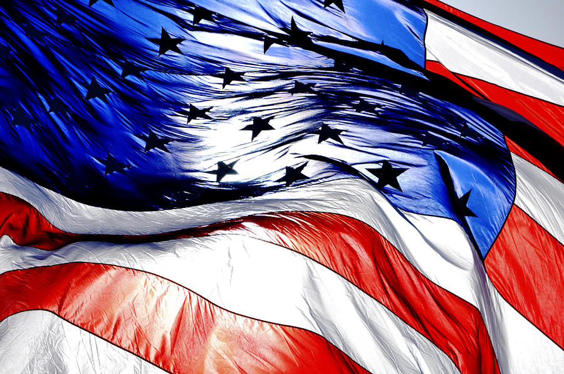
Jackson's
First
Presidential Run

Slide 10
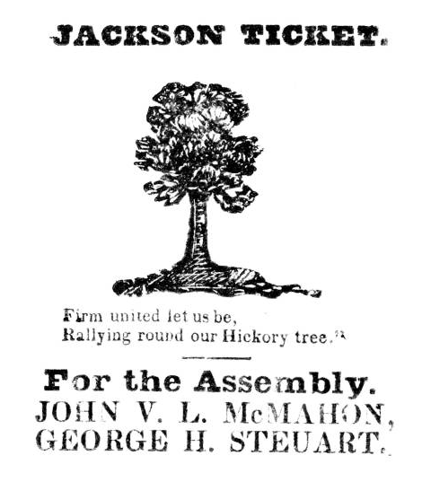
The “Common Man’s”
Presidential Candidate

Slide 11
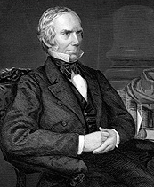
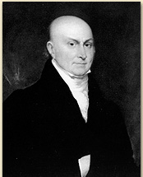
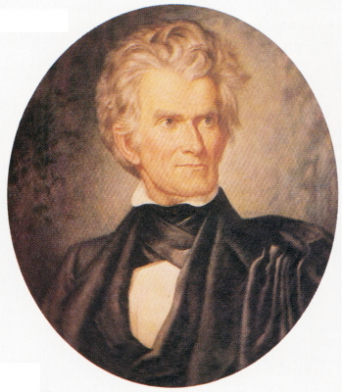
Jackson’s Opponents in 1824
Henry Clay
[KY]
John Quincy Adams
[MA]
John C. Calhoun
[SC]
William H. Crawford
[GA]

Slide 12
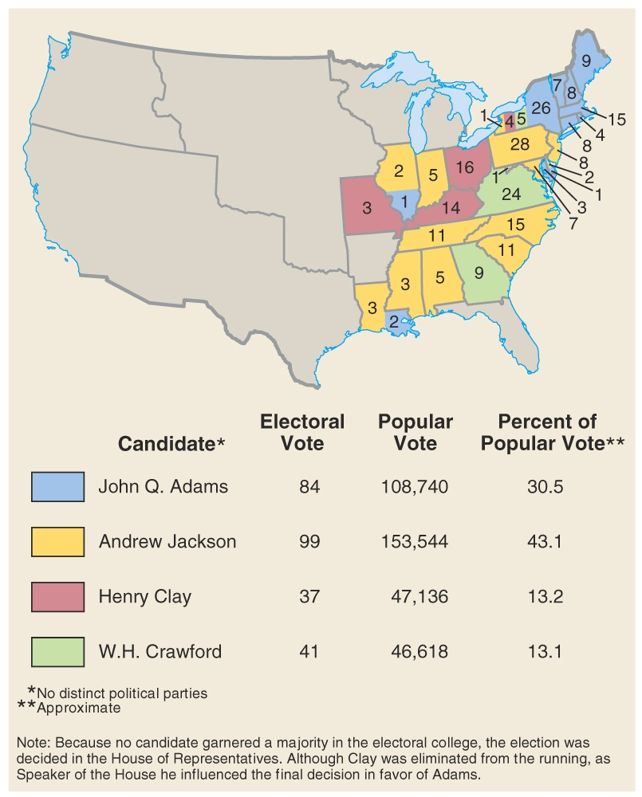
Results of the 1824 Election
A
“Corrupt Bargain?”

Slide 13
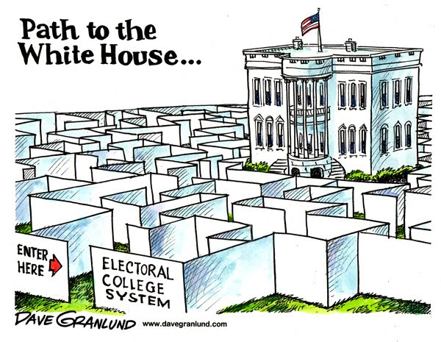
Election of 1824…
Disputed Election
He received the most popular votes
  But not a majority of the electoral votes
Went to Congress
  They elected John Quincy Adams
A few issues existed that Jackson was angry about
  Called it a “Corrupt Bargain”
  “…there was cheating and corruption and bribery, too.”
  His anger damaged Adams efforts as president

Slide 14
Opposition to John Quincy Adams
Some believed he allowed too much political control to be held by elites.
Some objected to his support of national economic development on constitutional grounds.
  Adams believed a strong, active central government was necessary.
    A national university.
    An astronomical observatory.
    A naval academy.
Many Americans saw Adams’ vision of a might nation led by a strong president as a threat to individual liberties.

Slide 15
Rematch, Election of 1828…
Rematch between Adams and Jackson
“Corrupt Bargainer” vs. “Military Chieftain”
Jackson won easily and became president a few months later
His wife died before he became president however
  He blamed Adams
  Using a lot of Mudslinging, propaganda

Slide 16
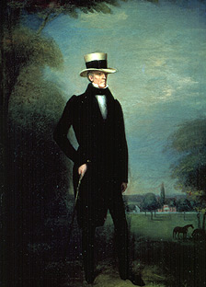
Jackson in Mourning for His Wife

Slide 17
Spoils System…
After the election, he fired many government employees
  He hired many of his supporters
“The duties of all public offices are…so plain and simple…”
A supporter said, “To the victor goes the spoils”
  Very few of his supporters were qualified
Unofficial advisors were referred to as his “Kitchen Cabinet”

Slide 18
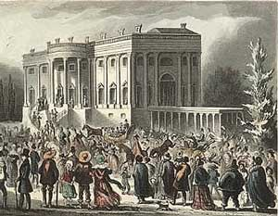
Jackson opposed members of Congress that he said looked out only for special interests.
He opposed Marshall, to powerful.
He was in favor of state’s rights and will of people – democracy.
He named advisors from all over the country, kitchen cabinet.
He favored “laissez-faire” policies.
He wanted to move the country back toward the “simplicity” of Jefferson.

Slide 19
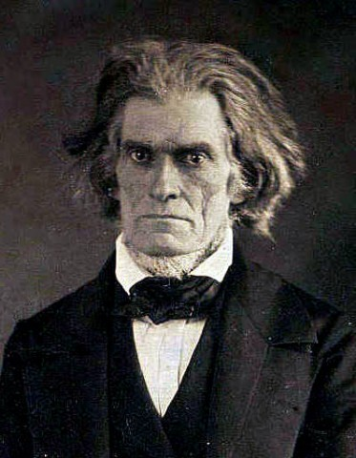
Nullification Crisis…
Tariff of Abominations
  This tariff helped manufacturers in the North and hurt Southern planters
    Southern states now paid more for European goods
    VP Calhoun leaves
States decided to nullify the federal law
  Means they weren’t going to follow the law
A smaller tariff was put in its place
  South Carolina still wasn’t happy
  They talked about seceding
    Leaving the Union
Jackson didn’t like this!
  He thought it would lead to civil war

Slide 20
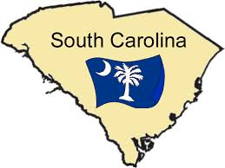
Fortune Telling…Succession…
Jackson said…
“If one drop of blood be shed there in defiance of the laws of the United States, I will hang the first man of them I can get my hands on to the first tree I can find.”
“If we get in a war over this I will kill anyone responsible for starting the war.”

Slide 21
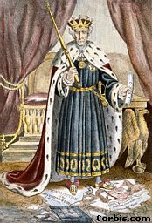
President Jackson sends warships to Charleston Harbor and threatens to hang Calhoun for treason.
SC calls a state convention and declares the Tariff of 1832 invalid and refuses to collect it.
Congress introduces a “force bill” to force SC to pay with force.
Henry Clay offers compromise: Tariffs would be reduced over a period of nine years.

Slide 22
Jackson vs. the Natives
1830-Indian Removal Act
Court cases
  Cherokee Nation vs. Georgia (1831)
  Worcester vs. Georgia (1832)
Supreme Court-John Marshall
  John Marshall has made his decision, now let him enforce it!

Slide 23
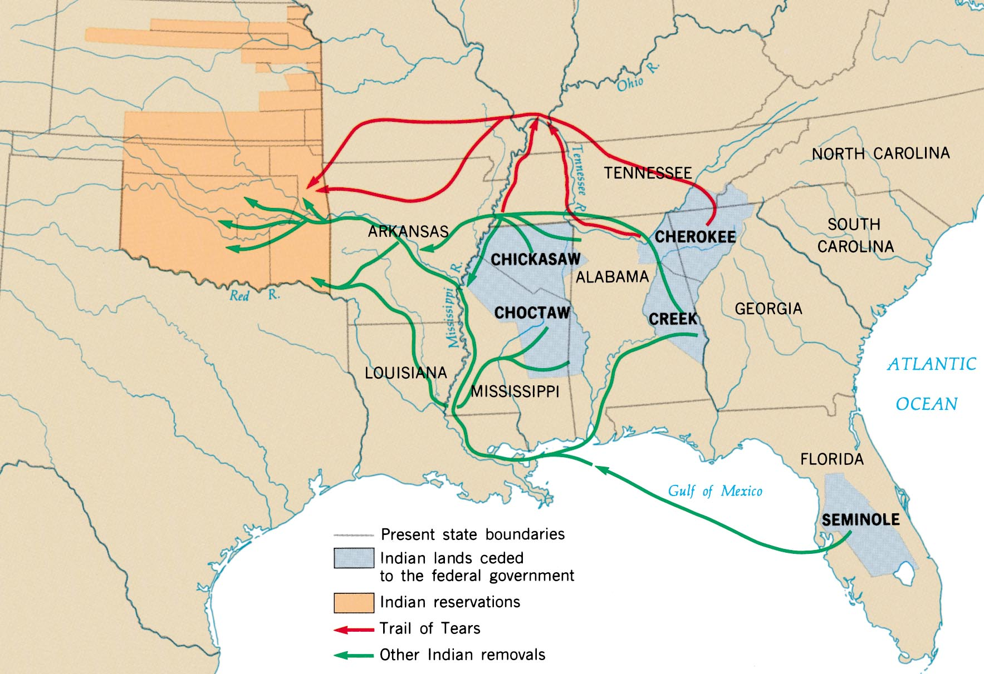
Indian Removal

Slide 24
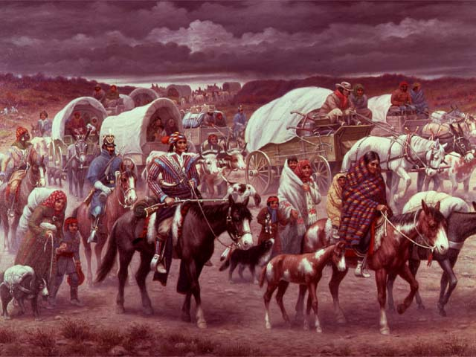
Trail of Tears (1838-1839)

Slide 25
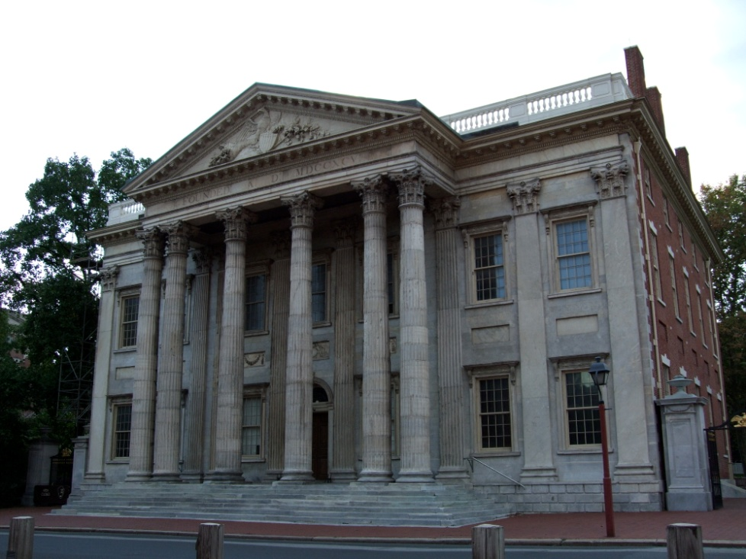
Jackson and the Bank…
Jackson hated the federal bank
  He let them know!
“The bank…is trying to kill me, but I will kill it!”
He felt the National Bank was only helping the rich
  Issue dealing with farmers and merchants
He vetoed a renewal of the bank
  Ended the National Bank and sent money to state banks

Slide 26
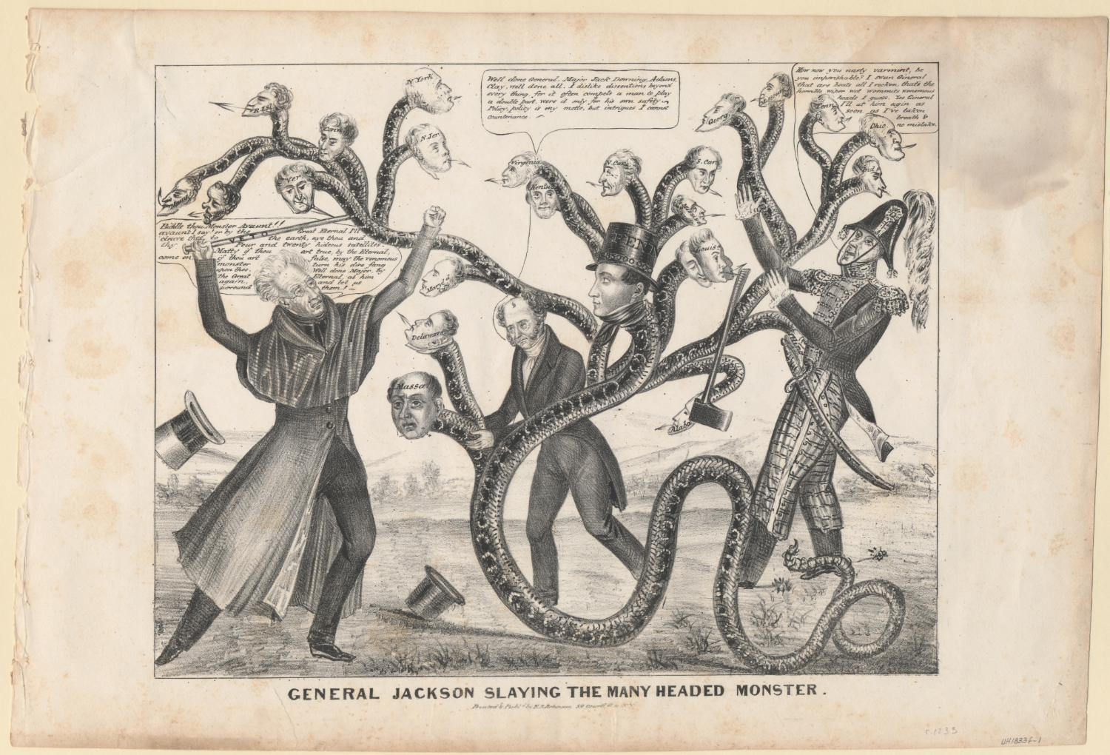

Slide 27
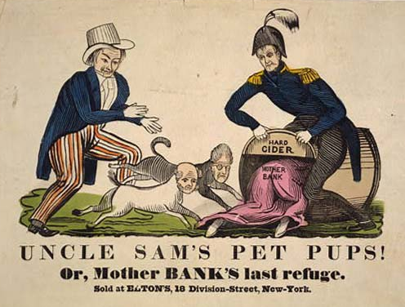
The “Monster” Is Destroyed!
“Pet Banks”
1832 → Jackson
vetoed the
extension of the 2nd National Bank of the United States.
1836 → the charter expired.
1841 → the bank went bankrupt!

Slide 28
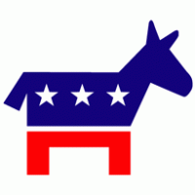
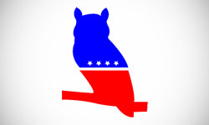
Political Split
Jackson was very strong willed
His presidency caused a division in his political party
  Democrats
  Whigs

Slide 29
Positions on the Key Issues of 1832
WHIGS
DEMOCRATS
Less concerned about the widening gap between rich and poor.
Opposed “liberal capitalism” because they believed it would lead to economic chaos.
Strong national govt. to coordinate the expanding economy was critical.
Opposes Indian removal.
Favored tariffs.
Supported a National Bank.
Felt the widening gap between rich and poor was alarming.
Believed that bankers, merchants, and speculators were “non-producers” who used their govt. connections to line their own pockets.
Govt. should have a hands-off approach to the economy to allow the little guy a chance to prosper.
For Indian removal.
Oppose tariffs.
States’ rights.
Oppose federal support for internal improvements.
Opposed the National Bank.

